Slide 1
Chapter 7
Real Estate as an Investment: Some Background Information

Slide 2
CHAPTER OUTLINE
7.1 Investment Industry, and Real Estate’s Role Therein
7.1.1 Investor Objectives and Concerns
7.1.2 Implications of Investor Heterogeneity
7.1.3 General Structure of Investment Products and Vehicles
7.2 Real Estate as an Asset Class
7.2.1 Four Major Investment Asset Classes
7.2.2 Historical Investment Performance
7.3 Perspective on the U.S. Institutional Property Market
7.3.1 Brief History of Commercial Real Estate Investment During Recent Decades
7.3.2 Sources of Debt and Equity Capital
7.4 Chapter Summary

Slide 3
LEARNING OBJECTIVES
After reading this chapter, you should understand:
The basic structure and functioning of the investment industry.
The nature of investor objectives, constraints, and concerns.
The major types of investment products and vehicles and the difference between an underlying asset and an investment product.
The major similarities and differences in the investment products based on real estate as opposed to other classical industrial or service corporations as underlying assets.
The four major traditional investment asset classes and their characteristic differences.
The investment performance of the major asset classes in recent decades, at a broad-brush and general level.
Some of the major historical trends and events that have influenced real estate investment performance in recent decades.

Slide 4
7.1 Investment Industry, and Real Estate’s Role Therein

Slide 5
7.1.1 Investor Objectives and Concerns

Slide 6
7.1.2 Implications of Investor Heterogeneity

Slide 7
7.1.3 General Structure of Investment Products and Vehicles

Slide 8
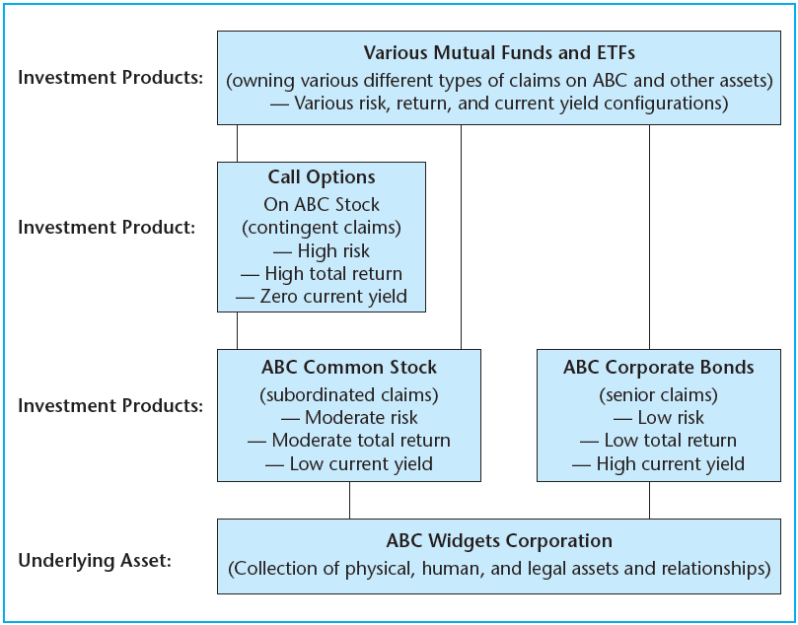
EXHIBIT 7-1 Underlying Assets versus Investment Products, an Example from Traditional Corporate Finance
© OnCourse Learning

Slide 9
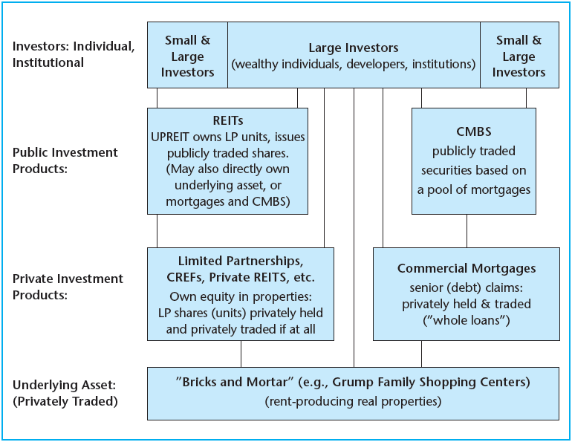
EXHIBIT 7-2 Real Estate Example of the Investment System
© OnCourse Learning

Slide 10
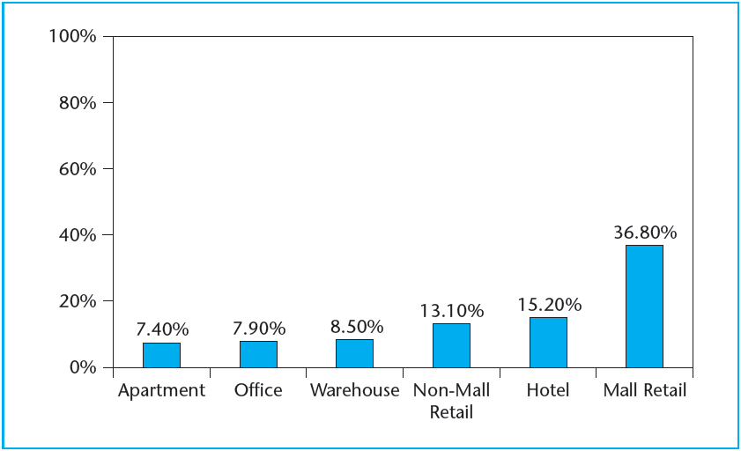
EXHIBIT 7-3 REIT Ownership Share of U.S. Institutional Property Asset Market, 2003
Source: Hess and Liang (2004).

Slide 11
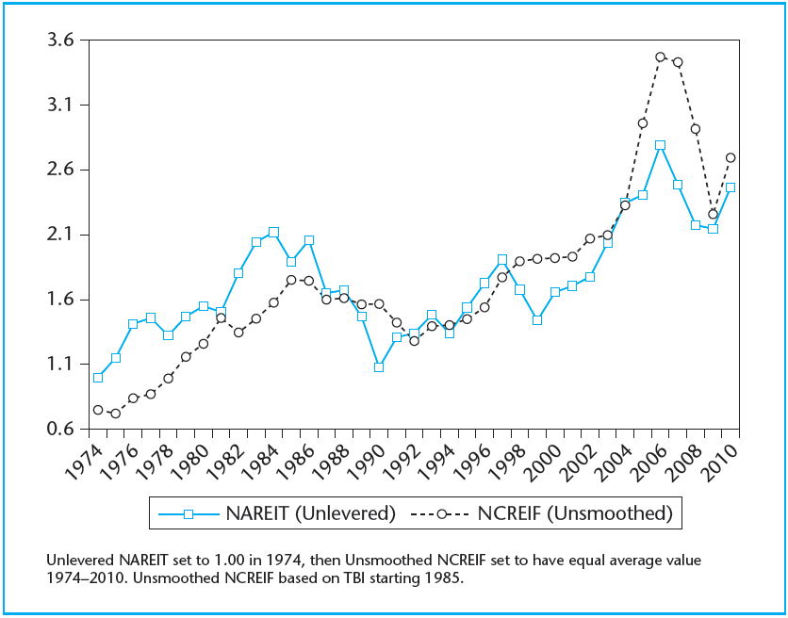
EXHIBIT 7-4 End-of-Year Public versus Private Asset Market Commercial Real Estate Values (Indexes set to have equal average values 1974–2010.)
© OnCourse Learning

Slide 12
7.2 Real Estate as an Asset Class

Slide 13
7.2.1 Four Major Investment Asset Classes

Slide 14
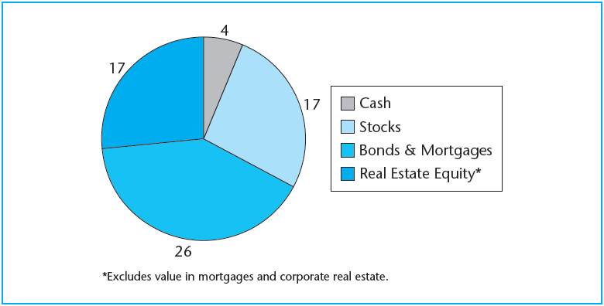
EXHIBIT 7-5 Approximate Aggregate Value of Asset Classes, USA Early 2000s (in trillions of dollars)
© OnCourse Learning

Slide 15
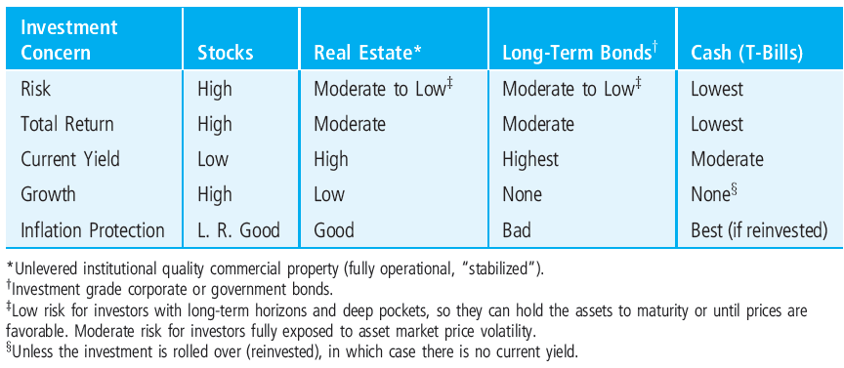
EXHIBIT 7-6 Stereotypical Characterization of Major Investment Asset Classes
© OnCourse Learning

Slide 16
7.2.2 Historical Investment Performance

Slide 17
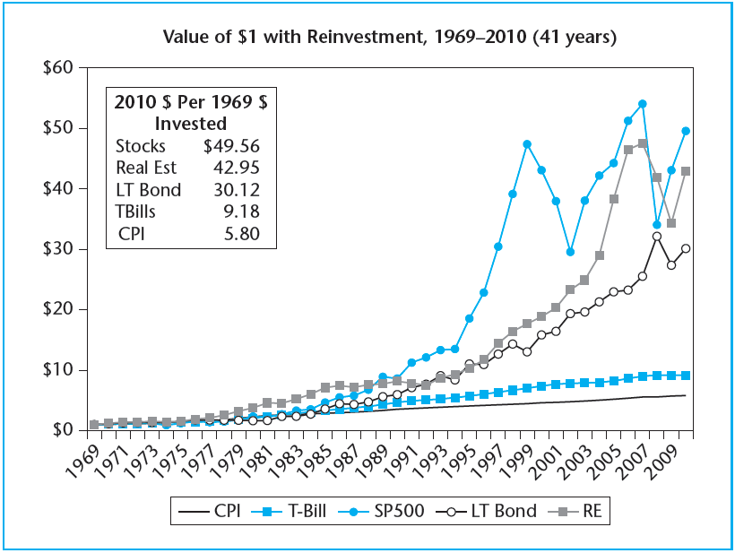
EXHIBIT 7-7 Historical Performance of Major Investment Asset Classes, Compared to Inflation (CPI), 1969–2010
© OnCourse Learning

Slide 18
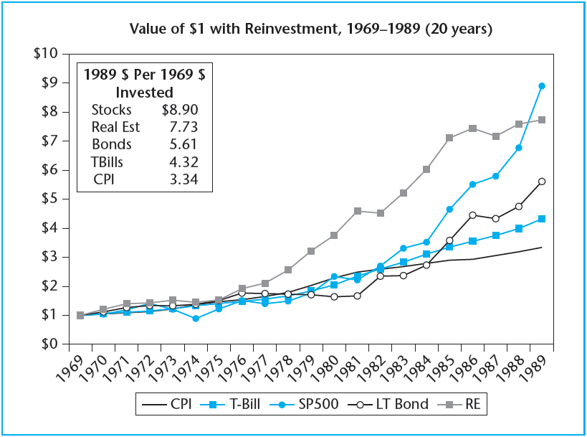
EXHIBIT 7-8A Performance of the Major Asset Classes, 1969–1989
© OnCourse Learning

Slide 19
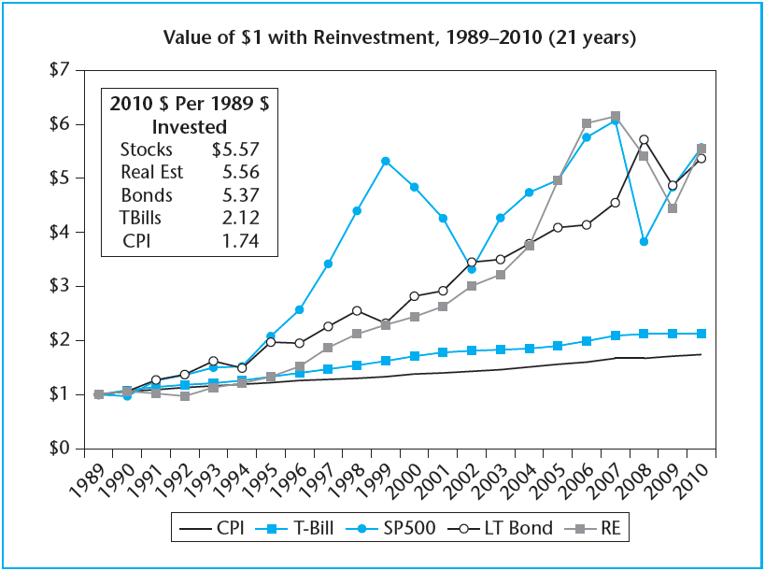
EXHIBIT 7-8B Performance of the Major Asset Classes, 1989–2010
© OnCourse Learning

Slide 20
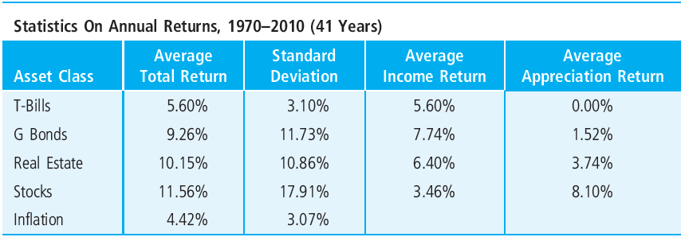
EXHIBIT 7-9 Historical Statistics on Annual Returns, 1970–2010
© OnCourse Learning

Slide 21
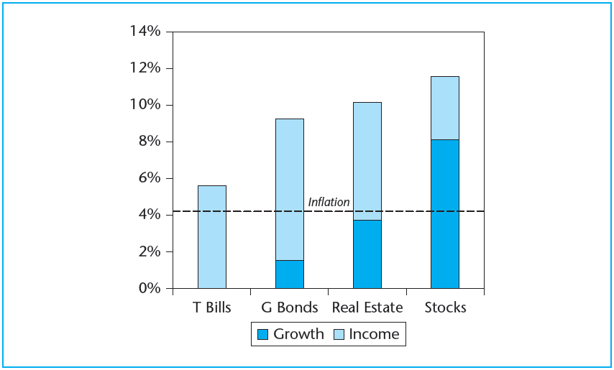
EXHIBIT 7-10A Average Annual Total Return, 1970–2010
Sources: NCREIF, MIT, Ibbotson.

Slide 22
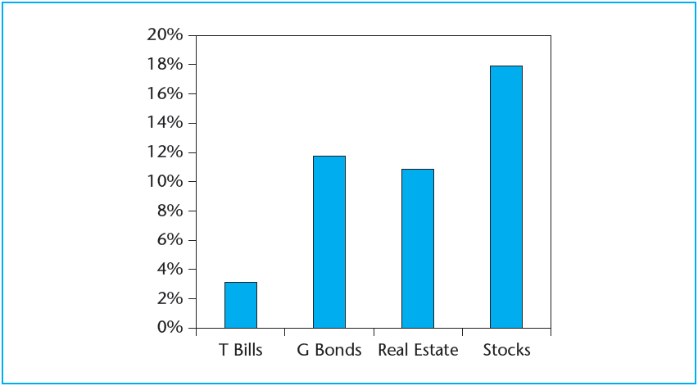
EXHIBIT 7-10B Annual Volatility, 1970–2010
Sources: NCREIF, MIT, Ibbotson.

Slide 23
7.3 Perspective on the U.S. Institutional Property Market

Slide 24
7.3.1 Brief History of Commercial Real Estate Investment During Recent Decades

Slide 25
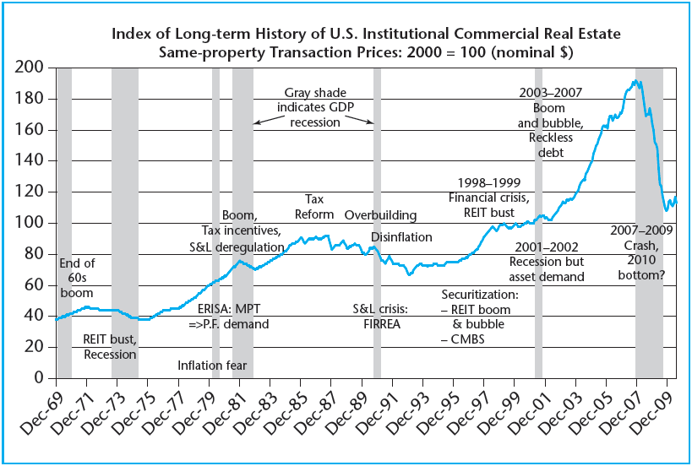
EXHIBIT 7-11 The “Roller Coaster Ride” in U.S. Institutional Commercial Property Prices over Recent Decades
Sources: Moody's/REAL, TBI, and author's estimates.

Slide 26
7.3.2 Sources of Debt and Equity Capital

Slide 27
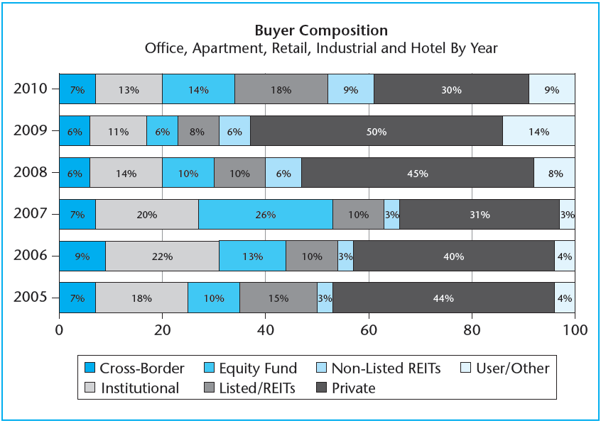
EXHIBIT 7-12 Buyer Composition of Investors into U.S. Institutional Commercial Real Estate, 2005–2010
Source: Real Capital Analytics Inc.

Slide 28
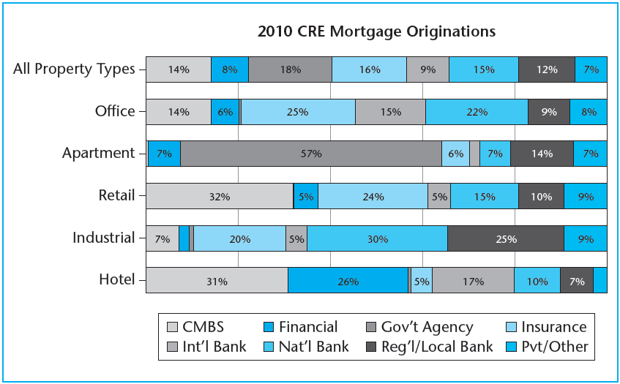
EXHIBIT 7-13 Sources of Debt Capital for Various Types of U.S. Institutional Property Investment, 2010
Source: Real Capital Analytics Inc.

Slide 29
7.4 Chapter Summary

Slide 30
KEY TERMS
investment objective
growth (savings) objective
income (current cash flow) objective
risk
liquidity
time horizon
investor expertise
investor management burden
investor size
capital constraint
investor heterogeneity
underlying asset
investment product (vehicle)
passive investors
commingled real estate funds (CREFs)
private REITs (real estate investment trusts)
private markets
commercial mortgage-backed securities (CMBS)
stagflation
Employee Retirement Income Security Act (ERISA)
Financial Institutions Recovery, Reform, and Enforcement Act (FIRREA)

