Slide 1
Chapter 6
Real Estate Market Analysis

Slide 2
CHAPTER OUTLINE
6.1 General Features of Real Estate Market Analysis
6.1.1 Purpose of Market Analysis
6.1.2 Market Supply and Demand Variables and Indicators
6.1.3 Defining the Scope of the Analysis
6.1.4 Trend Extrapolation versus Structural Analysis
6.1.5 Major General Tasks in Conducting a Basic Short-Term Structural Market Analysis
*6.2 Formal Model of Space Market Equilibrium Dynamics and Cyclicality
6.3 Chapter Summary

Slide 3
LEARNING OBJECTIVES
After reading this chapter, you should understand:
What is meant by real estate market analysis and what types of business decisions it can usefully assist.
The key elements and quantitative variables involved in market analysis.
Some of the major types of data sources for conducting market analyses.
The difference between simple trend extrapolation and a structural market analysis.
The major steps in conducting a structural analysis of the real estate space market.
The implications for space market dynamics and cyclicality when market participants cannot or do not base decisions on forward-looking forecasts of the space market.

Slide 4
6.1 General Features of Real Estate Market Analysis

Slide 5
6.1.1 Purpose of Market Analysis

Slide 6
6.1.2 Market Supply and Demand Variables and Indicators

Slide 7
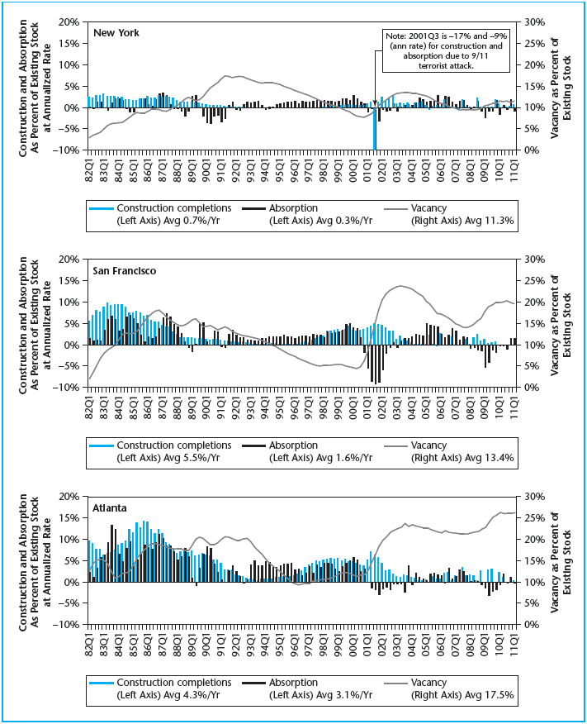
EXHIBIT 6-1 Construction, Absorption, and Vacancy in Three Major Metropolitan Office Markets, 1982 to 2011
Source: Based on CoStar data.

Slide 8
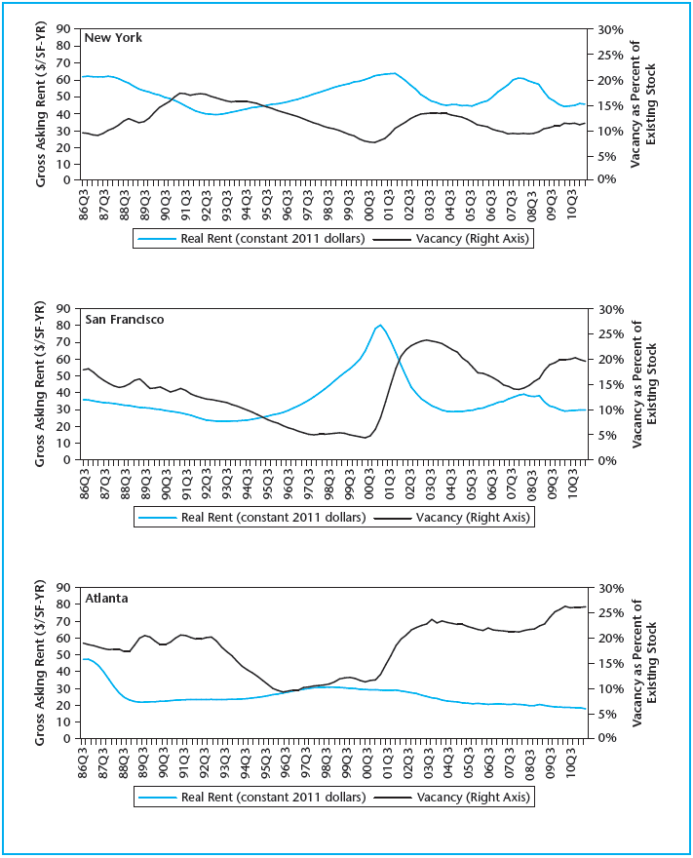
EXHIBIT 6-2 Rents and Vacancy Cycle in Three Major Metropolitan Office Markets, 1982 to 2011
Source: Based on CoStar data.

Slide 9
6.1.3 Defining the Scope of the Analysis

Slide 10
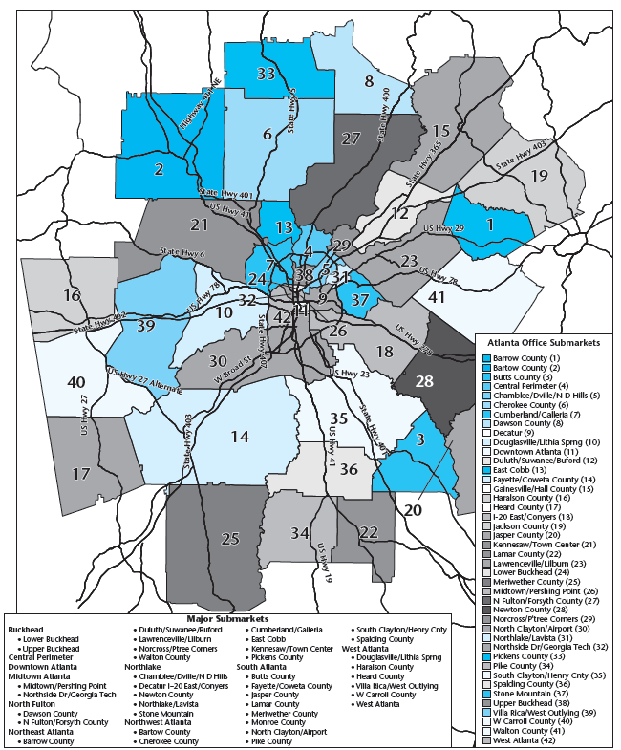
EXHIBIT 6-3A Atlanta MSA Office Submarkets
Source: CoStar Property, used with permission.

Slide 11
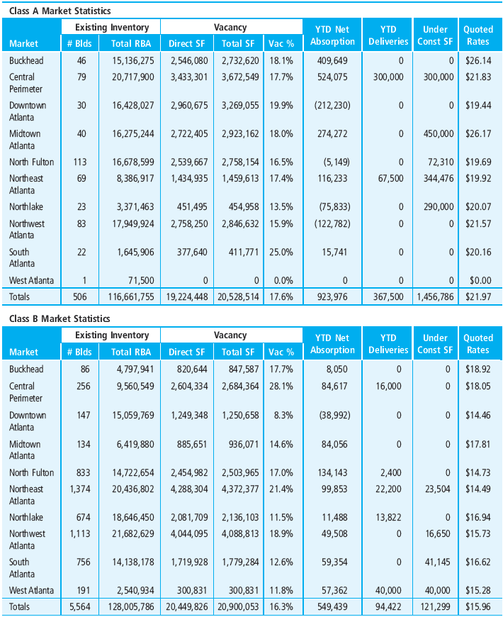
EXHIBIT 6-3B Atlanta Space Market Data Consolidated Into 10 Major Submarkets, Mid-Year 2012
Source: CoStar Property, used with permission.

Slide 12
6.1.4 Trend Extrapolation versus Structural Analysis

Slide 13
6.1.5 Major General Tasks in Conducting a Basic Short-Term Structural Market Analysis

Slide 14
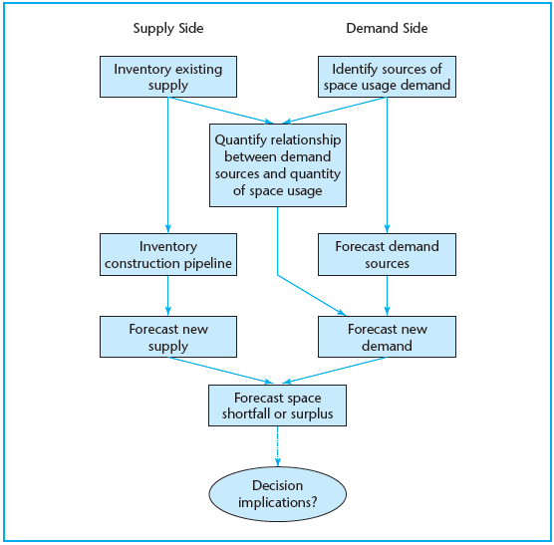
EXHIBIT 6-4 Generic Framework of a Basic Short-Term Structural Market Analysis for Real Estate
© OnCourse Learning

Slide 15
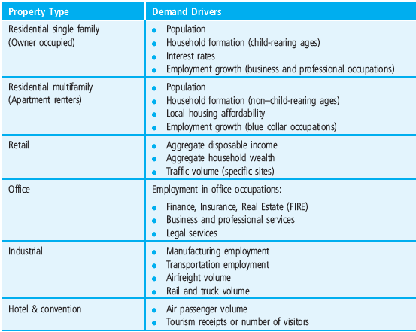
EXHIBIT 6-5 Major Demand Drivers by Property Type
© OnCourse Learning

Slide 16
*6.2 Formal Model of Space Market Equilibrium Dynamics and Cyclicality

Slide 17
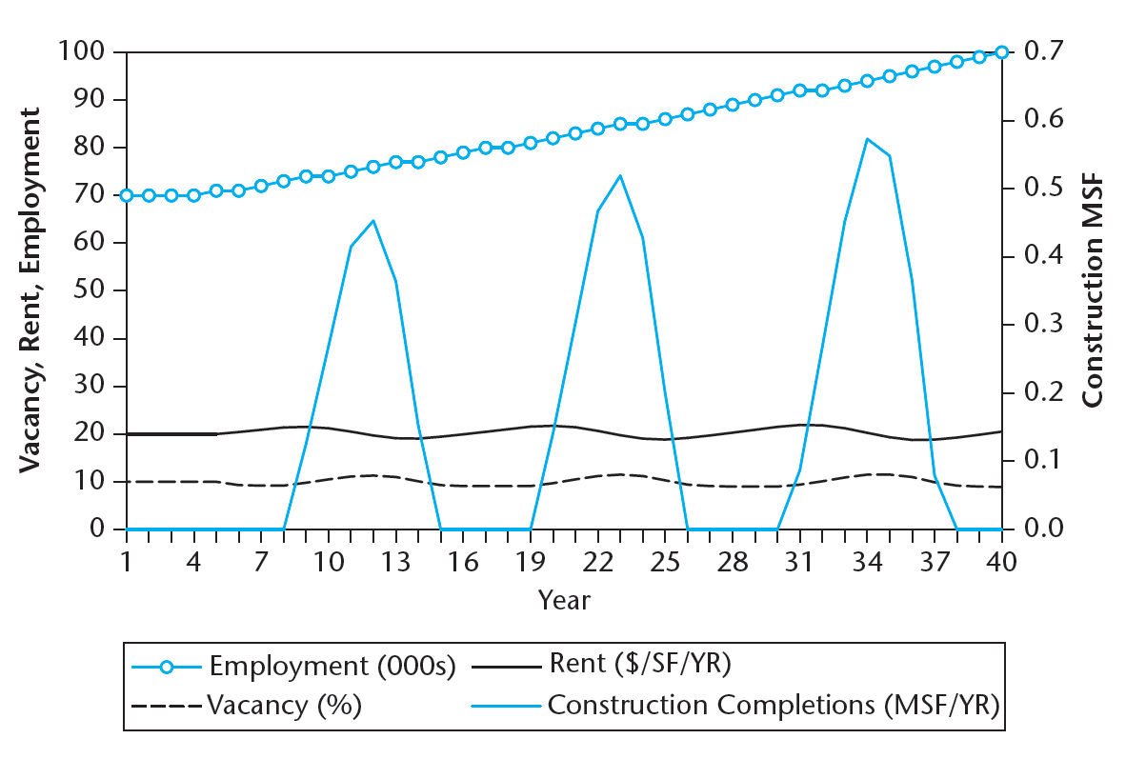
EXHIBIT 6-6 Simulated Space Market Dynamics
© OnCourse Learning

Slide 18
6.3 Chapter Summary

Slide 19
KEY TERMS
real estate market analysis
market segment
construction starts
construction completions
absorption
gross absorption
net absorption
vacancy rate
natural vacancy rate
market rent
months supply
submarkets
simple trend extrapolation
structural analysis
price elasticity
lags
demand drivers
stock-flow model
real estate cycle

