Slide 1
Chapter 30
Leases and Leasing Strategy

Slide 2
CHAPTER OUTLINE
30.1 Commercial Property Lease Terminology and Typology
30.1.1 Basic Lease Typology: The Responsibility for Expenses
30.1.2 Types of Rent Changes in Leases
30.2 Lease Characteristics Affecting Value or Rent
30.3 Annuitized Lease Value and Effective Rent
30.3.1 Discount Rate in the ALV
30.3.2 ALV Numerical Examples
30.3.3 Summarizing ALV and Effective Rent

Slide 3
CHAPTER OUTLINE
(continued)
30.4 Broader Leasing Strategy Considerations: Term Length and the Space Market Term Structure of Rent
30.4.1 Interlease Risk
30.4.2 Releasing Costs
30.4.3 Expectations about the Future Rental Market
30.4.4 Uncertainty and the Value of Flexibility and Options in Leases
30.4.5 Staggered Lease Expirations and Releasing Risk
30.4.6 Summary: Rent Term Structure and Optimal Lease-Term Length

Slide 4
CHAPTER OUTLINE
(continued)
30.5 Other Leasing and Rent Issues
30.5.1 Microspatial Trade-Offs and Synergies
30.5.2 Why Percentage Rents? (Consideration of Optimal Rent Structure)
30.5.3 Why Concessions?
30.5.4 Optimal Asking Rent and Optimal Vacancy
30.6 Chapter Summary

Slide 5
LEARNING OBJECTIVES
After reading this chapter, you should understand:
The major characteristics and descriptive terminology used in commercial property leases in the United States.
What is meant by “effective rent,” “annuitized lease value,” and how to calculate these values.
The major factors determining lease value to the landlord that are left out of the effective rent or annuitized lease value calculation.
Some major leasing strategy issues and trade-offs facing landlords and tenants.

Slide 6
30.1 Commercial Property Lease Terminology and Typology

Slide 7
30.1.1 Basic Lease Typology: The Responsibility for Expenses

Slide 8
30.1.2 Types of Rent Changes in Leases

Slide 9
30.2 Lease Characteristics Affecting Value or Rent

Slide 10
30.3 Annuitized Lease Value and Effective Rent

Slide 11
30.3.1 Discount Rate in the ALV

Slide 12
30.3.2 ALV Numerical Examples

Slide 13
30.3.3 Summarizing ALV and Effective Rent

Slide 14
30.4 Broader Leasing Strategy Considerations: Term Length and the Space Market Term Structure of Rent

Slide 15
30.4.1 Interlease Risk

Slide 16
30.4.2 Releasing Costs

Slide 17
30.4.3 Expectations about the Future Rental Market

Slide 18
30.4.4 Uncertainty and the Value of Flexibility and Options in Leases

Slide 19
30.4.5 Staggered Lease Expirations and Releasing Risk

Slide 20
30.4.6 Summary: Rent Term Structure and Optimal Lease-Term Length

Slide 21
30.5 Other Leasing and Rent Issues

Slide 22
30.5.1 Microspatial Trade-Offs and Synergies

Slide 23
30.5.2 Why Percentage Rents? (Consideration of Optimal Rent Structure)

Slide 24
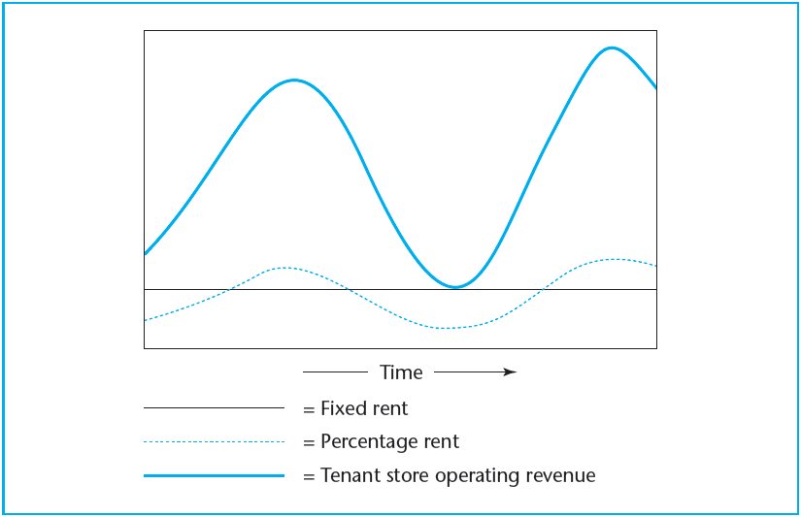
EXHIBIT 30-1 How Percentage Rent Reduces Operating Leverage
© OnCourse Learning

Slide 25
30.5.3 Why Concessions?

Slide 26
30.5.4 Optimal Asking Rent and Optimal Vacancy

Slide 27
30.6 Chapter Summary

Slide 28
KEY TERMS
lease
lessor
lessee
ground lease
rent
gross (full service) lease
net lease
triple net (NNN) lease
hybrid lease
expense stops
flat rent
graduated rent
step-ups
revaluated rent
indexed rent
percentage rent
base rent
lease term
concessions
lease covenants
sublet
lease options

Slide 29
KEY TERMS
(continued)
right of first refusal
effective rent
annuitized lease value (ALV)
term structure of rents
intralease discount rate
interlease discount rate
spot (or short-term) rents
releasing costs
holdup problem
complementary expectations
conflicting expectations
microspacial considerations
rational expectations
efficiency ratio
tenant mix synergies
anchor tenants
quoted (asking) rent
optimal asking rent
noisy price information
rational vacancy
thin markets

