Slide 1
Chapter 3
Central Place Theory and the System of Cities

Slide 2
CHAPTER OUTLINE
3.1 Pattern of City Size
3.2 Pattern of City Location
3.3 Factors Underlying the Pattern: Centripetal and Centrifugal Forces
3.3.1 Centripetal Forces
3.3.2 Centrifugal Forces
3.3.3 Balance of Forces
3.3.4 Central Place Theory and the Urban Hierarchy
3.3.5 Why Does CPT Matter?
3.4 Economic Base and the Growth of Cities and Regions
3.4.1 Definition of Economic Base
3.4.2 Export Base
3.4.3 Location Quotients and SICs
3.4.4 Service Sector and Export Multiplier
3.4.5 Classification of Cities by Economic Base
3.5 Chapter Summary

Slide 3
LEARNING OBJECTIVES
After reading this chapter, you should understand:
Why cities form, grow, and decline.
The centralizing and decentralizing forces that explain the number and sizes of cities.
What constitutes a “system” of cities and the essential characteristics of the U.S. system of cities.
The key practical insights and principles of central place theory and urban hierarchy theory and how real estate decision makers can use these.
What is meant by the economic base and export base of a city.
Employment and population multipliers.

Slide 4
3.1 Pattern of City Size

Slide 5
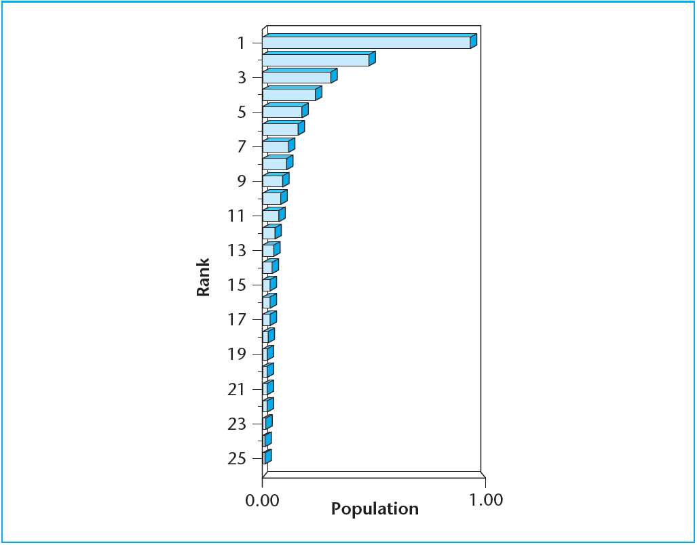
EXHIBIT 3-1A Theoretical Rank/Size Rule
© OnCourse Learning

Slide 6
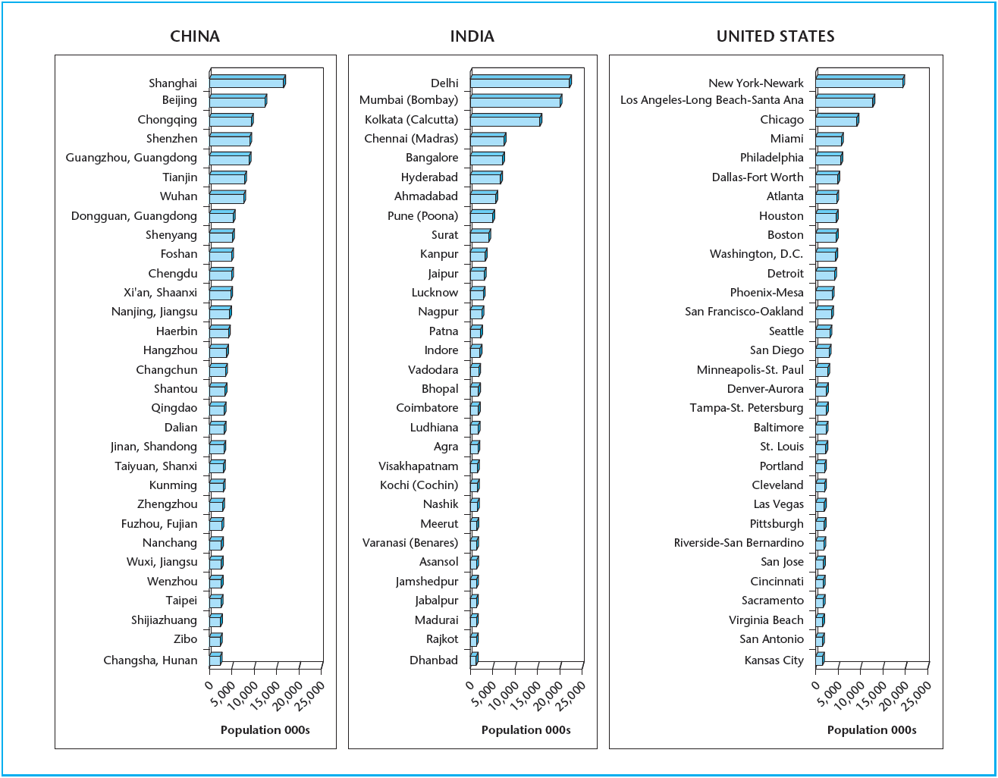
EXHIBIT 3-1B Rank/Size Rule in the World’s Three Largest Countries
Source: U.N. Urban Agglomeration Population, 2009

Slide 7
3.2 Pattern of City Location

Slide 8
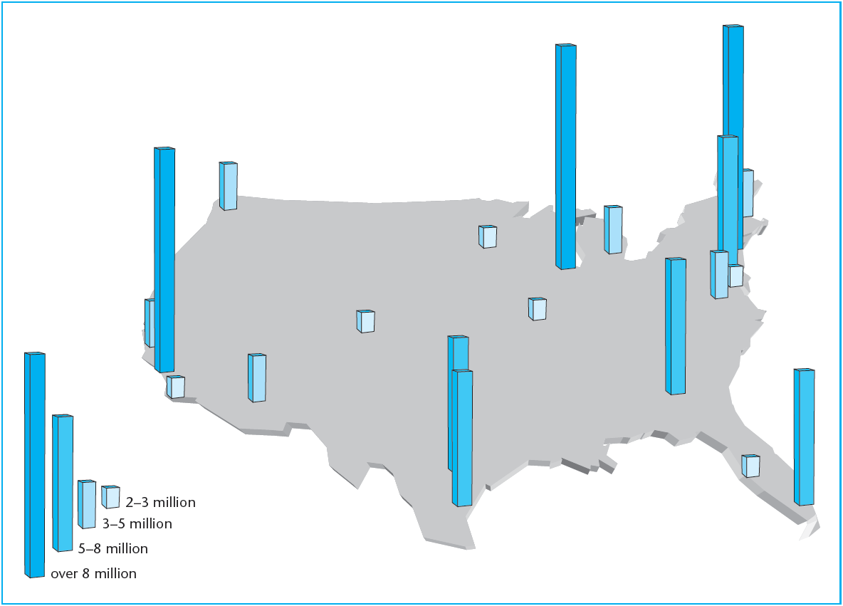
EXHIBIT 3-2 The 20 Largest U.S. Metropolitan Areas
Source: U.N. Urban Agglomeration Population, 2009.

Slide 9
3.3 Factors Underlying the Pattern: Centripetal and Centrifugal Forces

Slide 10
3.3.1 Centripetal Forces

Slide 11
3.3.2 Centrifugal Forces

Slide 12
3.3.3 Balance of Forces

Slide 13
3.3.4 Central Place Theory and the Urban Hierarchy

Slide 14
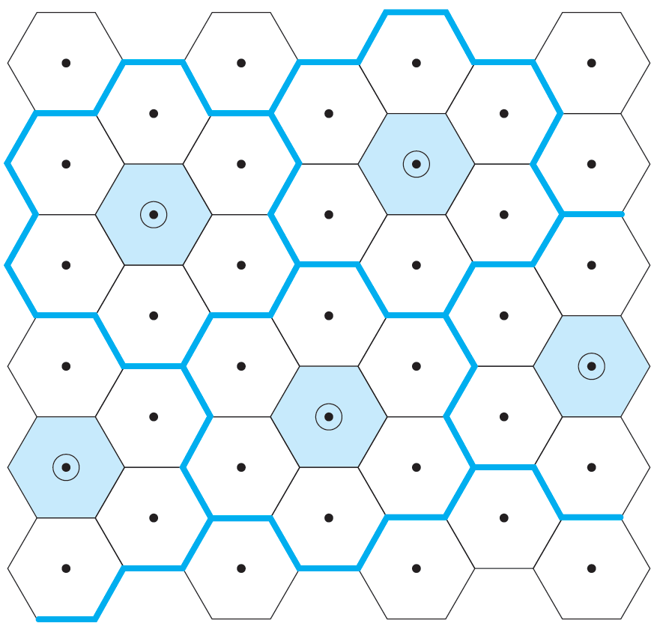
EXHIBIT 3-3 Central Place Theory and Urban Hierarchy
The diagram shows the theoretical configuration of 34 lower-order cities (single dots) and 5 higher-order cities (circled dots), with their “hinterland” territories indicated as on a “featureless plain.” The hexagonal shapes minimize aggregate transportation costs. The even spacing of the central points is the key point.

Slide 15
3.3.5 Why Does CPT Matter?

Slide 16
3.4 Economic Base and the Growth of Cities and Regions

Slide 17
3.4.1 Definition of Economic Base

Slide 18
3.4.2 Export Base

Slide 19
3.4.3 Location Quotients and SICs

Slide 20
3.4.4 Service Sector and Export Multiplier

Slide 21
3.4.5 Classification of Cities by Economic Base

Slide 22
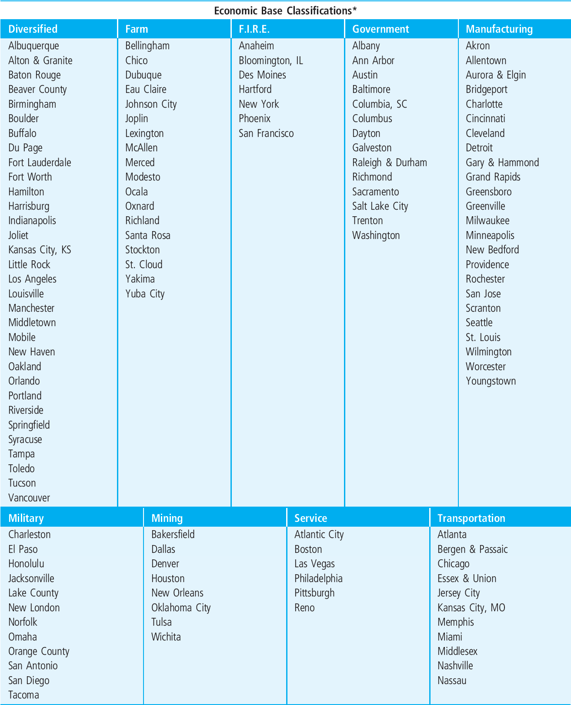
EXHIBIT 3-4 Example of U.S. City Classification by Dominant Economic Base
*Location quotients do change over time causing cities to move from one EBC to another—however, this is infrequent.
Source: G. Mueller. 1993. Refining Economic Diversification Strategies for Real Estate Portfolios. Journal of Real Estate Research 8(1)

Slide 23
3.5 Chapter Summary

Slide 24
KEY TERMS
system of cities
rank/size rule (Zipf’s Law)
centralizing (centripetal) forces
decentralizing (centrifugal) forces
economies of scale
economies of agglomeration
positive locational externalities
cumulative causation
central place theory (CPT)
theory of urban hierarchy
hinterlands
threshold market
agglomeration shadows
economic base
export base theory
export (basic) sector
service (nonbasic) sector
location quotient (LQ)
standard industrial classification (SIC)
employment multiplier effect
population multiplier
classification of cities
economic cluster of cities

