Slide 1
Chapter 28
Investment Analysis of Real Estate Development Projects: Overview & Background

Slide 2
CHAPTER OUTLINE
28.1 Overview of the Development Decision-Making Process
The Trend Towards Greener Development
28.2 Basic Information: Enumerating Project Costs and Benefits
28.3 Construction Budget Mechanics
28.4 Simple Financial Feasibility Analysis in Current Practice
28.4.1 Simple Feasibility Analysis Explained
28.4.2 Problems with the Simple Approach
28.5 Chapter Summary

Slide 3
LEARNING OBJECTIVES
After reading this chapter, you should understand:
The typical real estate development project decision process, at a broad-brush level, and the trend towards greener and more sustainable buildings.
The role of financial analysis in development project decision making and the mortgage-based simplified techniques that are widely employed in this role in current practice, including their strengths and weaknesses.
The basics of construction loan mechanics.

Slide 4
28.1 Overview of the Development Decision-Making Process The Trend Towards Greener Development

Slide 5
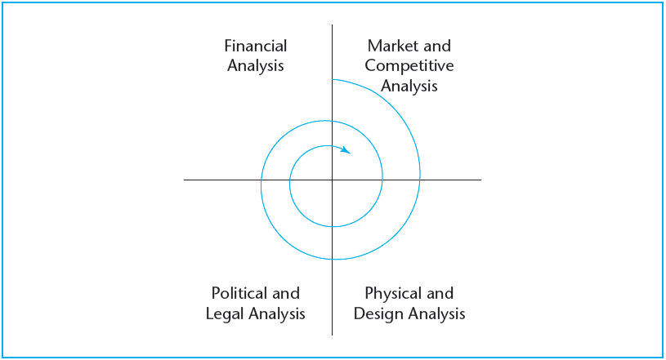
EXHIBIT 28-1 Iterative, Multidisciplinary Process of Real Estate Development Decision Making (the Graaskamp Model)
© OnCourse Learning

Slide 6
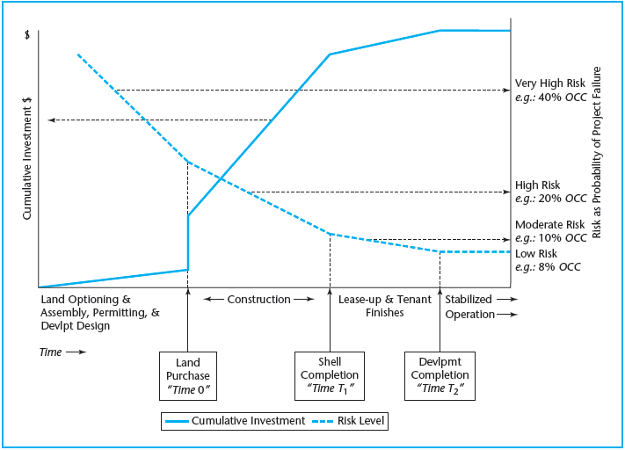
EXHIBIT 28-2 Development Project Phases: Typical Cumulative Capital Investment Profile and Investment Risk Regimes
© OnCourse Learning

Slide 7
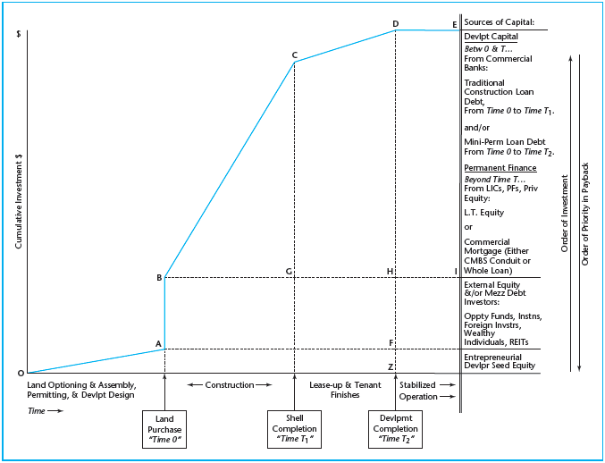
EXHIBIT 28-3 Development Project Typical Sources of Investment Capital
© OnCourse Learning

Slide 8
The Trend Towards Greener Development

Slide 9
28.2 Basic Information: Enumerating Project Costs and Benefits

Slide 10
28.3 Construction Budget Mechanics

Slide 11
28.4 Simple Financial Feasibility Analysis in Current Practice

Slide 12
28.4.1 Simple Feasibility Analysis Explained

Slide 13
EXHIBIT 28-4 SFFA Front-Door Procedure

Slide 14
28.4.2 Problems with the Simple Approach

Slide 15
EXHIBIT 28-5 SFFA Back-Door Procedure

Slide 16
28.5 Chapter Summary

Slide 17
KEY TERMS
site-looking-for-a-use
use-looking-for-a-site
lease-up risk
development project phases
construction and absorption budget
operating budget
stabilized (year or cash flows)
hard costs
soft costs
sustainable development
absorption or lease-up phase
on spec (speculative development)
tenant build-outs
construction loan
future advances
draw-down (of loan commitment)
draw
permanent loan
certification of occupancy
take-out loan
accrued interest
financing costs (construction loan interest)
simple financial feasibility analysis (SFFA)
front-door feasibility analysis
back-door feasibility analysis
gross leaseable area (GLA)
efficiency ratio
net rentable area (NRA)
financial feasibility
financial economic desirability

