Slide 1
Chapter 27
Real Options and Land Value

Slide 2
CHAPTER OUTLINE
27.1 The Call Option Model of Land Value
27.2 Simple Numerical Example of OVT Applied to Land Valuation and the Development Timing Decision
*27.3 A Rigorous Model of Option Value
27.3.1 The Arbitrage Perspective on the Option Value
27.3.2 The Certainty-Equivalence DCF Perspective on the Option Value
27.3.3 Why the Option Valuation Model Works
27.4 The Binomial Model of Option Value
*27.5 A Perpetual Model in Continuous Time
27.5.1 The Classical Samuelson-McKean Formula
27.5.2 General Implications of the Model for Development Timing and Land Speculation Investment Risk and Return Expectations
27.6 Using Option Theory to Understand Overbuilding
27.7 Chapter Summary

Slide 3
LEARNING OBJECTIVES
After reading this chapter, you should understand:
The call option and how this concept can be used to understand the value of land.
The binomial model of option valuation, and how and why it works.
The Samuelson-McKean formula and how it can be used to shed light on land value, development timing, and the opportunity cost of capital for investment in land speculation.
Some of the insights option valuation theory provides for understanding real estate development behavior, including how over-development can be rational in some circumstances.

Slide 4
27.1 The Call Option Model of Land Value

Slide 5
27.2 Simple Numerical Example of OVT Applied to Land Valuation and the Development Timing Decision

Slide 6
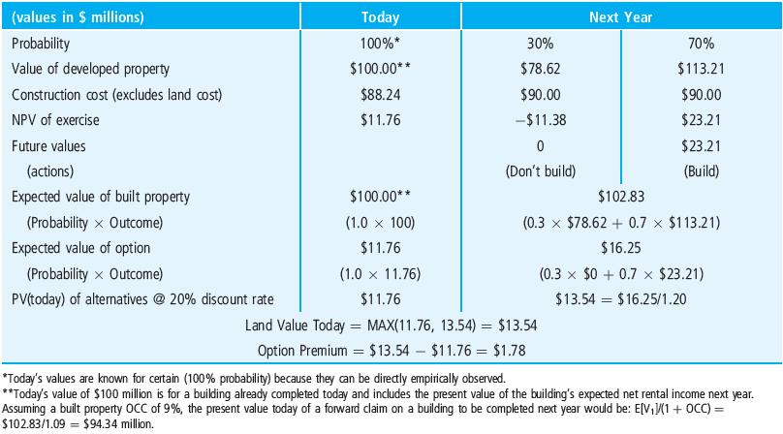
EXHIBIT 27-1 Numerical Example of Option Premium Value Due to Future Uncertainty in Built Property Value
© OnCourse Learning

Slide 7
*27.3 A Rigorous Model of Option Value

Slide 8
27.3.1 The Arbitrage Perspective on the Option Value

Slide 9
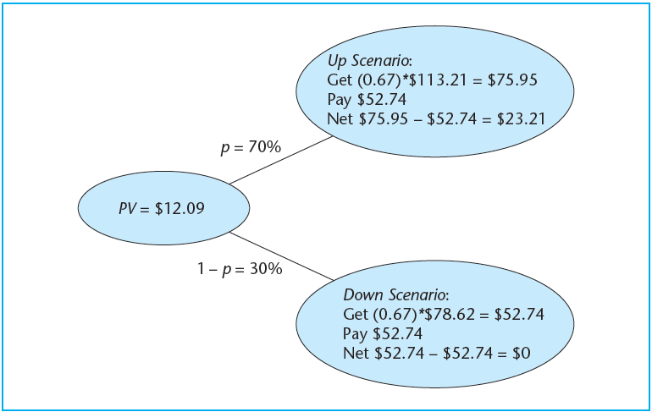
EXHIBIT 27-2 Binomial Outcome Possibilities for the One-Period Development Option Arbitrage or “Hedge Portfolio” (values in millions)
© OnCourse Learning

Slide 10
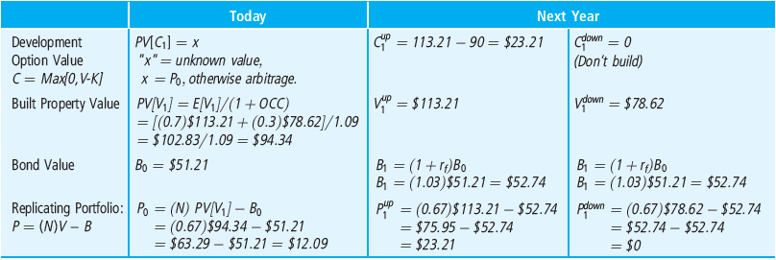
EXHIBIT 27-3 Summary of Arbitrage-Based Valuation of the Development Option
© OnCourse Learning

Slide 11
27.3.2 The Certainty-Equivalence DCF Perspective on the Option Value

Slide 12
27.3.3 Why the Option Valuation Model Works

Slide 13
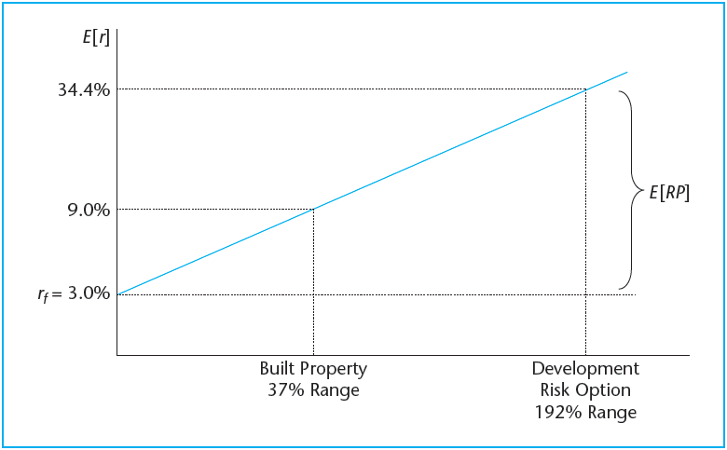
EXHIBIT 27-4 The Option Model Equates the Expected Return Risk Premium per Unit of Risk Across the Markets for Built Property and Developable Land
© OnCourse Learning

Slide 14
27.4 The Binomial Model of Option Value

Slide 15
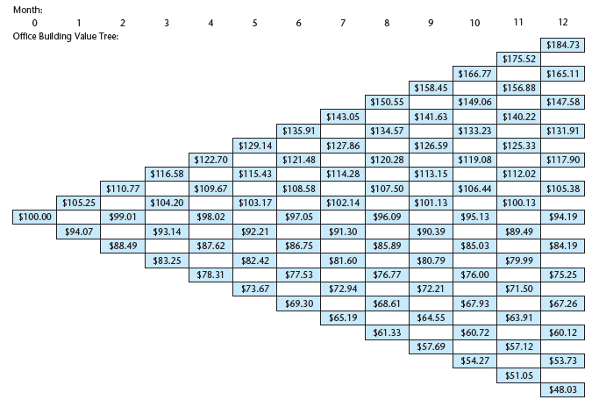
EXHIBIT 27-5 One-Year Monthly Binomial Value Tree
© OnCourse Learning

Slide 16
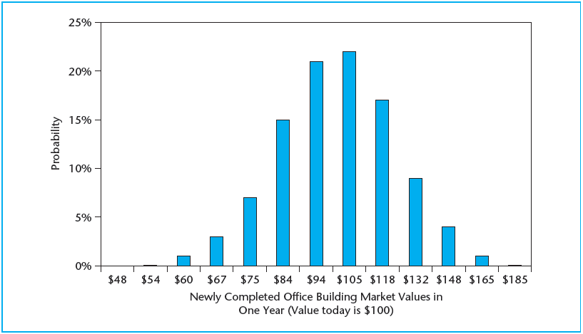
EXHIBIT 27-6 One-Year Value Probabilities for Office Building
© OnCourse Learning

Slide 17
*27.5 A Perpetual Model in Continuous Time

Slide 18
27.5.1 The Classical Samuelson-McKean Formula

Slide 19
27.5.2 General Implications of the Model for Development Timing and Land Speculation Investment Risk and Return Expectations

Slide 20
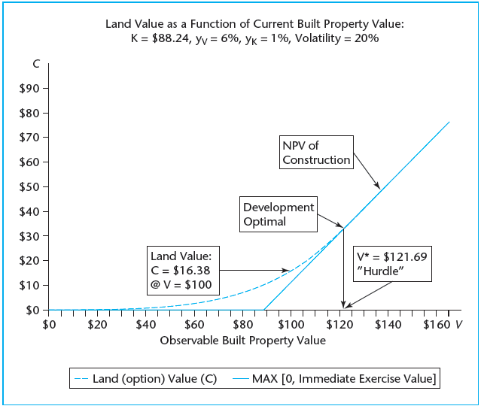
EXHIBIT 27-7 Samuelson-McKean Model Land Value as a Function of Current Built Property Value
© OnCourse Learning

Slide 21
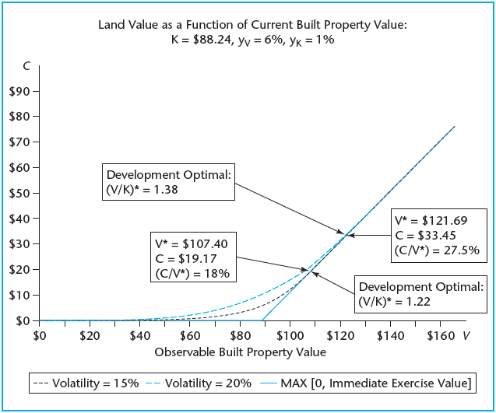
EXHIBIT 27-8 Samuelson-McKean Model Land Value as a Function of Current Built Property Value: Two Different Volatility Assumptions
© OnCourse Learning

Slide 22
27.6 Using Option Theory to Understand Overbuilding

Slide 23
27.7 Chapter Summary

Slide 24
KEY TERMS
option valuation theory (OVT)
real options
option
exercise of options
underlying asset
exercise price
American option
European option
call option
call option model of land value
certainty-equivalence value
irreversibility premium
option premium
replicating portfolio (or hedge portfolio)
arbitrage
perpetual options
Samuelson-McKean formula
option elasticity
hurdle value (critical value)
hurdle benefit/cost ratio
overbuilding
leasing option
cascades (of development)
development timing

