Slide 1
Chapter 26
Real Estate Investment Management and Derivatives

Slide 2
CHAPTER OUTLINE
26.1 Macro-Level Investment Performance Attribution
26.1.1 The Importance of Property-Level Investment Management
26.1.2 Macro Property-Level Performance Attribution and the Four Fundamental Responsibilities
26.1.3 Portfolio-Level Performance Attribution
26.1.4 Use of a Benchmark in Performance Attribution
26.1.5 The Case for Using Manager Allocation Weights in the Benchmark
26.2 Investment Performance Evaluation and Benchmarking
26.2.1 The Basic Idea
26.2.2 Benchmarks and Investment Styles in the Private Real Estate Asset Class
26.3 Real Estate Derivatives
26.3.1 How Index Swaps Can Be Used and Priced
26.3.2 The Broader Potential Role of Index Derivatives
26.3.3 Solving the Index Problem
26.4 Chapter Summary

Slide 3
LEARNING OBJECTIVES
After reading this chapter, you should understand:
What is meant by investment performance attribution at both the macro property level and the portfolio level.
How to quantify segment allocation versus asset selection effects in a portfolio’s differential performance relative to an appropriate benchmark.
What are the major institutional real estate investment management “styles” and how these may be accounted for in quantitative investment performance evaluation.
The new concept of real estate equity index derivatives and how such products might be used in real estate investment management.

Slide 4
26.1 Macro-Level Investment Performance Attribution

Slide 5
26.1.1 The Importance of Property-Level Investment Management

Slide 6
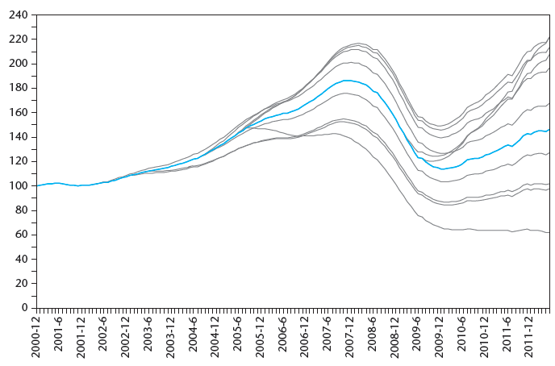
EXHIBIT 26-1 Dispersion of Individual Property Price Change Around an Aggregate Index: Moody’s/RCA CPPI and Price Paths of 10 Last-Sold Property Investments as of June 2012
Pegged to starting value on index at time of prior sale (buy), then tracked at constant rate per month to ultimate sale price deviation from index at disposition in June 2012.
Source: Data from Real Capital Analytics Inc. (Used by permission)

Slide 7
26.1.2 Macro Property-Level Performance Attribution and the Four Fundamental Responsibilities

Slide 8
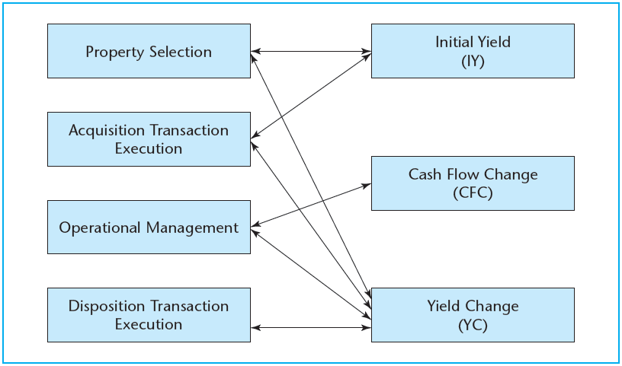
EXHIBIT 26-2 The Four Fundamental Property-Level Investment Management Responsibilities Related to the Three Property-Level Performance Attributes
© OnCourse Learning

Slide 9
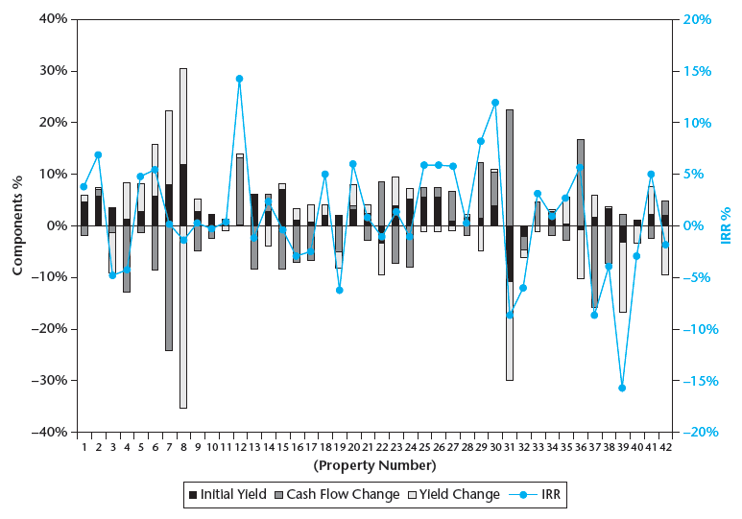
EXHIBIT 26-3 Property-Level IRR Attributes in 42 Round-Trip Investments: Subject Property vs. NCREIF Cohort, IRR Component by Property
Source: Modified from Feng (2010).

Slide 10
26.1.3 Portfolio-Level Performance Attribution

Slide 11
EXHIBIT 26-4 Returns Realized for Clients by Bob and Sue
© OnCourse Learning

Slide 12
26.1.4 Use of a Benchmark in Performance Attribution

Slide 13
EXHIBIT 26-5 Sue’s Performance Attribution Relative to Her Benchmark
© OnCourse Learning

Slide 14
26.1.5 The Case for Using Manager Allocation Weights in the Benchmark

Slide 15
26.2 Investment Performance Evaluation and Benchmarking

Slide 16
26.2.1 The Basic Idea

Slide 17
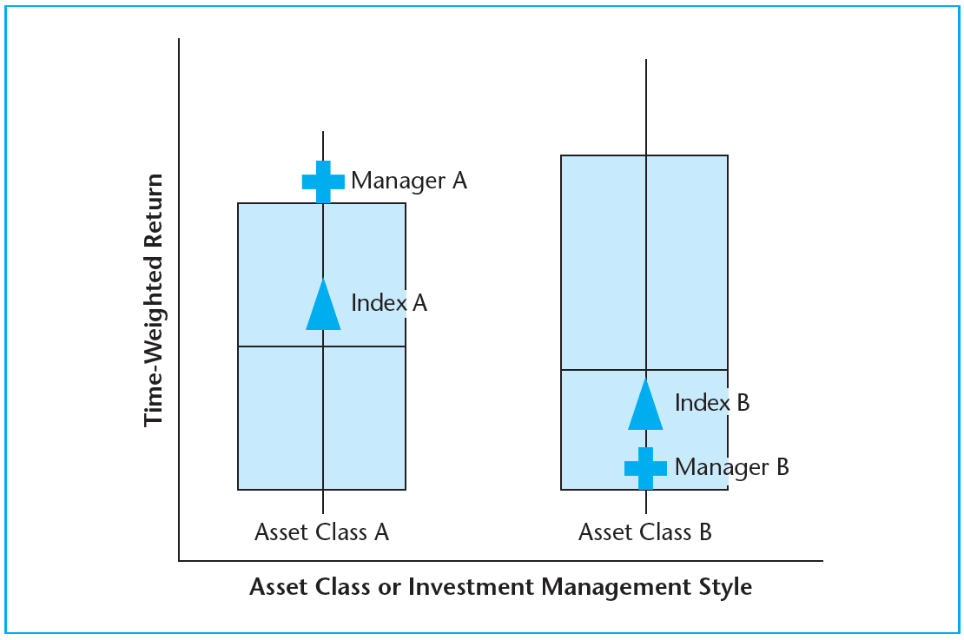
EXHIBIT 26-6 Graphical Depiction of Typical Investment Manager Performance Evaluation
© OnCourse Learning

Slide 18
26.2.2 Benchmarks and Investment Styles in the Private Real Estate Asset Class

Slide 19
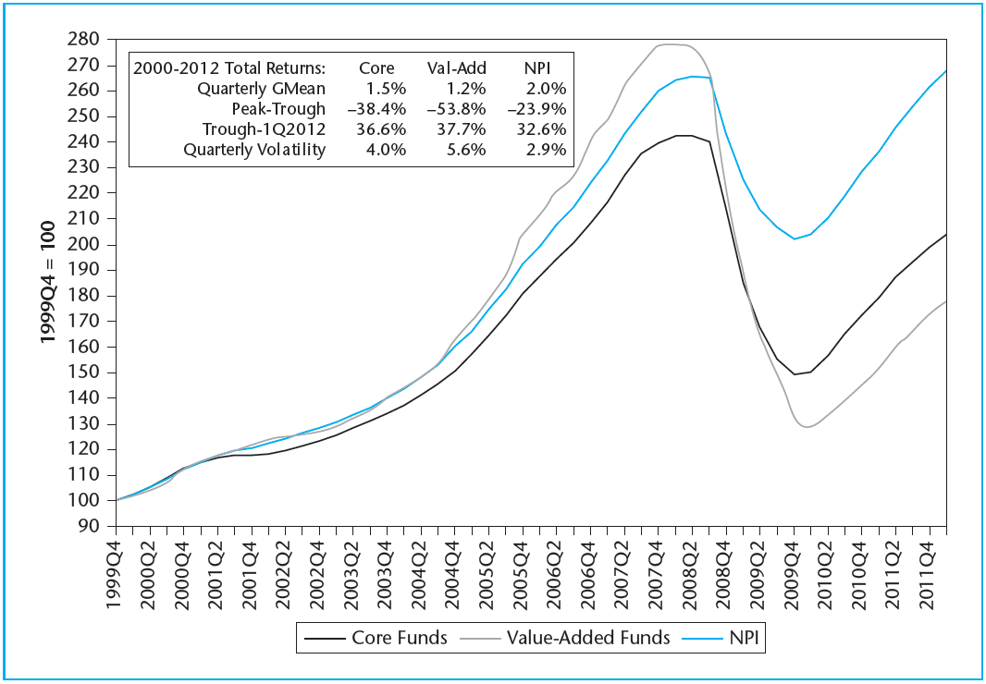
EXHIBIT 26-7 NCREIF/Townsend Fund Indices vs. NCREIF Property Index: Cumulative Total Returns, 2000–2012
Based on value-weighted all-funds indices, net of fees. NPI is property level gross of fees.
© OnCourse Learning

Slide 20
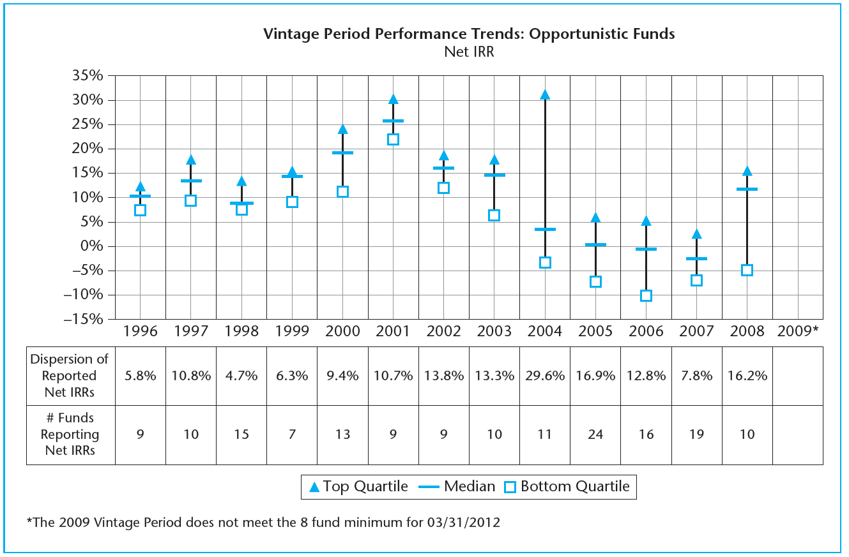
EXHIBIT 26-8 NCREIF/Townsend Report of Real Estate Opportunistic Funds IRR Performance by Vintage Year (as of March 31, 2012)
Source: NCREIF and The Townsend Group, “Real Estate Fund Indices and Vintage Period Performance Report, 1st Quarter 2012f,” NCREIF, Chicago, 2012.

Slide 21
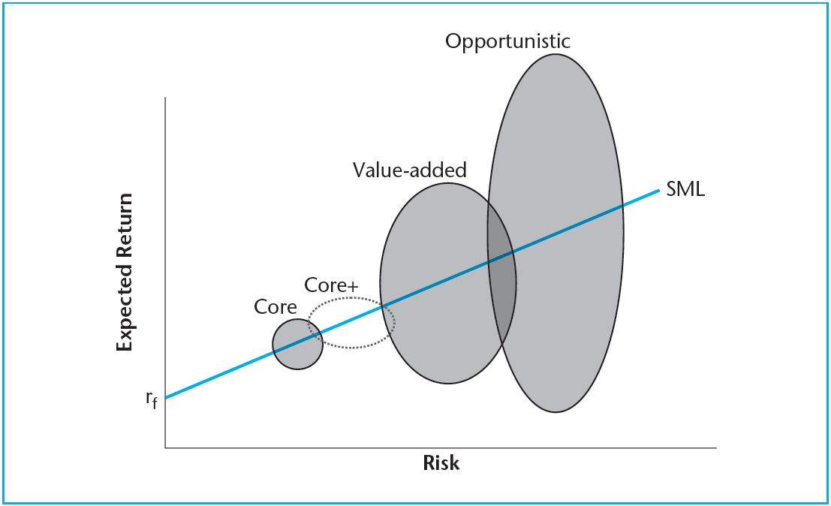
EXHIBIT 26-9 Schematic Diagram of Institutional Real Estate Investment Management Styles
© OnCourse Learning

Slide 22
26.3 Real Estate Derivatives

Slide 23
26.3.1 How Index Swaps Can Be Used and Priced

Slide 24
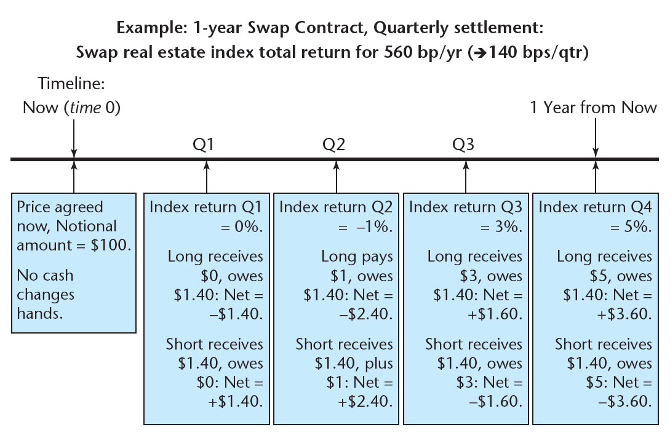
EXHIBIT 26-10 Example Index Swap Contract
© OnCourse Learning

Slide 25
26.3.2 The Broader Potential Role of Index Derivatives

Slide 26
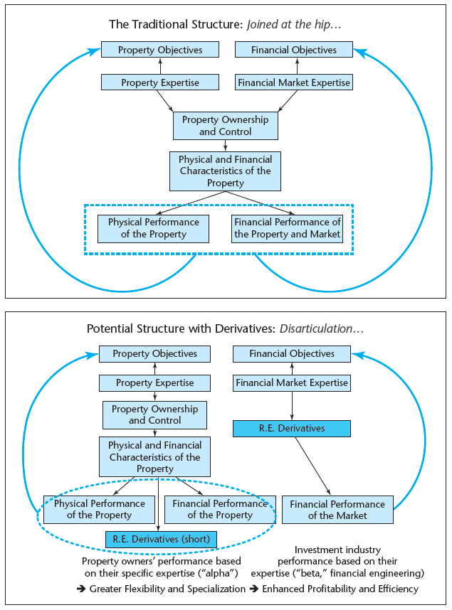
EXHIBIT 26-11 Potential Role of Index Derivatives within the Real Estate Investment System to Facilitate Greater Flexibility and Specialization via Synthetic Investment and Risk Management Hedging
© OnCourse Learning

Slide 27
26.3.3 Solving the Index Problem

Slide 28
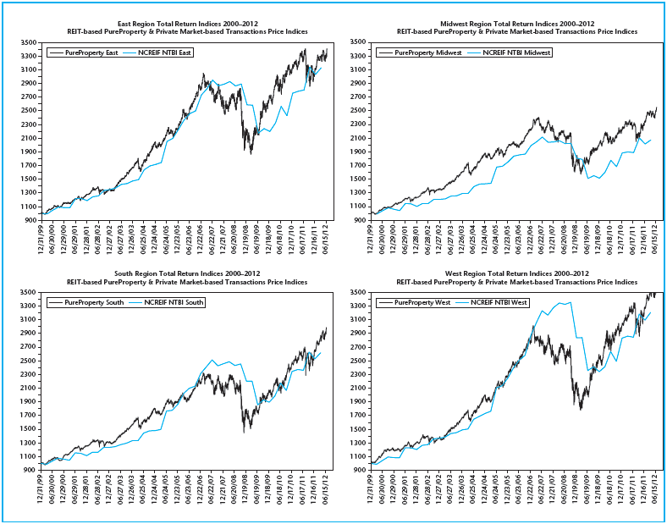
EXHIBIT 26-12 Cumulative Total Returns of FTSE NAREIT PureProperty Indices Compared to NCREIF NTBI for Four Regional Target Segments, 2000–2012
This exhibit shows this relationship for four major geographic regional indices, comparing the cumulative total return of the PureProperty Index with that of the corresponding transaction based NTBI.
Source: FTSE and NCREIF data.

Slide 29
26.4 Chapter Summary

Slide 30
KEY TERMS
performance attribution
benchmarking
macro property level (performance attribution)
property selection
acquisition transaction execution
operational management during the holding period
disposition transaction execution
portfolio level (performance attribution)
allocation
selection
segments (in the asset market)
benchmark
interaction effect
performance evaluation
peer universe
passive index
active management
fund-level indices
investment styles
core
value-added
opportunistic
vintage
sample
population
derivative
synthetic investment
covered long
hedge
covered short
alpha
stock market based property return indices (SMPRIs)

