Slide 1
Chapter 24
International Real Estate Investments: Markets, Strategies, and Implementation

Slide 2
CHAPTER OUTLINE
24.1 There’s a Big World Out There
24.1.1 The Global Real Estate Capital Market: Size and Flows
24.1.2 The Institutions of Globalization
24.2 Going International: Rationales and Obstacles
24.2.1 Return Opportunities
24.2.2 International Diversification
24.2.3 Managerial Considerations
24.2.4 Obstacles to International Property Investment
24.3 Developing and Implementing International Real Estate Strategies
24.3.1 Public Real Estate Investment
24.3.2 Determining Country Allocation
24.3.3 The “Home Market” Concept
24.4 Chapter Summary

Slide 3
LEARNING OBJECTIVES
After reading this chapter, you should understand:
The rationale of international real estate investment
The major obstacles and disadvantages to investing in real estate in foreign markets
The nature of international institutional investment portfolios and capital flows and the practical considerations shaping them
The nature of the institutions enabling a successful international real estate strategy
Risk management strategies associated with successful international real estate investment

Slide 4
24.1 There’s a Big World Out There

Slide 5
24.1.1 The Global Real Estate Capital Market: Size and Flows

Slide 6
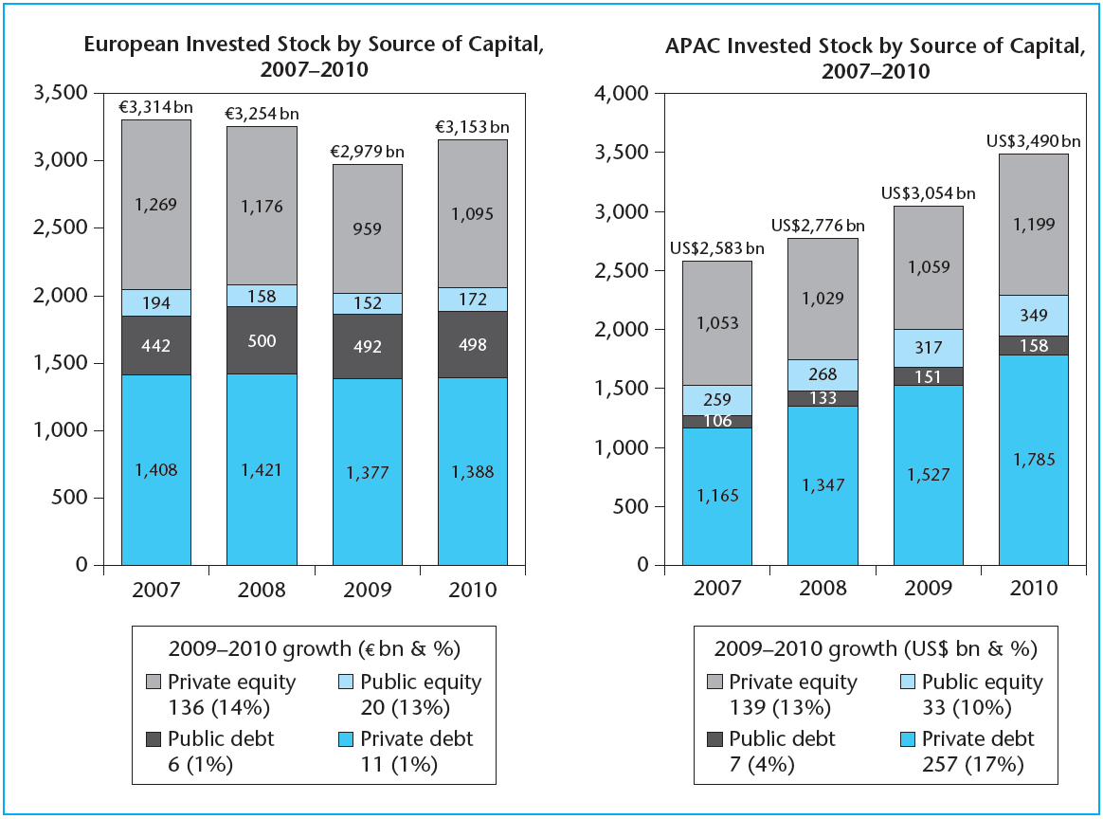
EXHIBIT 24-1 The Composition of Foreign Institutional Property Markets
Source: DTZ Research (2011).

Slide 7
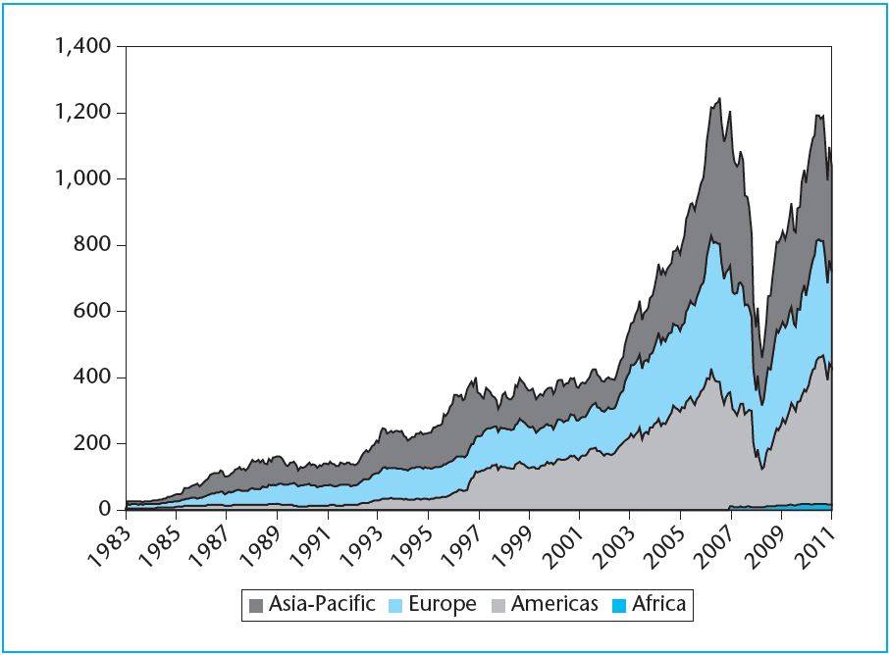
EXHIBIT 24-2 The Global Property Share Market (US$ billion), 1983–2011
Source: GPR.

Slide 8
24.1.2 The Institutions of Globalization

Slide 9
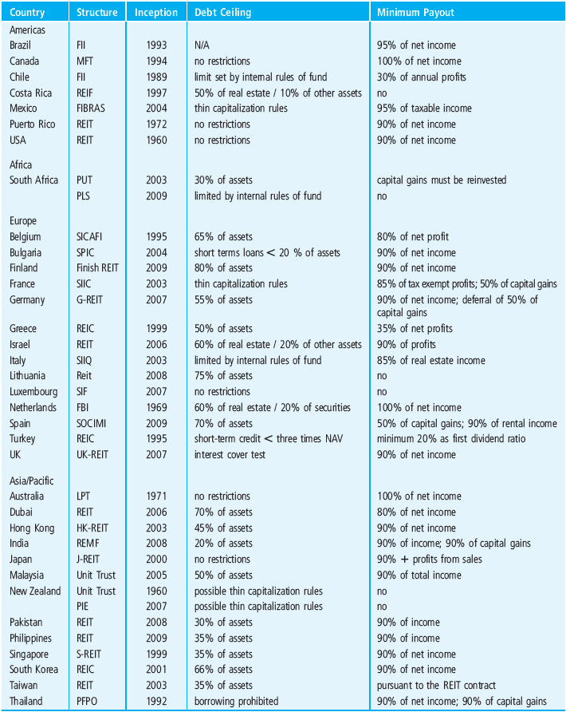
EXHIBIT 24-3 Tax Pass-Through Property Structures and Characteristics
Source: EPRA (2012).

Slide 10
24.2 Going International: Rationales and Obstacles

Slide 11
24.2.1 Return Opportunities

Slide 12
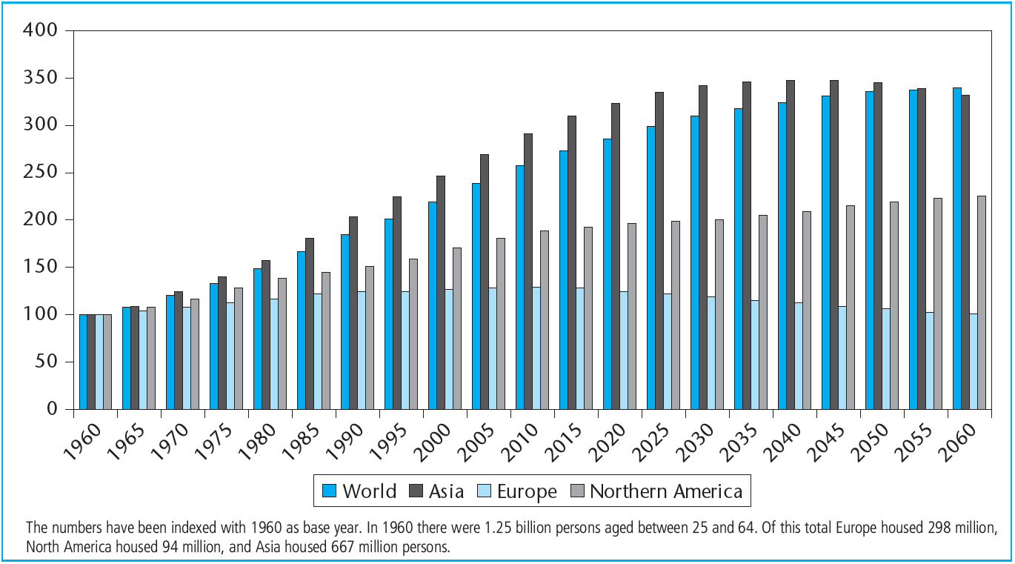
EXHIBIT 24-4 International Labor Force Statistics and Projections (age group 25–64)
Source: United Nations World Population Prospects Database.

Slide 13
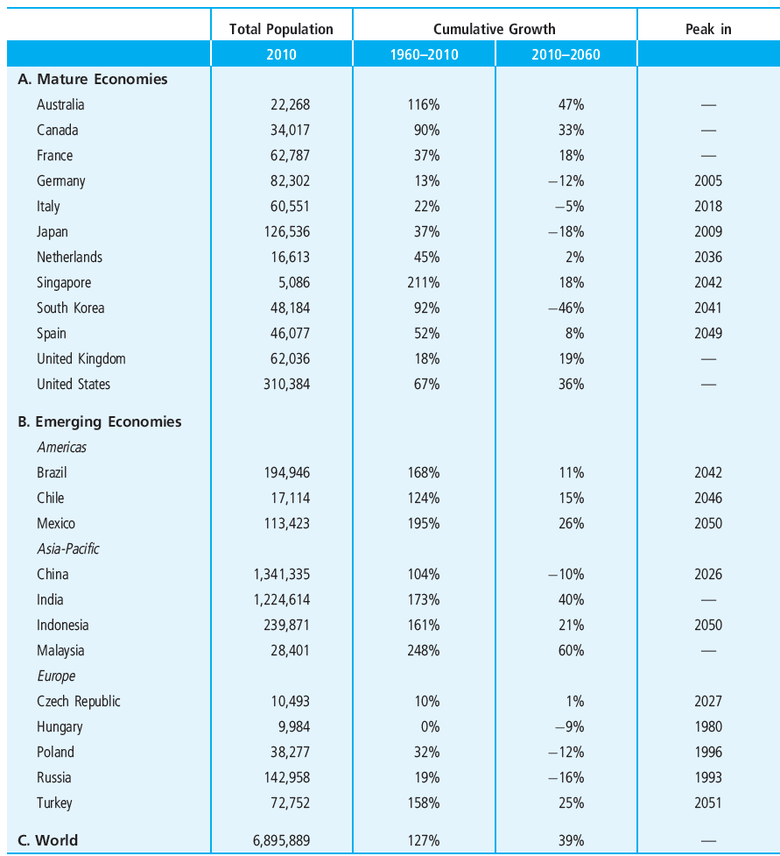
EXHIBIT 24-5 Population (× 1000 persons) in International Perspective, 1960–2060
Source: United Nations World Population Prospects Database.

Slide 14
24.2.2 International Diversification

Slide 15
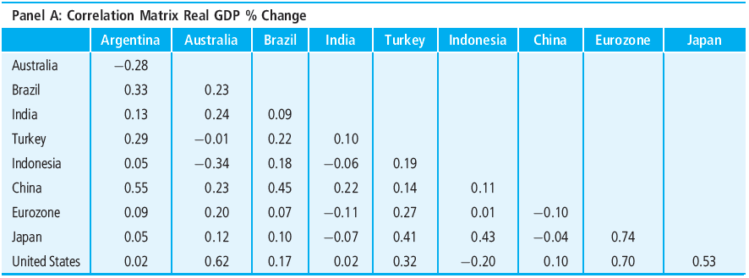
EXHIBIT 24-6 International Correlations of Selected Market Fundamentals across Economies
Source: Authors’ calculations based on Thompson Datastream.

Slide 16
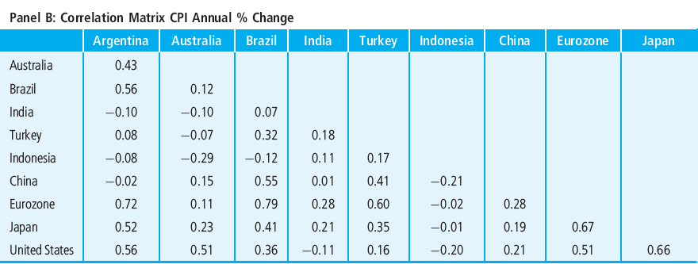
EXHIBIT 24-6 International Correlations of Selected Market Fundamentals across Economies
(continued)
Source: Authors’ calculations based on Thompson Datastream.

Slide 17
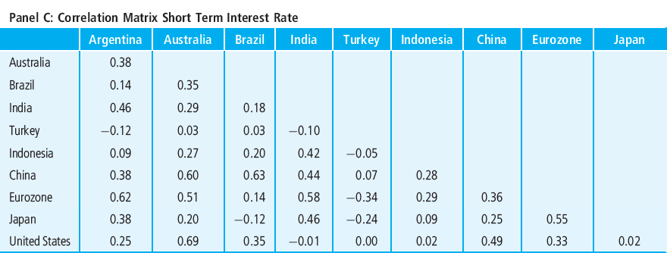
EXHIBIT 24-6 International Correlations of Selected Market Fundamentals across Economies
(continued)
Source: Authors’ calculations based on Thompson Datastream.

Slide 18
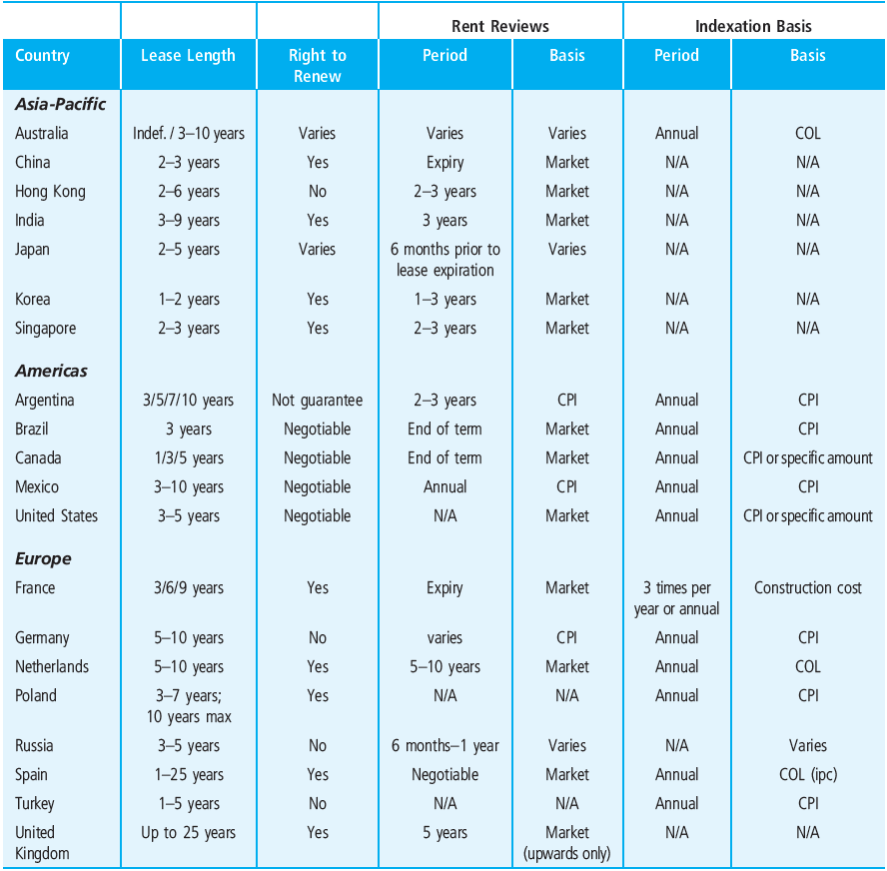
EXHIBIT 24-7 Rental Contract Types in Property Markets across the Globe
© OnCourse Learning

Slide 19
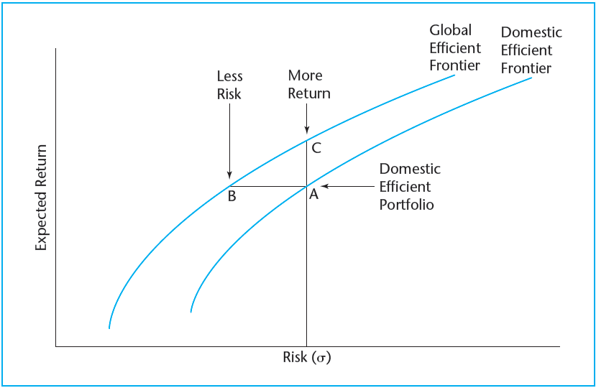
EXHIBIT 24-8 Domestic versus Global Efficient Frontier
© OnCourse Learning

Slide 20
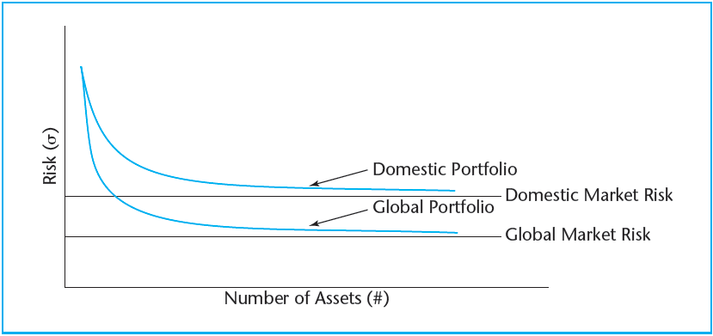
EXHIBIT 24-9 Domestic and Global Market Risk
© OnCourse Learning

Slide 21
24.2.3 Managerial Considerations

Slide 22
24.2.4 Obstacles to International Property Investment

Slide 23
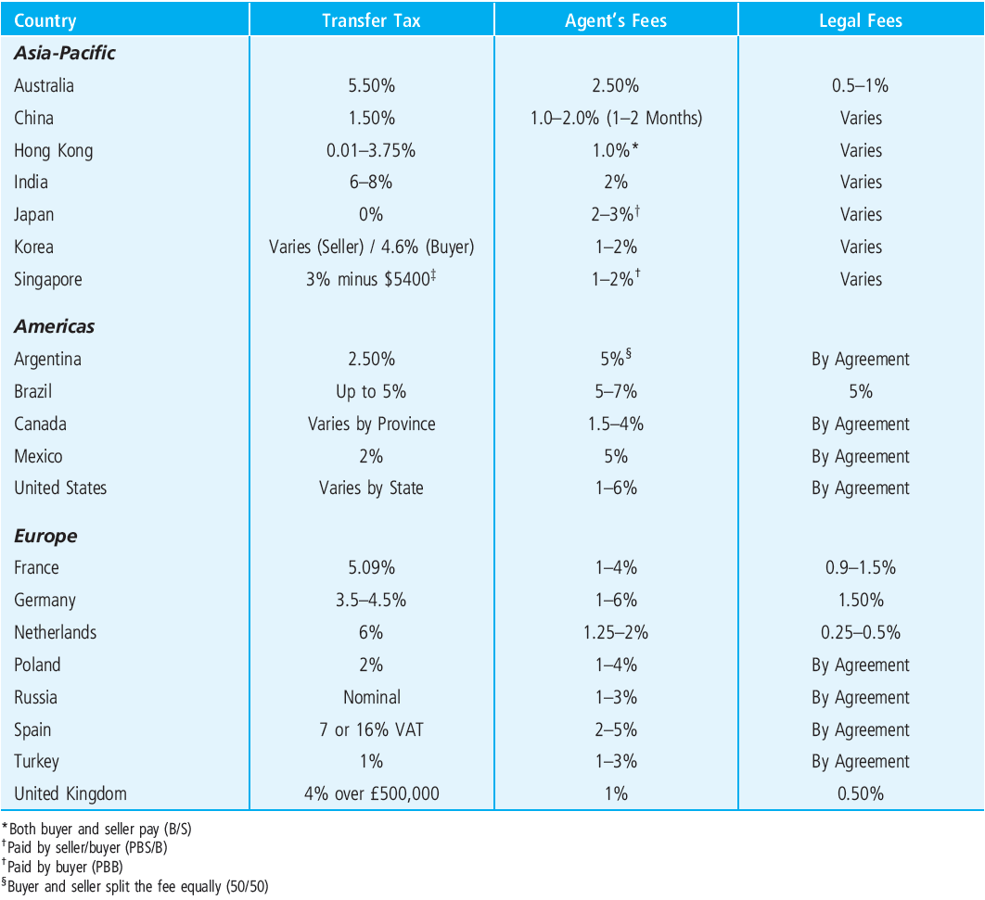
EXHIBIT 24-10 Transaction Costs in Selected Private Real Estate Markets
*Both buyer and seller pay (B/S)
†Paid by seller/buyer (PBS/B)
†Paid by buyer (PBB)
§Buyer and seller split the fee equally (50/50)
Source: NAIdirect.com.

Slide 24
24.3 Developing and Implementing International Real Estate Strategies

Slide 25
24.3.1 Public Real Estate Investment

Slide 26
24.3.2 Determining Country Allocation

Slide 27
24.3.3 The “Home Market” Concept

Slide 28
24.4 Chapter Summary

Slide 29
KEY TERMS
real estate investment trust (REIT)
structural return opportunities
structural capital needs
demographics
cyclical return opportunities
international diversification
international correlations
global market portfolio
transaction costs
information costs
informational inefficiencies
risks
political risk
economic risk
currency risk
liquidity
home market

