Slide 1
Chapter 21
Real Estate and Portfolio Theory: Strategic Investment Considerations

Slide 2
CHAPTER OUTLINE
21.1 Numerical Example of the Portfolio Allocation Problem: Real Estate in the Mixed-Asset Portfolio
21.2 Basic Mean-Variance Portfolio Theory (MPT)
21.2.1 Investor Preferences and Dominant Portfolios
21.2.2 Portfolio Theory and Diversification
21.2.3 Perceived Role of Real Estate in the Mixed-Asset Portfolio
21.2.4 The Efficient Frontier
21.2.5 Bringing in Investor Preferences
21.2.6 Major Implications of Portfolio Theory for Real Estate Investment
21.2.7 Expanding the Asset Class Choice Set: The Role of REITs
21.3 Allowing for a Riskless Asset: The Two-Fund Theorem and the Sharpe-Maximizing Portfolio
21.3.1 Two-Fund Theorem
21.3.2 Sharpe-Maximizing Portfolio
21.3.3 Summary of the Implications of the Riskless Asset Construct
21.4 Some Broader Considerations in Portfolio Allocation
21.5 Chapter Summary
Appendix 21 A Review of Some Statistics about Portfolio Returns

Slide 3
LEARNING OBJECTIVES
After reading this chapter, you should understand:
What is meant by modern portfolio theory (MPT) and how to apply this theory using computer spreadsheets.
The major strategic investment policy implications MPT holds for real estate at the broad-brush level of the overall mixed-asset portfolio.
The usefulness of the riskless asset assumption and the meaning of the Sharpe-maximizing portfolio.
The nature of institutional investment portfolios in the real world and the major practical considerations involved in applying portfolio theory to such investors.

Slide 4
21.1 Numerical Example of the Portfolio Allocation Problem: Real Estate in the Mixed-Asset Portfolio

Slide 5
EXHIBIT 21-1A Bob’s Risk and Return Expectations

Slide 6
EXHIBIT 21-1B Bob’s Covariance Expectations

Slide 7
EXHIBIT 21-1C Bob’s Weighted Covariances

Slide 8
21.2 Basic Mean-Variance Portfolio Theory (MPT)

Slide 9
21.2.1 Investor Preferences and Dominant Portfolios

Slide 10
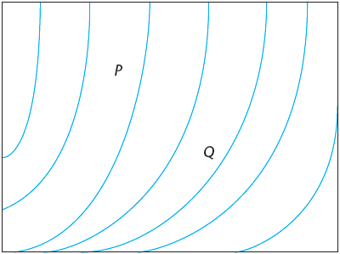
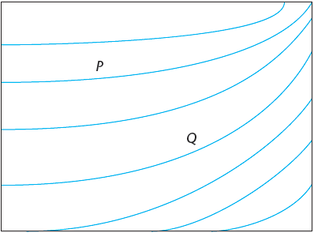
EXHIBIT 21-2 Utility Preference Surface (indifference curves) of an Investor
Panel A: Conservative (relatively risk-averse) investor
Panel B: Aggressive (less risk-averse) investor
Return
Return
© OnCourse Learning
Risk
Risk

Slide 11
21.2.2 Portfolio Theory and Diversification

Slide 12
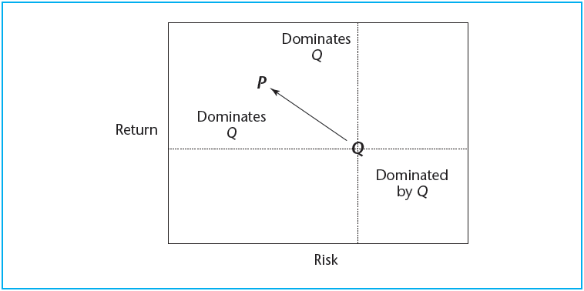
EXHIBIT 21-3 Portfolio Dominance
© OnCourse Learning

Slide 13
21.2.3 Perceived Role of Real Estate in the Mixed-Asset Portfolio

Slide 14
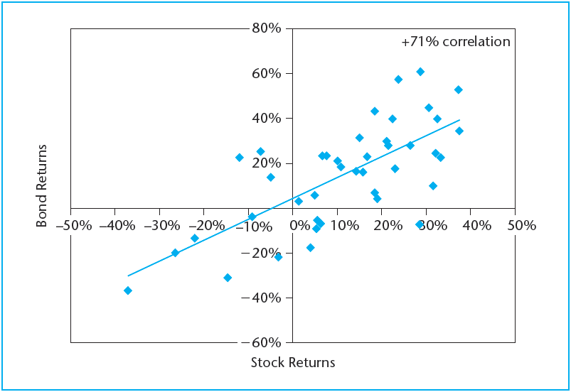
EXHIBIT 21-4A Scatter-Plot of Annual Stock and Bond Total Returns, 1970–2010 Based on S&P 500 and Long-Term Treasury Bonds
Source: Ibbotson.

Slide 15
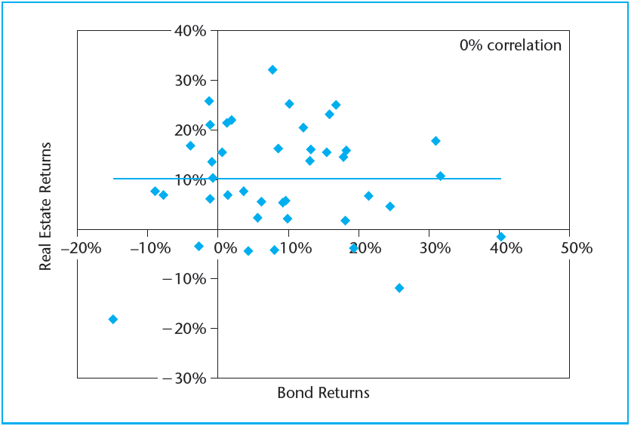
EXHIBIT 21-4B Scatter-Plot of Annual Real Estate and Bond Total Returns, 1970–2010 Based on Long-Term Treasury Bonds and Unsmoothed NCREIF
Source: Ibbotson, NCREIF, and authors.

Slide 16
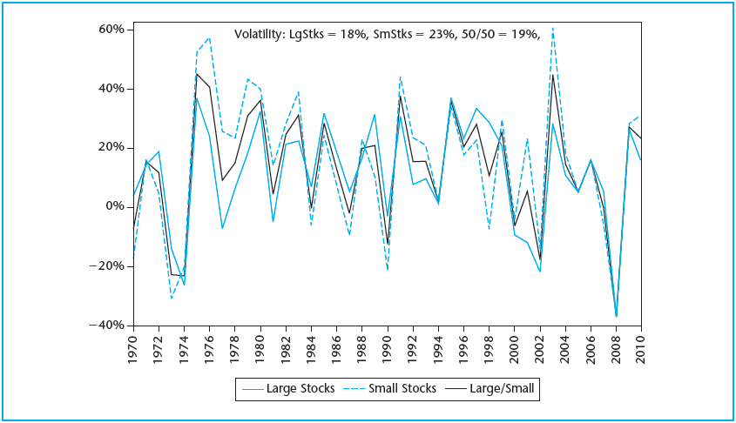
EXHIBIT 21-5A Annual Periodic Total Returns, Large and Small Stock, 50/50 Portfolio, 1970–2010
Source: Ibbotson, NCREIF, and authors

Slide 17
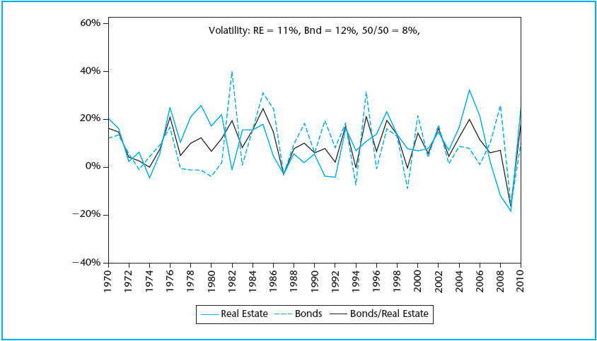
EXHIBIT 21-5B Annual Periodic Total Returns, Long-Term Bonds and Real Estate, 1970–2010
Source: Ibbotson, NCREIF, and authors.

Slide 18
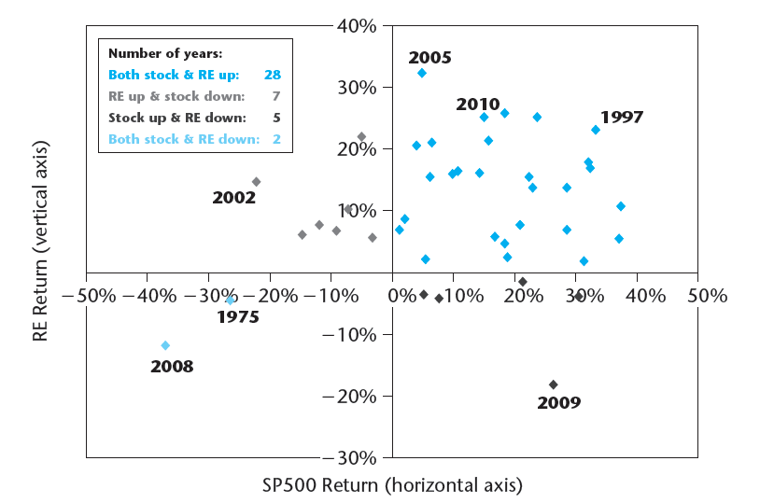
EXHIBIT 21-6 Stock and Real Estate Returns, 1970–2011, 42 Yearly Total Returns to S&P 500 and NCREIF-based TBI
© OnCourse Learning

Slide 19
21.2.4 The Efficient Frontier

Slide 20
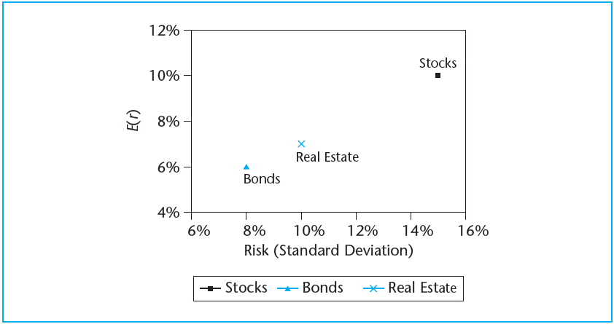
EXHIBIT 21-7A Three Assets: Stocks, Bonds, Real Estate (no diversification)
© OnCourse Learning

Slide 21
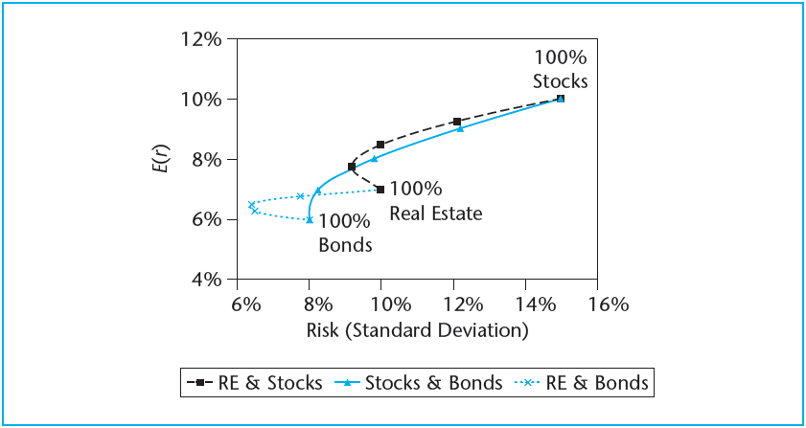
EXHIBIT 21-7B Three Assets: Stocks, Bonds, Real Estate (with pairwise combinations)
© OnCourse Learning

Slide 22
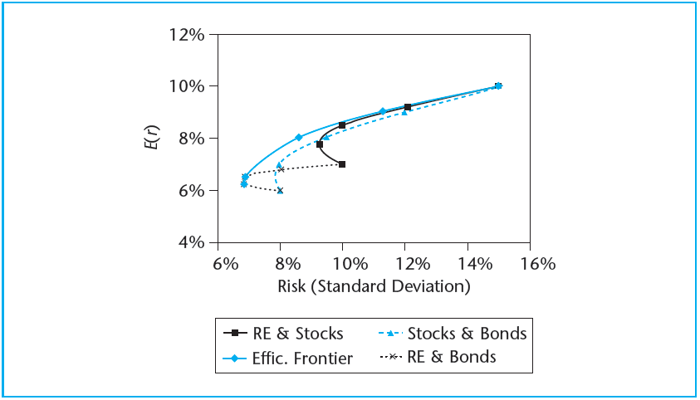
EXHIBIT 21-7C Three Assets with Diversification: The Efficient Frontier
© OnCourse Learning

Slide 23
21.2.5 Bringing in Investor Preferences

Slide 24
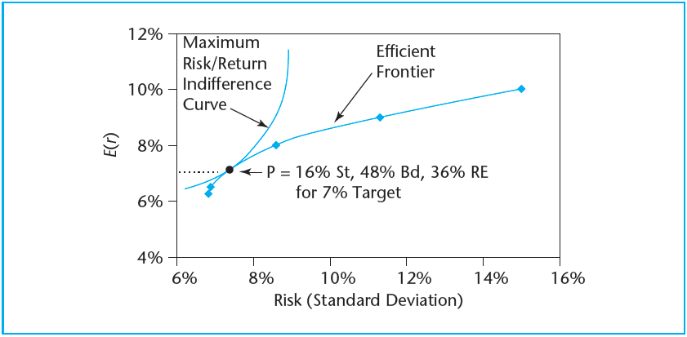
EXHIBIT 21-8A Optimal Portfolio for a Conservative Investor (P = 7% target)
© OnCourse Learning

Slide 25
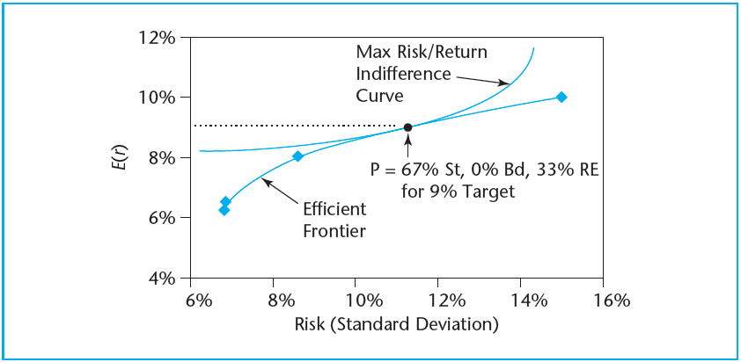
EXHIBIT 21-8B Optimal Portfolio for an Aggressive Investor (P = 9% target)
© OnCourse Learning

Slide 26
21.2.6 Major Implications of Portfolio Theory for Real Estate Investment

Slide 27
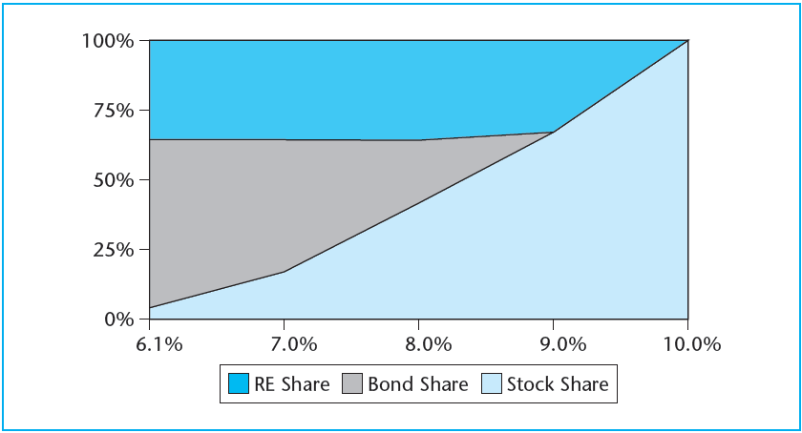
EXHIBIT 21-9 Asset Composition of the Efficient Frontier (based on Exhibit 21-1A expectations)
© OnCourse Learning

Slide 28
21.2.7 Expanding the Asset Class Choice Set: The Role of REITs

Slide 29
EXHIBIT 21-10A Possible Risk and Return Expectations for Five Asset Classes
© OnCourse Learning

Slide 30
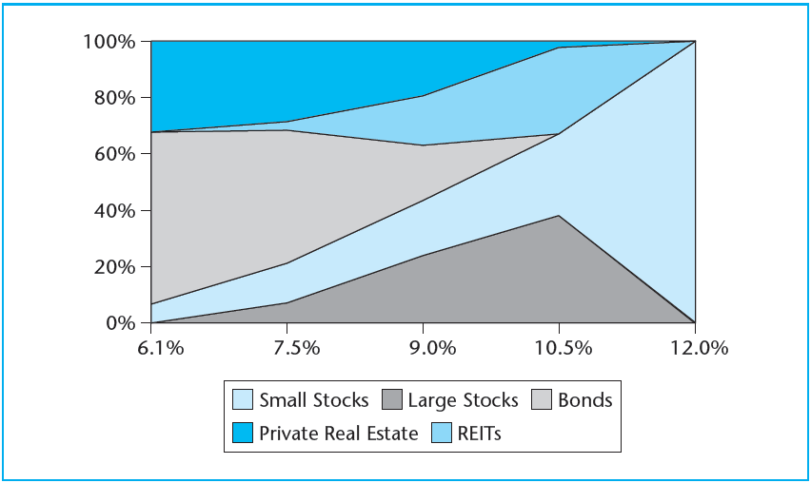
EXHIBIT 21-10B Asset Composition of the Efficient Frontier (based on Exhibit 21-10A expectations)
© OnCourse Learning

Slide 31
21.3 Allowing for a Riskless Asset: The Two-Fund Theorem and the Sharpe-Maximizing Portfolio

Slide 32
21.3.1 Two-Fund Theorem

Slide 33
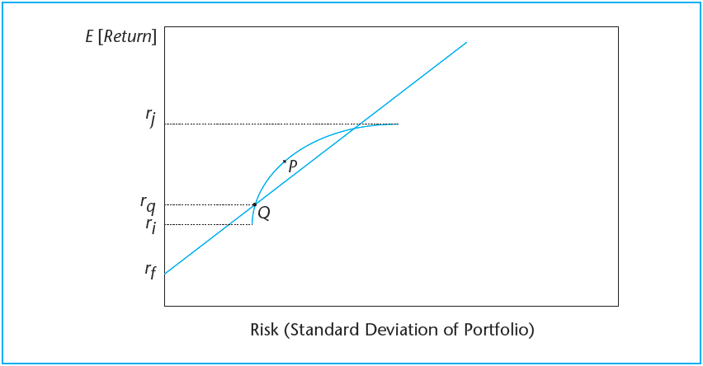
EXHIBIT 21-11A Risk and Return Possibilities of a Combination of a Riskless Asset with Return r_{f} and the Suboptimal Risky Portfolio with Expected Return r_{q}
© OnCourse Learning

Slide 34
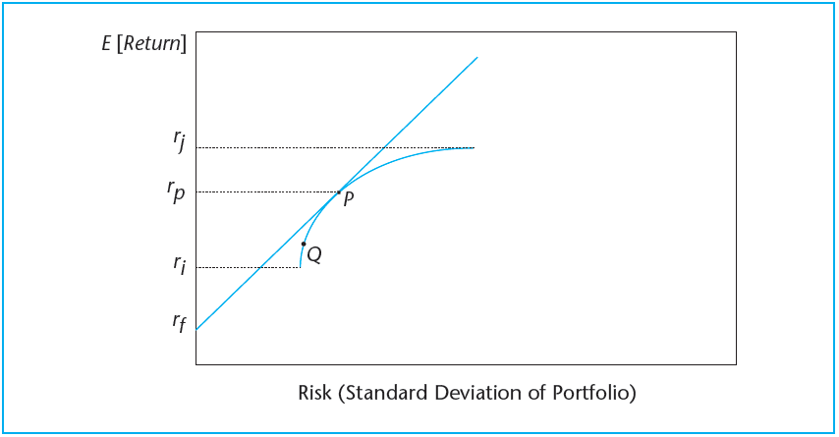
EXHIBIT 21-11B Risk and Return Possibilities of a Combination of a Riskless Asset with Return r_{f} and the Optimal Risky Portfolio with Expected Return r_{q}
© OnCourse Learning

Slide 35
21.3.2 Sharpe-Maximizing Portfolio

Slide 36
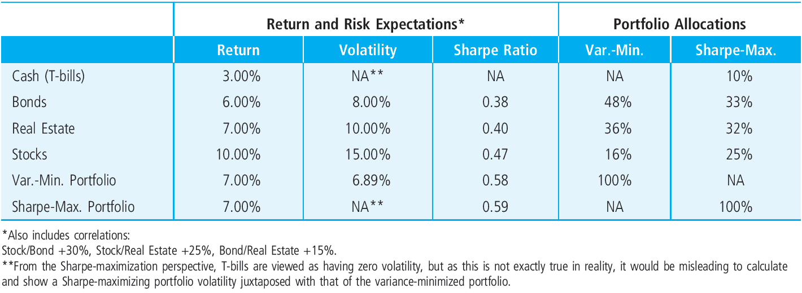
EXHIBIT 21-12 Comparison of Optimal 7%-Return-Target Portfolio Allocations, Variance-Minimization vs. Sharpe Ratio-Maximization
© OnCourse Learning

Slide 37
21.3.3 Summary of the Implications of the Riskless Asset Construct

Slide 38
21.4 Some Broader Considerations in Portfolio Allocation

Slide 39
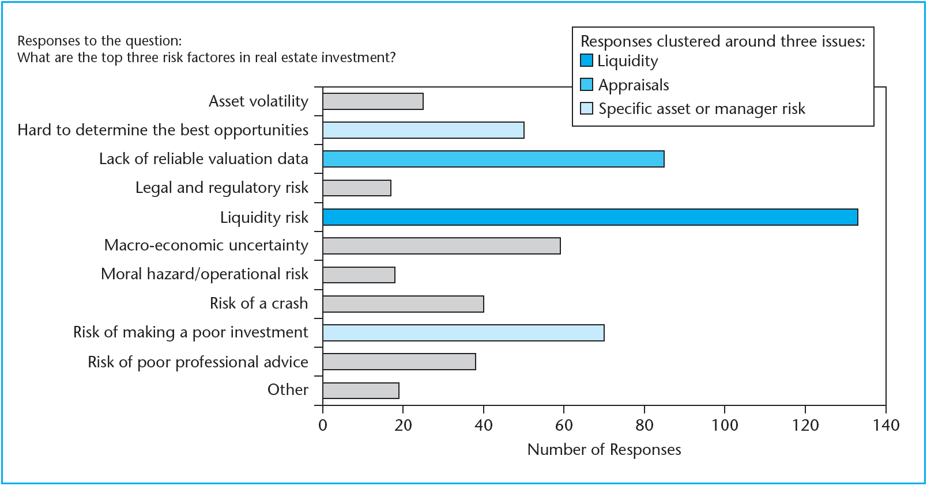
EXHIBIT 21-13 Top Risk Factors in Real Estate as Cited by U.S. Pension Funds
Source: Dhar and Goetzmann (2006).

Slide 40
21.5 Chapter Summary

Slide 41
Appendix 21 A Review of Some Statistics About Portfolio Returns

Slide 42
Cross-Sectional and Time-Series Return Statistics

Slide 43
Time-Series Statistics Used in Portfolio Theory

Slide 44
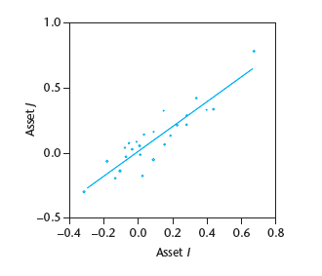
EXHIBIT 21A-1A +90% Correlation
© OnCourse Learning

Slide 45
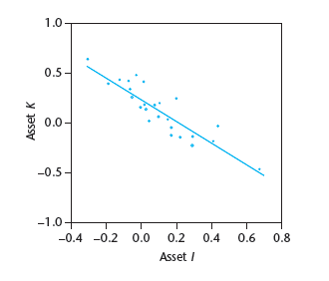
EXHIBIT 21A-1B −90% Correlation
© OnCourse Learning

Slide 46
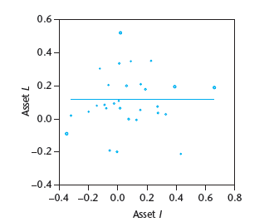
EXHIBIT 21A-1C 0% Correlation
© OnCourse Learning

Slide 47
KEY TERMS
modern portfolio theory (MPT)
volatility (standard deviation of return)
covariances (between assets)
weighted covariances
correlation coefficient (between returns)
solver (in spreadsheet)
target return (for portfolio)
sensitivity analysis
mean-variance portfolio theory (Markowitz)
risk preferences (of investors)
dominant portfolio (domination)
diversification benefit
cost-of-living adjustments (COLAs)
mixed-asset portfolio
efficient portfolio
efficient frontier
pension funds
two-fund theorem
Sharpe ratio
risk-adjusted return
Sharpe-maximizing portfolio
informational efficiency
illiquidity

