Slide 1
Chapter 20
Commercial Mortgage-Backed Securities

Slide 2
CHAPTER OUTLINE
20.1 What Are CMBS?
20.1.1 A Brief History of the CMBS Industry
20.1.2 Magnitude of the CMBS Industry and Its “Rise and Fall” (and Rebirth?)
20.2 CMBS Structure: Pooling, Tranching, and Subordination
20.2.1 A Simplified Numerical Example of Tranching
20.2.2 Allocating the Credit Losses
20.2.3 Unbundling, Specialization, and Value Creation
20.3 CMBS Rating and Yields
20.3.1 Bond Credit Rating
20.3.2 Credit Rating, Market Yields, and CMBS Structure
20.4 Lessons from the Financial Crisis
20.5 Chapter Summary

Slide 3
LEARNING OBJECTIVES
After reading this chapter, you should understand:
The basic outlines of the U.S. CMBS industry, including the typical structure of CMBS products and the role played by rating agencies.
What is meant by tranching, and how this is used to concentrate and stratify the default risk in CMBS.
What determines the market yields of CMBS, and why these yields have varied over time.
Some important considerations in the industry, such as moral hazard and adverse selection.

Slide 4
20.1 What Are CMBS?

Slide 5
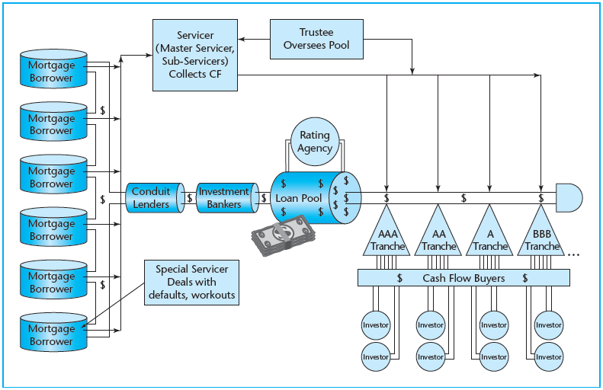
EXHIBIT 20-1 CMBS Securitization Process
© OnCourse Learning

Slide 6
20.1.1 A Brief History of the CMBS Industry

Slide 7
20.1.2 Magnitude of the CMBS Industry and Its “Rise and Fall” (and Rebirth?)

Slide 8
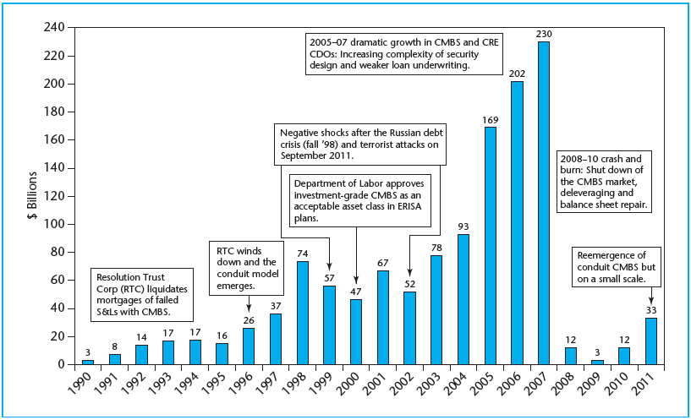
EXHIBIT 20-2 CMBS Issuance, U.S., 1990–2011
Source: Based on data from Commercial Mortgage Alert and Clodfelter (2005).

Slide 9
20.2 CMBS Structure: Pooling, Tranching, and Subordination

Slide 10
20.2.1 A Simplified Numerical Example of Tranching

Slide 11
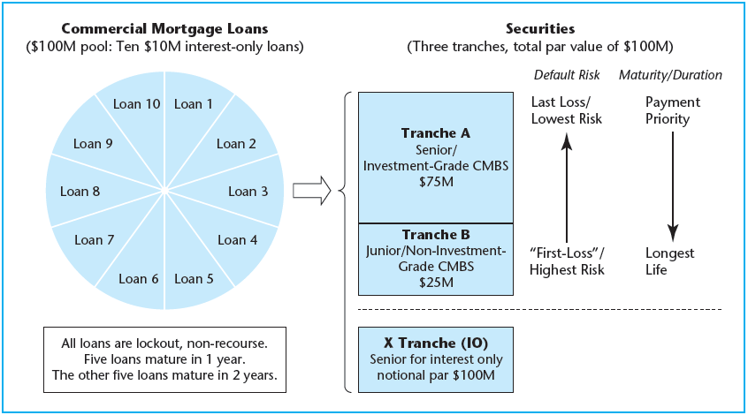
EXHIBIT 20-3 CMBS Mortgage Securitization Basics: Numerical Example of Tranching and Senior/Subordinate Structure
© OnCourse Learning

Slide 12
20.2.2 Allocating the Credit Losses

Slide 13
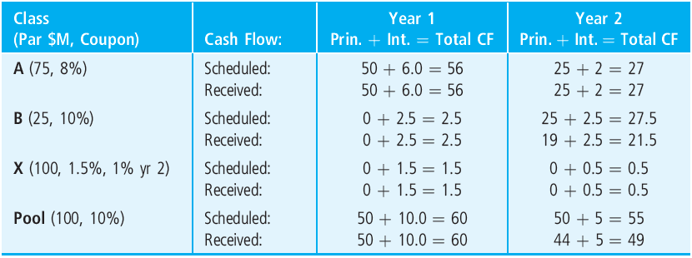
EXHIBIT 20-4 Contract vs. Ex Post (Realized) Cash Flows by Tranche and Year
© OnCourse Learning

Slide 14
EXHIBIT 20-5 Summary of CMBS Example Bond Characteristics, Values, and Ex Post Realized Returns
© OnCourse Learning
*YTM (yield to maturity reflects pricing of bond classes as determined in the bond market at the time of the IPO.
†Year 0 cash flow is negative of initial market value as CMBS, proceeds from IPO (assumed Year 0). The value of each tranche is determined by taking the present value of contractual cash flows at the yield to maturity. For example, for tranche B,
‡Class B realized cash flow in Year 2 is $6.0 million less than contractual cash flow, due to credit losses.
§The realized yield is the IRR earned on the investment, ex post, assuming that investors paid “Value as CMBS” for each tranche. For tranche B investors,

Slide 15
20.2.3 Unbundling, Specialization, and Value Creation

Slide 16
20.3 CMBS Rating and Yields

Slide 17
20.3.1 Bond Credit Rating

Slide 18
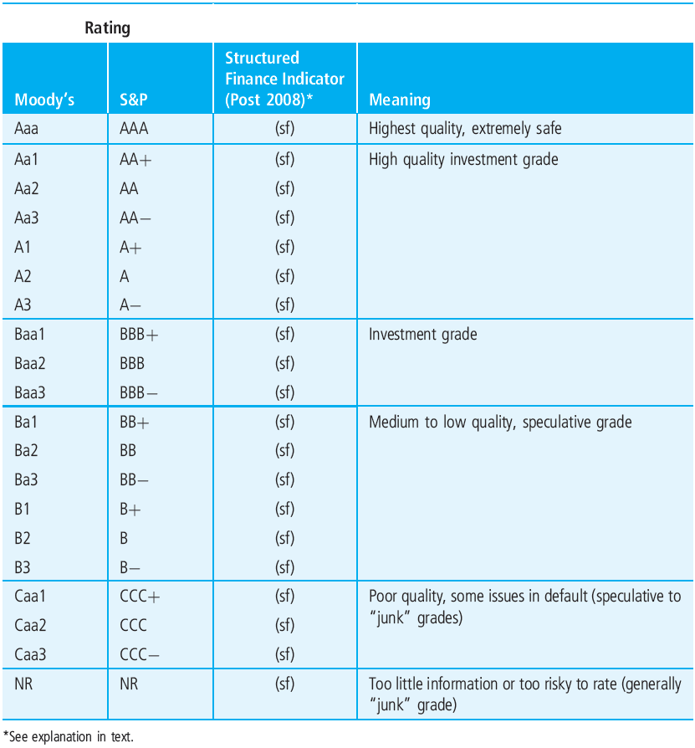
EXHIBIT 20-6 Bond Ratings for CMBS
© OnCourse Learning

Slide 19
20.3.2 Credit Rating, Market Yields, and CMBS Structure

Slide 20
20.4 Lessons from the Financial Crisis

Slide 21
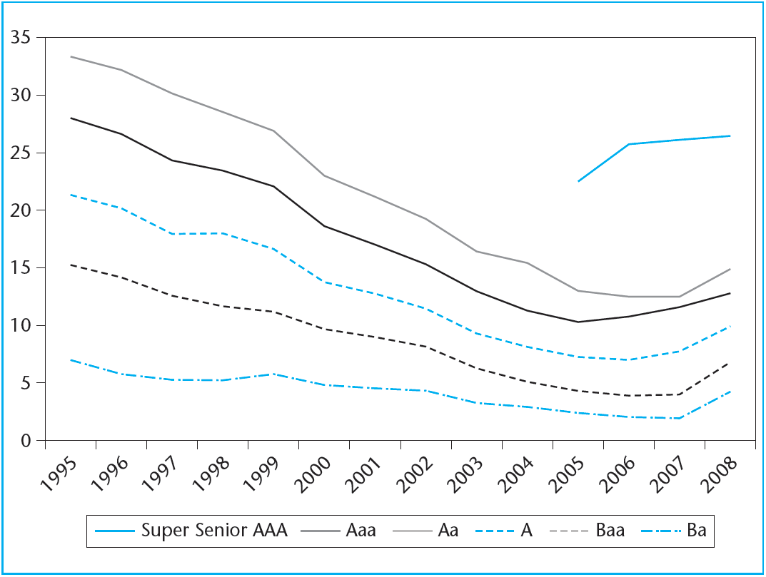
EXHIBIT 20-7 History of CMBS Subordination Levels, 1995–2008 (pre-crisis)
Source: Authors’ correspondence with Moody’s Investors.

Slide 22
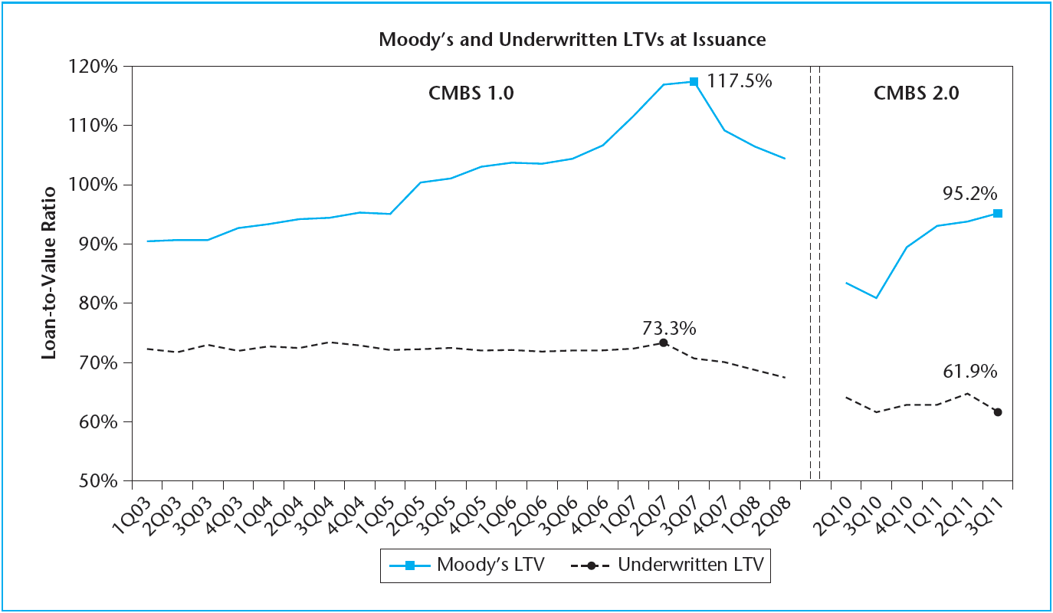
EXHIBIT 20-8 CMBS Conduit Loans LTVs at Issuance, as Underwritten by Issuers and as Haircutted by Moody’s, 2003–2011
Source: Moody’s Investors Service, Trepp LLC, September 2011. © Moody’s Investors Service, Inc. and/or its affiliates. Reprinted with permission. All Rights Reserved.

Slide 23
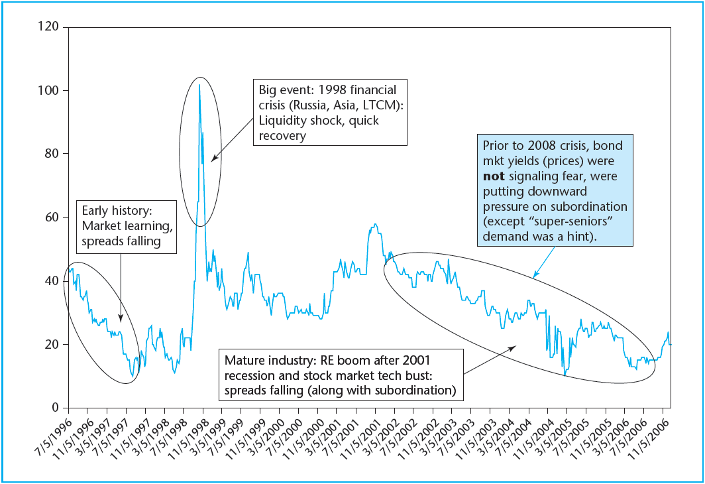
EXHIBIT 20-9 CMBS AAA Spreads over LIBOR Swaps, 1996–2006
© OnCourse Learning

Slide 24
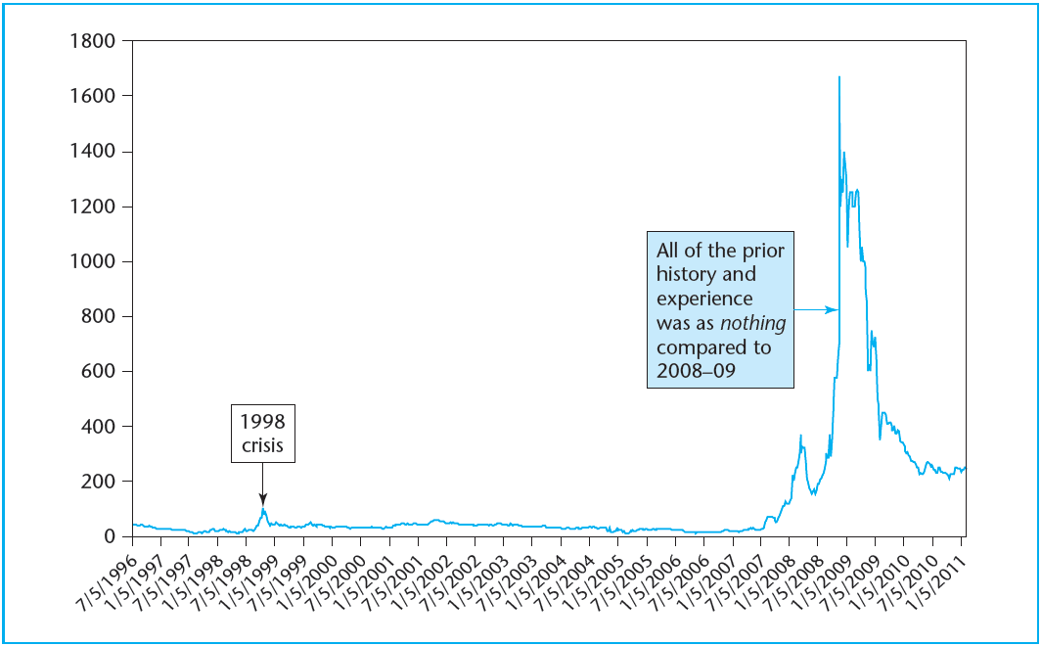
EXHIBIT 20-10 CMBS AAA Spreads to Swaps: 1996–2010
© OnCourse Learning

Slide 25
20.5 Chapter Summary

Slide 26
KEY TERMS
securitization
commercial mortgage-backed securities (CMBS)
tranches, tranching
unbundling or partitioning
conduit loans
weighted average coupon (WAC)
weighted average maturity (WAM)
waterfall
first-loss tranche (or “B-piece”)
levered debt
lockout
penalty
fixed percent of the remaining mortgage loan balance
yield maintenance (YM)
defease
pool servicer
specialization
standardization
B-piece buyers
special servicers
bond credit rating
investment grade
speculative grade
moral hazard
adverse selection

