Slide 1
Chapter 17
Mortgage Basics II: Payments, Yields, and Values

Slide 2
CHAPTER OUTLINE
17.1 Calculating Loan Payments and Balances
17.1.1 Four Basic Rules
17.1.2 Applying the Rules to Design Loans
17.2 Loan Yields and Mortgage Valuation
17.2.1 Computing Mortgage Yields
17.2.2 Why Points and Fees Exist
17.2.3 Using Yields to Value Mortgages
17.3 Refinancing Decision
17.3.1 Traditional Refinancing Calculation
*17.3.2 What Is Left Out of the Traditional Calculation: Prepayment Option Value
17.4 Chapter Summary

Slide 3
LEARNING OBJECTIVES
After reading this chapter, you should understand:
After reading this chapter, you should understand:
How to compute mortgage payments and balances for a variety of different types of loans, and how to creatively design your own customized loans.
How to compute mortgage yields, and how to use mortgage yields to evaluate mortgages.
The nature of the refinancing and prepayment decision, including the ability at some level to quantitatively evaluate this decision from a market value perspective.

Slide 4
17.1 Calculating Loan Payments and Balances

Slide 5
17.1.1 Four Basic Rules

Slide 6
17.1.2 Applying the Rules to Design Loans

Slide 7
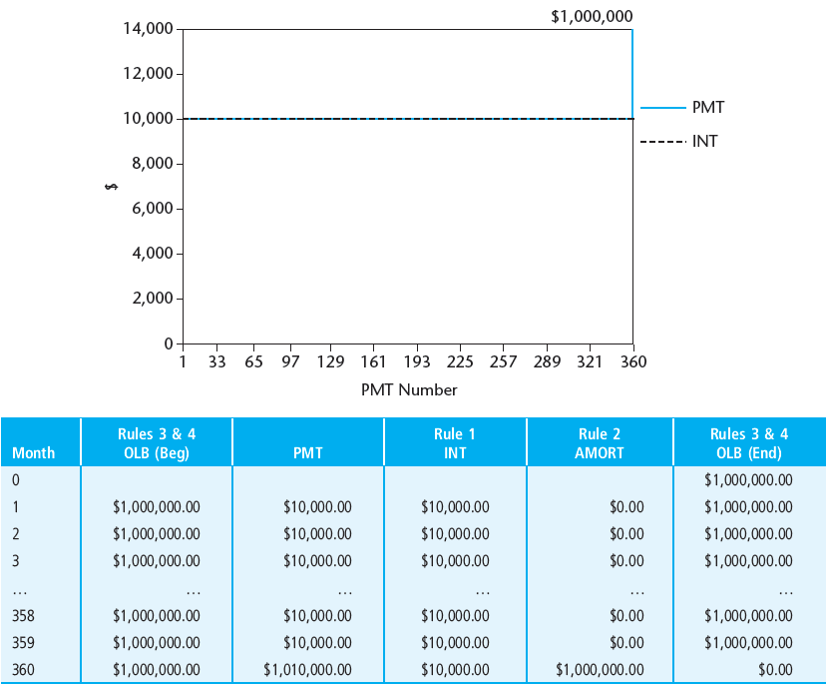
EXHIBIT 17-1 Interest-Only Mortgage Payments and Interest Component ($1 million, 12%, 30-year, monthly payments)
© OnCourse Learning

Slide 8
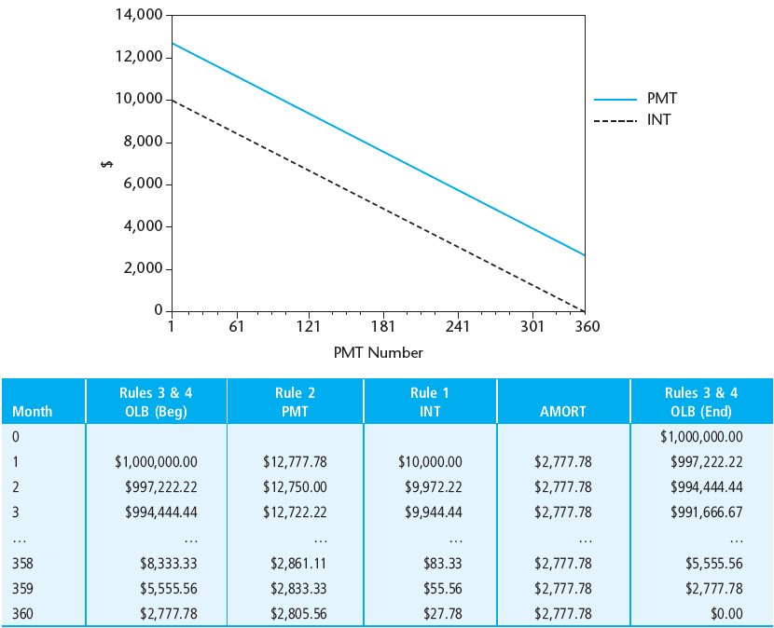
EXHIBIT 17-2 Constant-Amortization Mortgage (CAM) Payments and Interest Component ($1 million, 12%, 30-year, monthly payments)
© OnCourse Learning

Slide 9
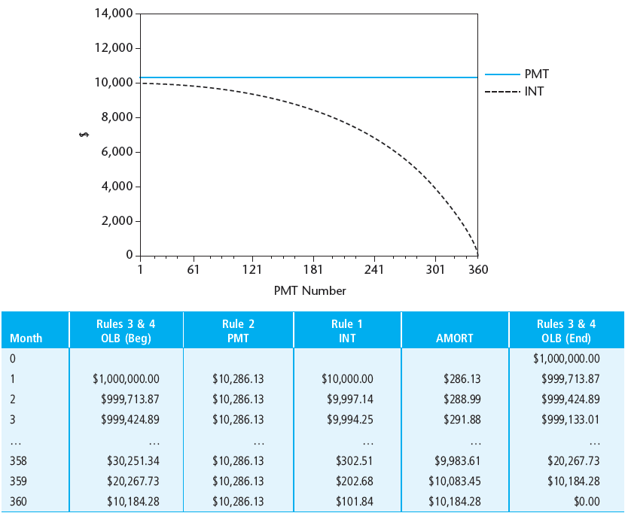
EXHIBIT 17-3 Constant-Payment Mortgage (CPM) Payments and Interest Component ($1 million, 12%, 30-year, monthly payments)
© OnCourse Learning

Slide 10
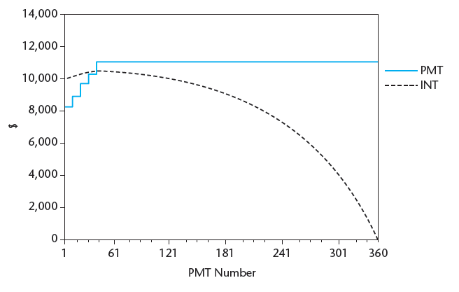
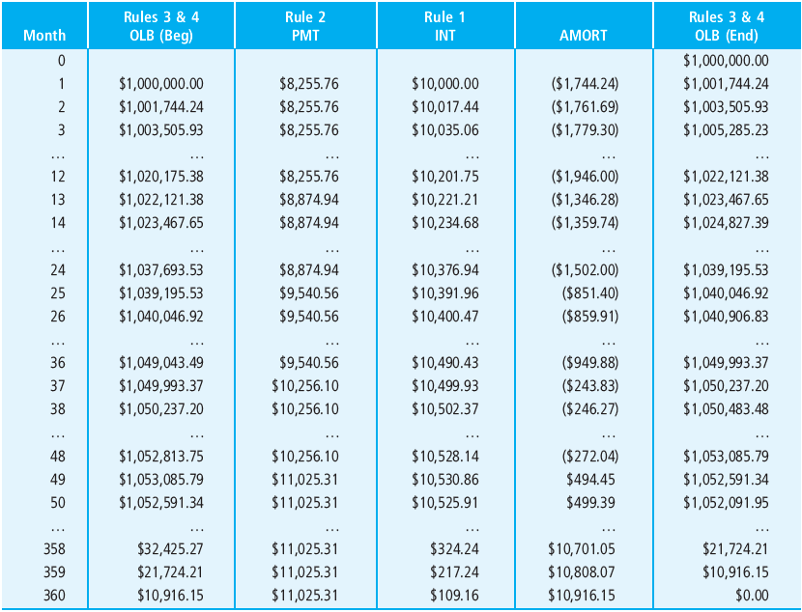
EXHIBIT 17-4 Graduated Payment Mortgage (GPM) Payments and Interest Component ($1 million, 12%, 30-year, monthly payments; 4 annual steps of 7.5%)
© OnCourse Learning

Slide 11
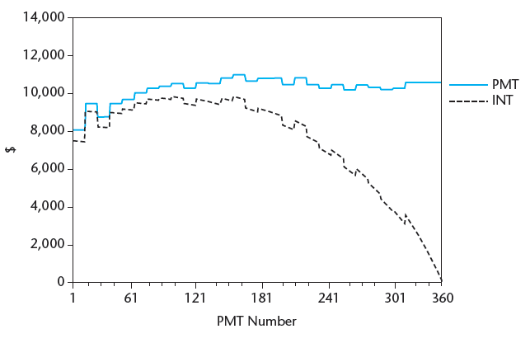
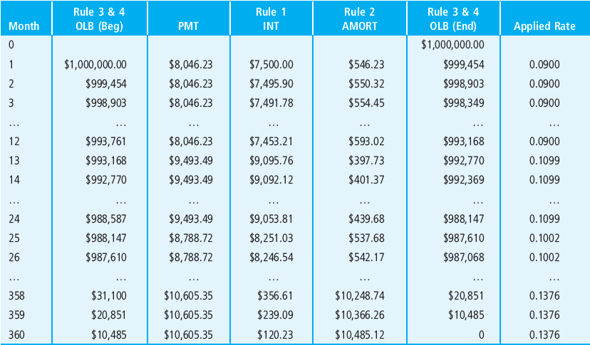
EXHIBIT 17-5 Adjustable Rate Mortgage (ARM) Payments and Interest Component ($1 million, 9% initial interest, 30-year, monthly payments; one-year adjustment interval, possible hypothetical history)
© OnCourse Learning

Slide 12
17.2 Loan Yields and Mortgage Valuation

Slide 13
17.2.1 Computing Mortgage Yields

Slide 14
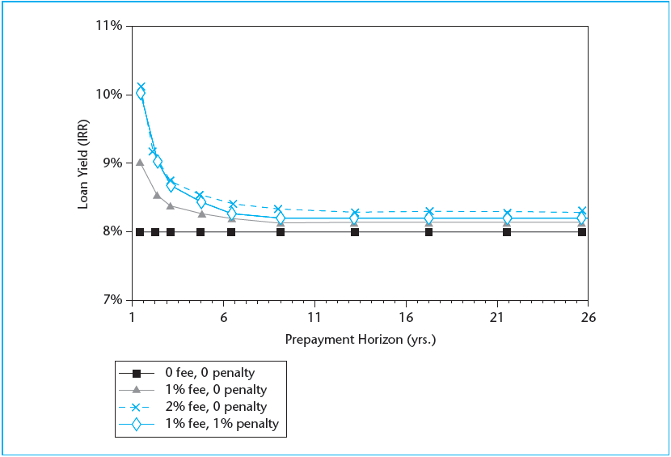
EXHIBIT 17-6A Effect of Prepayment on Loan Yield (8%, 30-year)
© OnCourse Learning

Slide 15
EXHIBIT 17-6B Yield (IRR) on 8%, 30-year CP-FRM
© OnCourse Learning

Slide 16
17.2.2 Why Points and Fees Exist

Slide 17
17.2.3 Using Yields to Value Mortgages

Slide 18
17.3 Refinancing Decision

Slide 19
17.3.1 Traditional Refinancing Calculation

Slide 20
*17.3.2 What Is Left Out of the Traditional Calculation: Prepayment Option Value

Slide 21
17.4 Chapter Summary

Slide 22
KEY TERMS
four basic rules of payments and balances
outstanding loan balance (OLB)
contract principal (L)
interest owed (INT)
amortization of principal (AMORT)
payment amount (PMT)
contract interest rate (r)
interest-only loan
constant-amortization mortgage (CAM)
constant-payment mortgage (CPM)
balloon payment
graduated payment mortgage (GPM)
negative amortization
adjustable rate mortgage (ARM)
yield curve

Slide 23
KEY TERMS (continued)
margin (in ARM)
index (in ARM)
teaser rate
fixed rate mortgage (FRM)
yield (IRR)
yield-to-maturity (YTM)
origination fee
discount points
basis points
par value
annual percentage rate (APR)
effective interest rate
prepayment penalty
mortgage menu
mortgage-equivalent yield (MEY)
bond- or coupon-equivalent yield (BEY, CEY)
prepayment option
refinancing
NPV of refinancing
contingent value

