Slide 1
Chapter 16
Mortgage Basics I: An Introduction and Overview

Slide 2
CHAPTER OUTLINE
16.1 Basic Typology of Mortgages and Overview of the U.S. Mortgage Industry
16.2 Basic Legal Concepts and Terminology for Mortgages
16.2.1 Legal Structure of Mortgages
16.2.2 Priority of Claims in Foreclosure
16.2.3 Typical Mortgage Covenants
16.3 Default, Foreclosure, and Bankruptcy
16.4 Nonlitigious Actions and Workouts
16.4.1 Costs of Foreclosure
16.4.2 Nonlitigious Actions
16.4.3 Workouts
16.5 Limited Liability and Foreclosure Costs: The Borrower’s Put Option and Strategic Default
16.5.1 Limited Liability and the Borrower’s Put
16.5.2 Foreclosure Costs and Strategic Default
16.6 Chapter Summary

Slide 3
LEARNING OBJECTIVES
After reading this chapter, you should understand:
The legal and financial structure of mortgages.
The major different types of real estate mortgages in the United States and how the mortgage industry works.
The major legal terms and legal characteristics of mortgages.
The nature and costs of the foreclosure process and the workout process as a way to avoid foreclosure.

Slide 4
Introduction

Slide 5
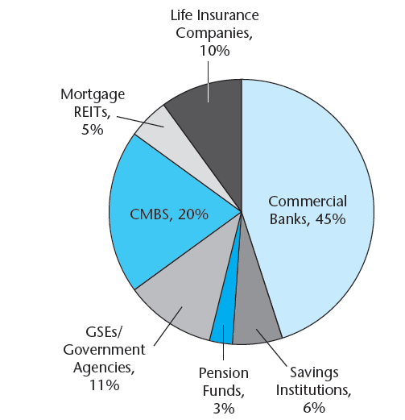
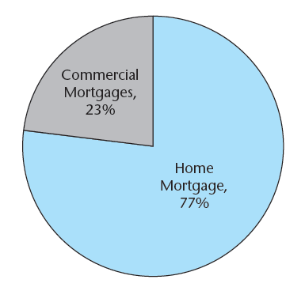
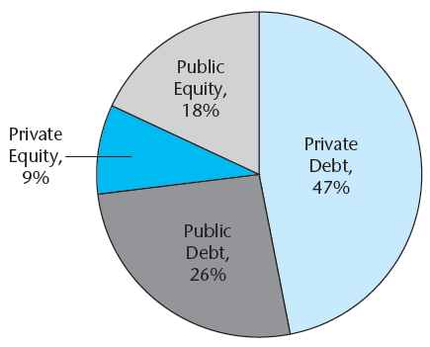
EXHIBIT 16-1 Overview of U.S. Mortgage Debt Outstanding as of 2011
Panel A U.S. Mortgages Outstanding, 2011 $13.5 trillion
Panel B U.S. Institutional Commercial Real Estate Capital Structure, 2011 $4.1 trillion
Panel C U.S. Commercial Mortgages Sources, 2011 $3 trillion outstanding
Sources: FRB, CoStar Group Inc.

Slide 6
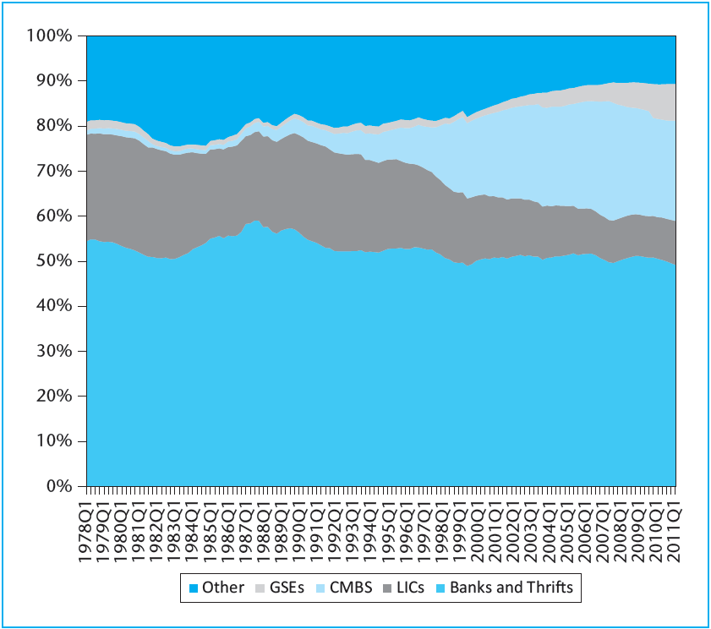
EXHIBIT 16-2 U.S. Commercial and Multifamily Mortgages Share of Outstanding Balance Held by Various Capital Sources, 1978–2011
Source: Federal Reserve Board.

Slide 7
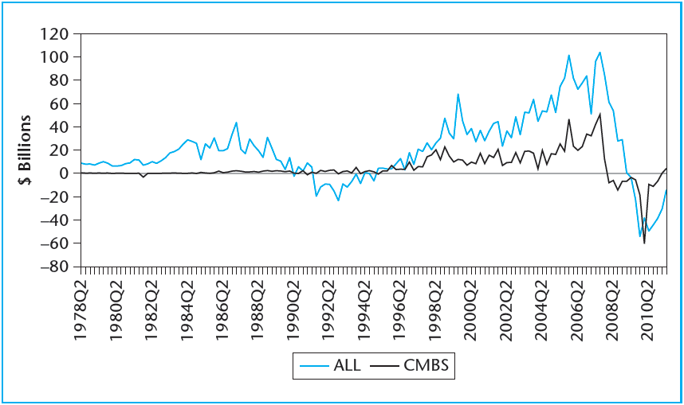
EXHIBIT 16-3 U.S. Commercial and Multifamily Quarterly Mortgage Flows, 1978–2011 (Change in Balance Outstanding)
Source: Based on data from the Federal Reserve.

Slide 8
16.1 Basic Typology of Mortgages and Overview of the U.S. Mortgage Industry

Slide 9
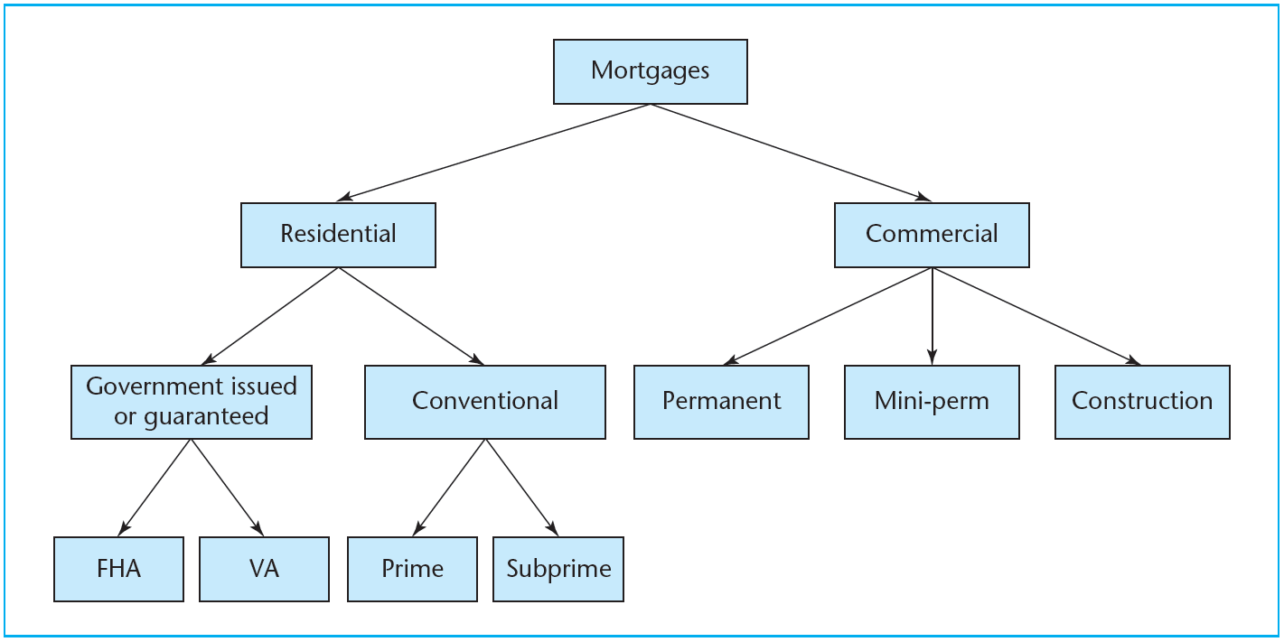
EXHIBIT 16-4 Typology of U.S. Mortgages
© OnCourse Learning

Slide 10
16.2 Basic Legal Concepts and Terminology for Mortgages

Slide 11
16.2.1 Legal Structure of Mortgages

Slide 12
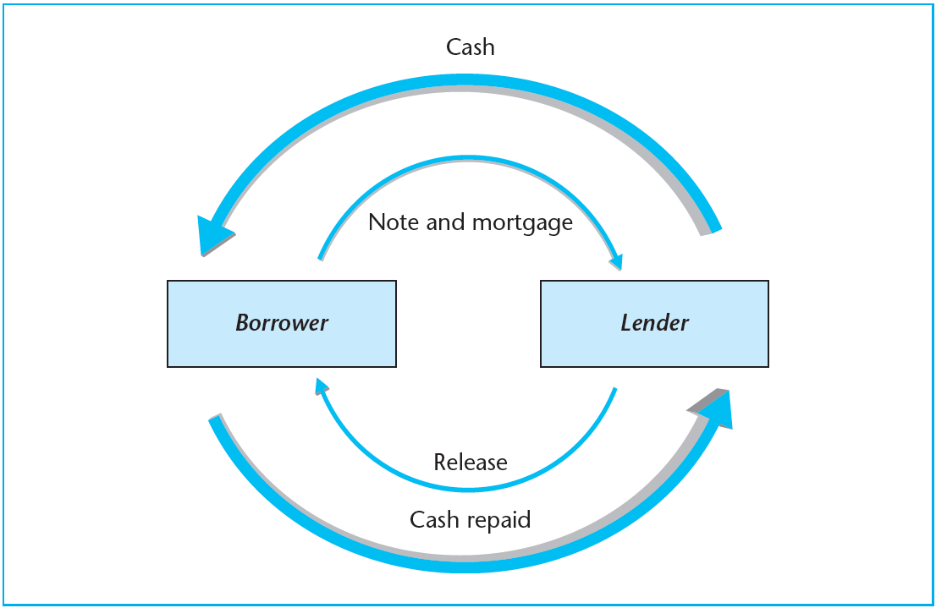
EXHIBIT 16-5 Mortgage Deed Relationships
© OnCourse Learning

Slide 13
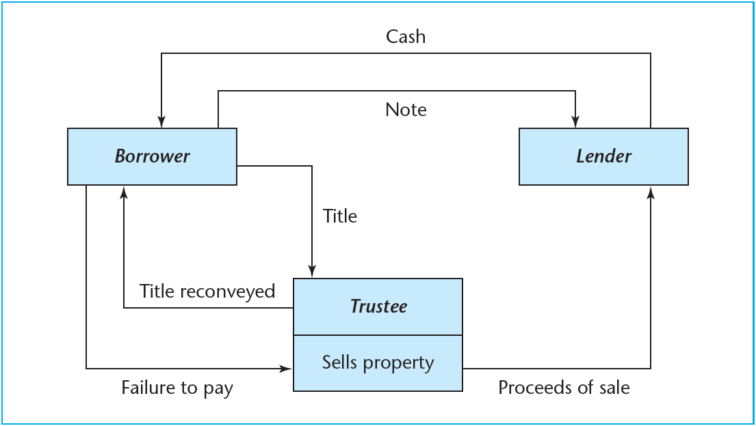
EXHIBIT 16-6 Deed of Trust Relationships
© OnCourse Learning

Slide 14
16.2.2 Priority of Claims in Foreclosure

Slide 15
16.2.3 Typical Mortgage Covenants

Slide 16
16.3 Default, Foreclosure, and Bankruptcy

Slide 17
16.4 Nonlitigious Actions and Workouts

Slide 18
16.4.1 Costs of Foreclosure

Slide 19
16.4.2 Nonlitigious Actions

Slide 20
16.4.3 Workouts

Slide 21
16.5 Limited Liability and Foreclosure Costs: The Borrower’s Put Option and Strategic Default

Slide 22
16.5.1 Limited Liability and the Borrower’s Put

Slide 23
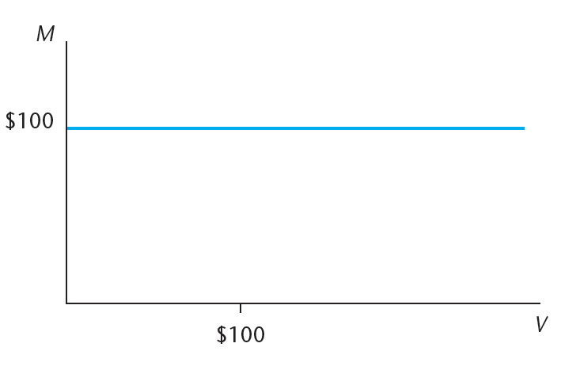
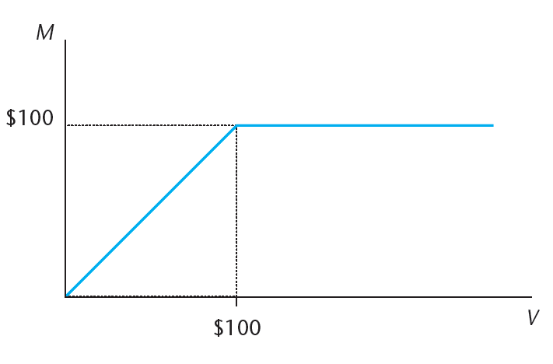
EXHIBIT 16-7 Value (M) of a $100 Mortgage at Maturity as a Function of the Underlying Property Value (V)
Panel A Without Limited Liability
Panel B With Limited Liability (showing effect of borrower’s put)
© OnCourse Learning

Slide 24
16.5.2 Foreclosure Costs and Strategic Default

Slide 25
16.6 Chapter Summary

Slide 26
KEY TERMS
mortgage
whole loans
residential mortgage
commercial mortgage
secondary mortgage market
primary mortgage market
origination (issuance) of loans
securitization
commercial mortgage-backed securities (CMBS)
permanent loans
construction loans
interest rate risk
floating interest rates
adjustable rate mortgages (ARMs)
depository institutions
mortgage bankers
mortgage brokers
take-out loan
collateralized debt obligation (CDO)
secured debt

Slide 27
KEY TERMS (continued)
mortgagee
mortgagor
promissory note
mortgage deed
deed of trust (security deed)
lien theory
title theory
power of sale
judicial sale
foreclosure
senior and junior debt
covenants
order of application of payments
acceleration clause
due-on-sale clause
loan assumption
wraparound loan
prepayment clause
defeasance
subordination clause
nonrecourse loans

Slide 28
KEY TERMS (continued)
default
litigious and nonlitigious actions
forbearance
deficiency judgment
bankruptcy
cramdown
Chapter 11 bankruptcy
short sale
deadweight burden
deed in lieu of foreclosure
restructuring loans
workout of loans
limited liability
borrower’s put option
credit risk (credit loss)
strategic default
underwater loans
rational default
reputation effects

