Slide 1
Chapter 15
Real Estate Investment Capital Structure

Slide 2
CHAPTER OUTLINE
15.1 Debt When There Is an Equity Capital Constraint
15.1.1 Debt to Obtain Positive Equity NPV
15.1.2 Debt and Diversification
15.1.3 Limitations on the Equity Constraint Argument for the Use of Debt
15.2 Other Considerations Regarding the Role of Debt in Real Estate Investments
15.2.1 Debt as an Incentive and Disciplinary Tool for Management
15.2.2 Debt and Liquidity
15.2.3 Cost of Financial Distress
15.2.4 Debt and Inflation
15.3 Project-Level Capital Structure in Real Estate
15.3.1 Enriching the Traditional Capital Structure Plate
15.3.2 Numerical Example of Multi-Tiered Project Capital Structure
15.3.3 Analyzing Project-Level Capital Structure: An Example Application of Sensitivity Analysis
15.4 Chapter Summary

Slide 3
LEARNING OBJECTIVES
After reading this chapter, you should understand:
What is meant by capital structure and the major pros and cons for the use of debt financing of real estate equity investments for different types of investors.
What is meant by an equity capital constraint and how this can affect the value of debt financing.
The relationship between the use of debt financing and such considerations as management incentives, investor liquidity, and inflation.
The costs of financial distress and how these are affected by the use of debt.
Typical capital structures used in micro-level real estate investment (project-level financing).

Slide 4
15.1 Debt When There Is an Equity Capital Constraint

Slide 5
15.1.1 Debt to Obtain Positive Equity NPV

Slide 6
15.1.2 Debt and Diversification

Slide 7
15.1.3 Limitations on the Equity Constraint Argument for the Use of Debt

Slide 8
15.2 Other Considerations Regarding the Role of Debt in Real Estate Investments

Slide 9
15.2.1 Debt as an Incentive and Disciplinary Tool for Management

Slide 10
15.2.2 Debt and Liquidity

Slide 11
15.2.3 Cost of Financial Distress

Slide 12
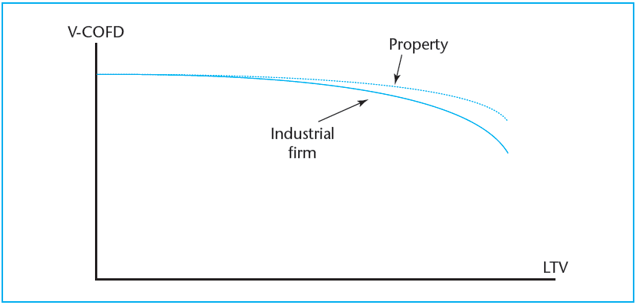
EXHIBIT 15-1 Effect of Expected Costs of Financial Distress (COFD) on the Value of the Firm and on Property Value
© OnCourse Learning

Slide 13
15.2.4 Debt and Inflation

Slide 14
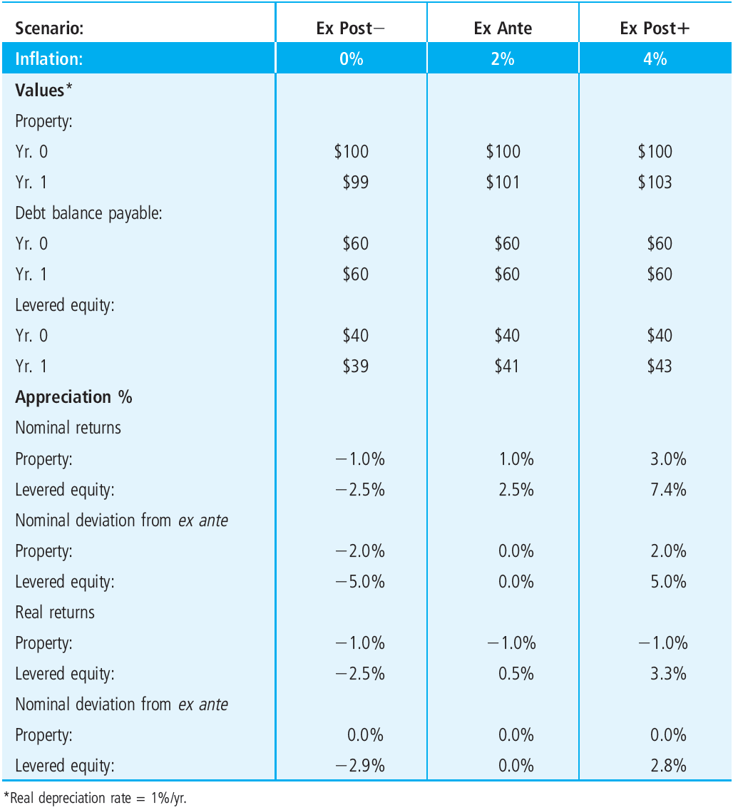
EXHIBIT 15-2 Example of Effect of Inflation on Ex Post Levered Equity Appreciation Returns with One-Year Loan
© OnCourse Learning

Slide 15
15.3 Project-Level Capital Structure in Real Estate

Slide 16
15.3.1 Enriching the Traditional Capital Structure Plate

Slide 17
15.3.2 Numerical Example of Multi-Tiered Project Capital Structure

Slide 18
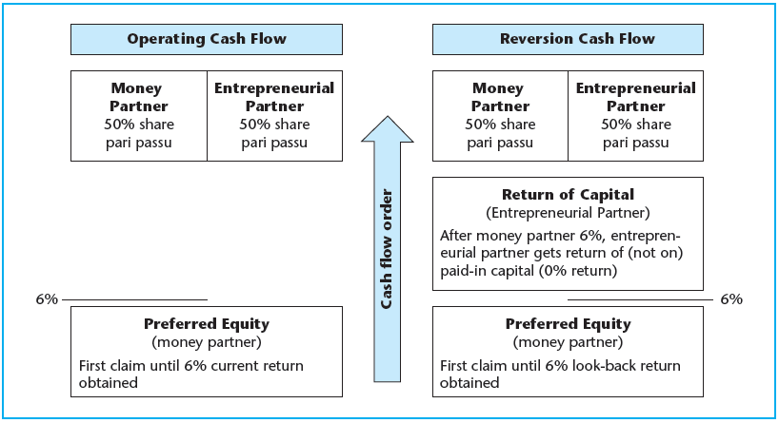
EXHIBIT 15-3 Apartment Example Waterfall Illustration
© OnCourse Learning

Slide 19
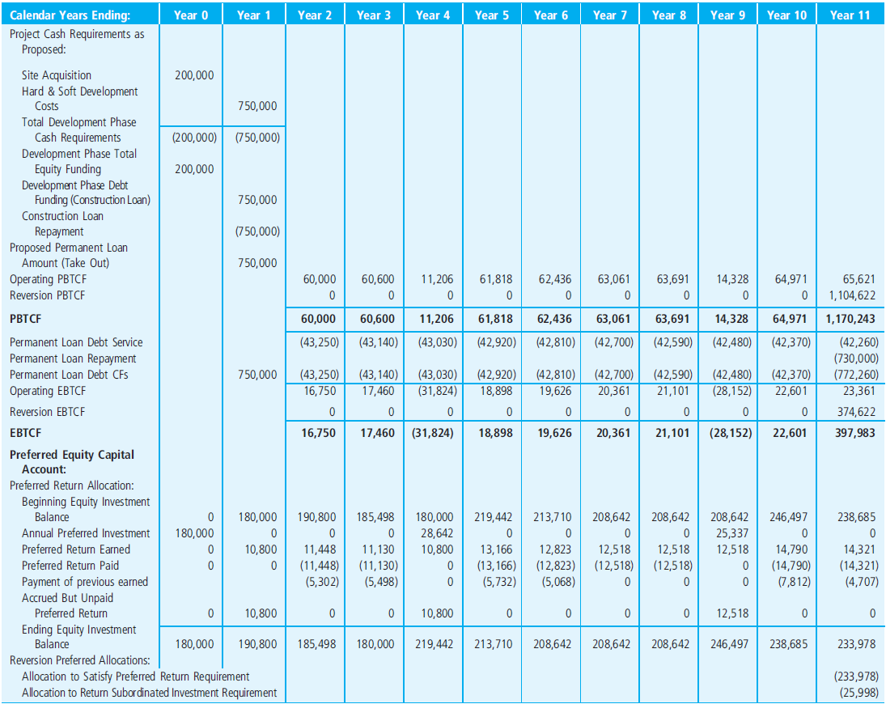
EXHIBIT 15-4 Apartment Property Example Cash Flows, Splits, and Returns
© OnCourse Learning

Slide 20
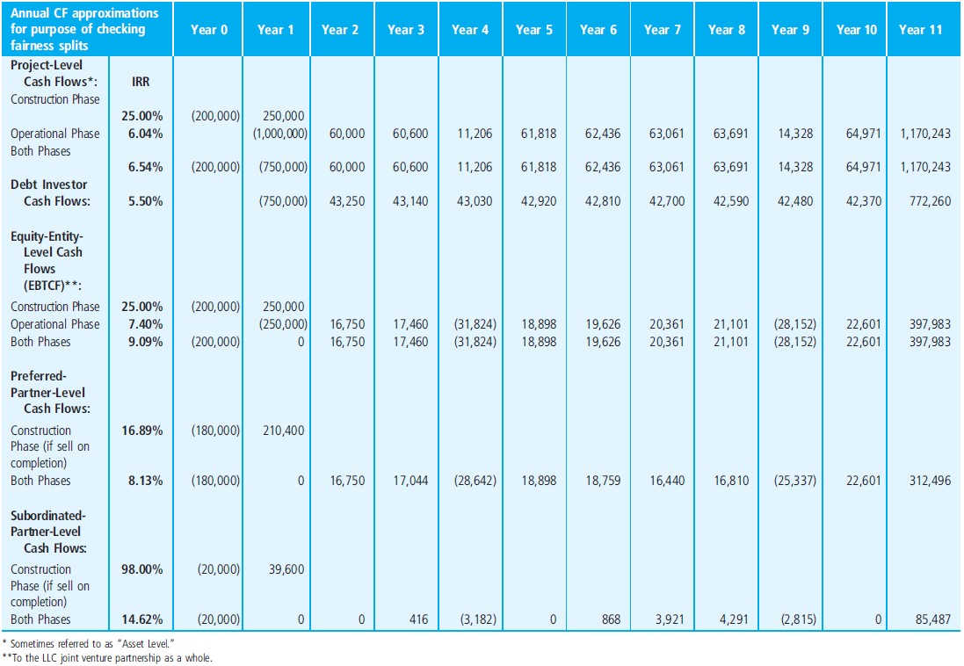
EXHIBIT 15-4 Apartment Property Example Cash Flows, Splits, and Returns
(continued)
© OnCourse Learning

Slide 21
15.3.3 Analyzing Project-Level Capital Structure: An Example Application of Sensitivity Analysis

Slide 22
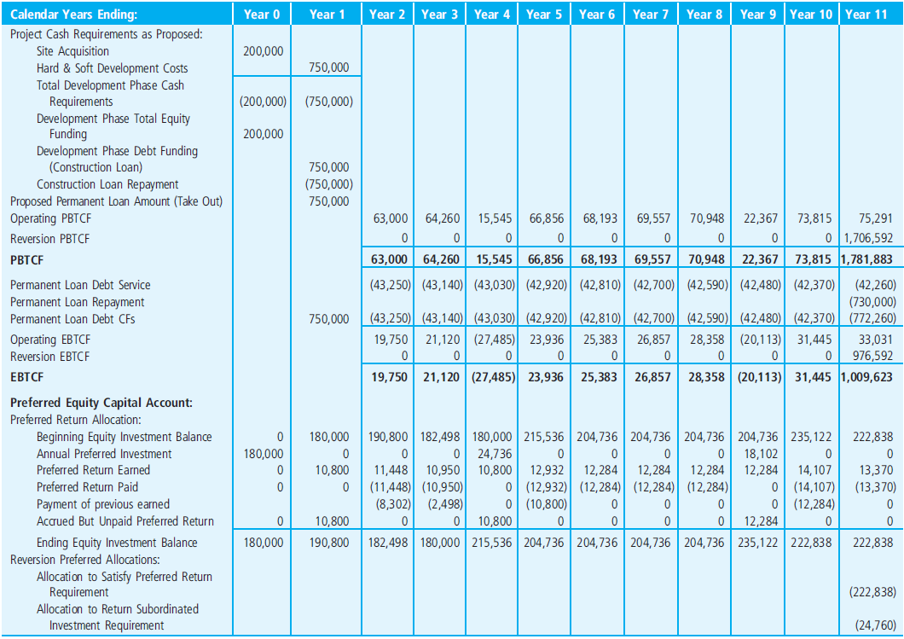
EXHIBIT 15-5A Apartment Property Example Cash Flows, Splits, and Returns, Optimistic Scenario
© OnCourse Learning

Slide 23
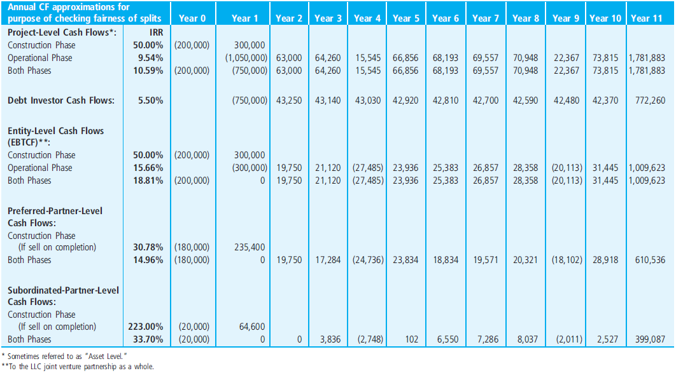
EXHIBIT 15-5A Apartment Property Example Cash Flows, Splits, and Returns, Optimistic Scenario
(continued)
© OnCourse Learning

Slide 24
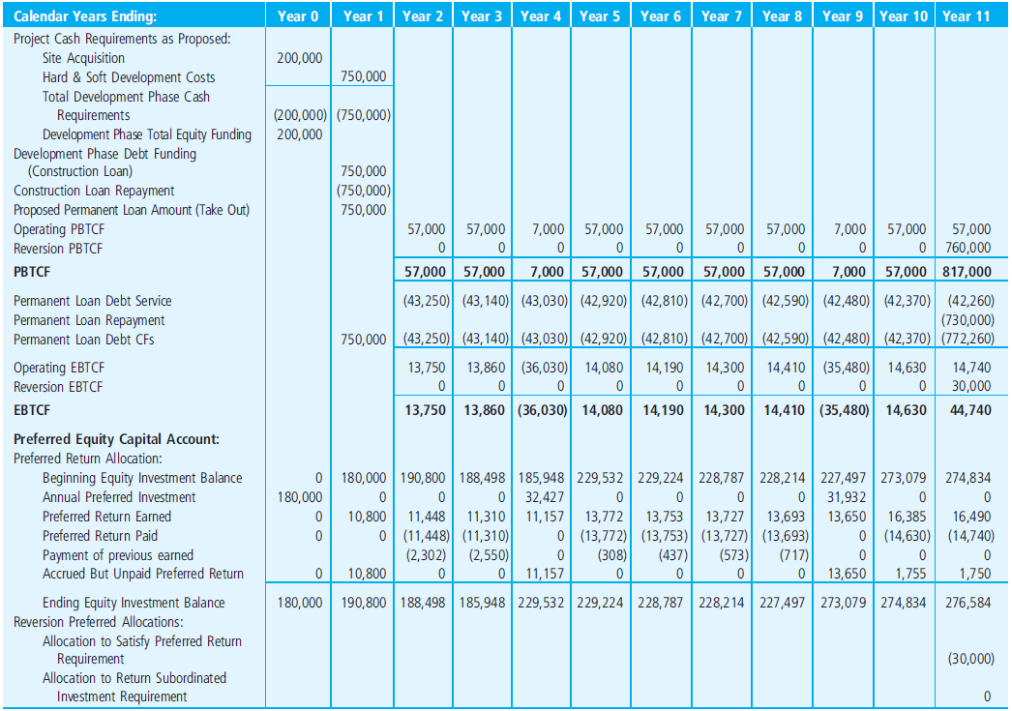
EXHIBIT 15-5B Apartment Property Example Cash Flows, Splits, and Returns, Pessimistic Scenario
© OnCourse Learning

Slide 25
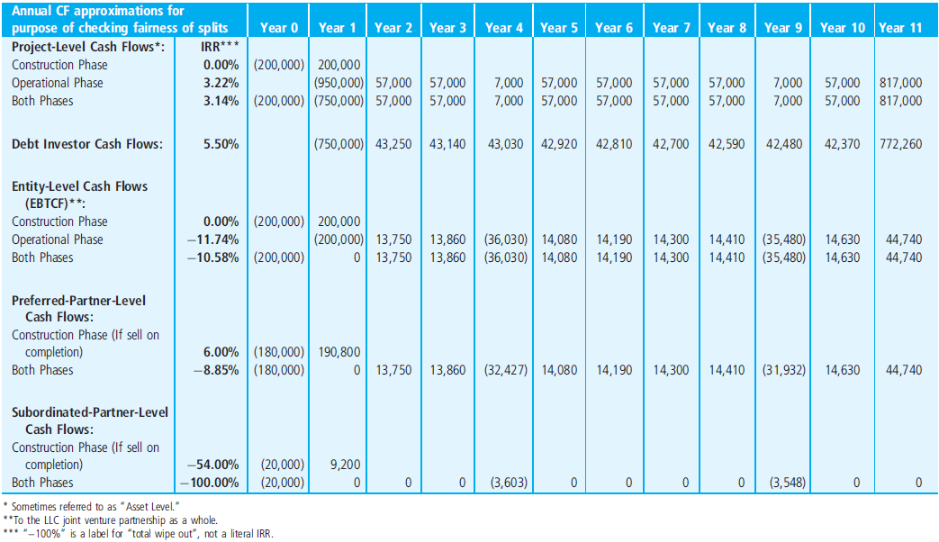
EXHIBIT 15-5B Apartment Property Example Cash Flows, Splits, and Returns, Pessimistic Scenario
(continued)
© OnCourse Learning

Slide 26
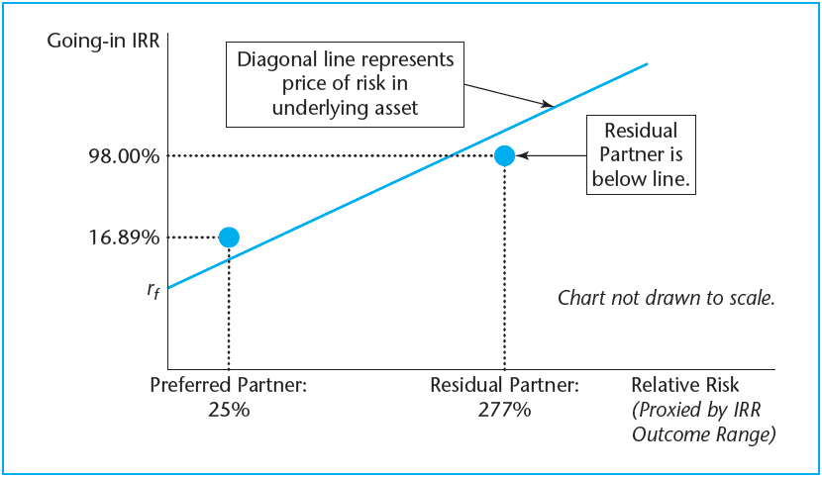
EXHIBIT 15-6 Framework for Evaluating Fairness of Capital Structure Terms
© OnCourse Learning

Slide 27
15.4 Chapter Summary

Slide 28
KEY TERMS
capital structure
ultimate investors (individuals)
equity capital constraint
human capital
IV-based NPV
diversification (and debt)
banker’s spread
control and governance issues
management incentives
liquidity
decision flexibility
costs of financial distress (COFD)
third-party costs
foreclosure
bankruptcy
agency costs
limited liability

Slide 29
KEY TERMS
(continued)
ex ante costs (probabilistic expectations)
inflation
hedging inflation risk
real returns
reverse-inflation risk
multiple-note mortgages
mezzanine debt
preferred equity
common (or residual) equity
differentiated equity partners (classes)
joint venture
entrepreneurial partner
money partner
pro rata pari passu
promote (hurdle and preferred return)
capital account
cash flow splits
sensitivity analysis

