Slide 1
Chapter 14
After-Tax Investment Analysis and Corporate Real Estate

Slide 2
CHAPTER OUTLINE
14.1 General Effects of Income Taxes and Debt
14.2 Numerical Example of After-Tax Proforma
  14.2.1 Basic Equity Cash Flow Calculations
  14.2.2 Accrual-Based Income and Tax Shelter
  14.2.3 After-Tax Operating Cash Flow
  14.2.4 After-Tax Reversion Cash Flow
  14.2.5 Cash Flow Components Analysis and Projected Total Return Calculations
14.3 After-Tax Equity Valuation and Capital Budgeting
  14.3.1 After-Tax DCF in General
  14.3.2 Shortcut for Marginal Investors
  *14.3.3 Evaluating Intramarginal Investment Value
  *14.3.4 Value Additivity and the APV Decision Rule
  *14.3.5 After-Tax Valuation of Debt Financing
  *14.3.6 Example Application of APV to Marginal Investor
14.4 Corporate Real Estate: The Own-versus-Rent Decision
14.5 Chapter Summary

Slide 3
LEARNING OBJECTIVES
After reading this chapter, you should understand:
How to extend the micro-level commercial property cash flow proforma projection to the level of the equity investor’s after-tax cash flows.
The major impacts income taxes have on the investor’s cash flows, including the basic effects of tax shields on the after-tax cash flows and investment returns of the levered equity investor.
A rigorous economic framework for analyzing and evaluating after-tax levered equity investment at the micro-level.
How to analyze the buy-versus-lease decision by a profitable taxed corporation.

Slide 4
14.1 General Effects of Income Taxes and Debt

Slide 5
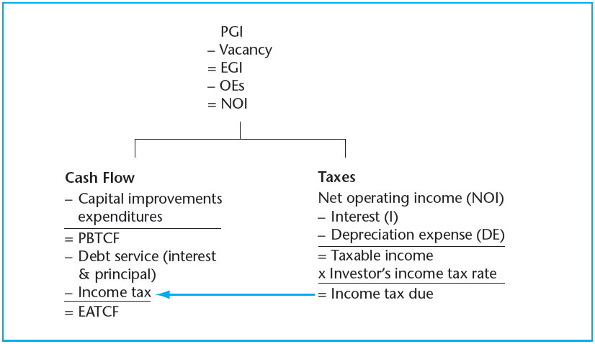
EXHIBIT 14-1A Equity-After-Tax Cash Flows from Operations
© OnCourse Learning

Slide 6
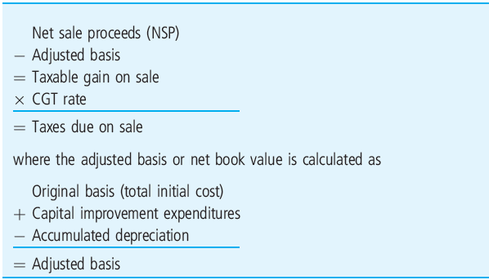
EXHIBIT 14-1B Computation of CGT in Reversion Cash Flow
© OnCourse Learning

Slide 7
14.2 Numerical Example of After-Tax Proforma

Slide 8
14.2.1 Basic Equity Cash Flow Calculations

Slide 9
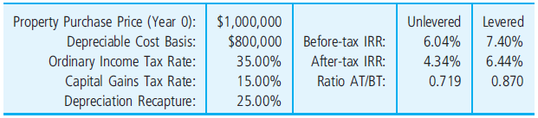
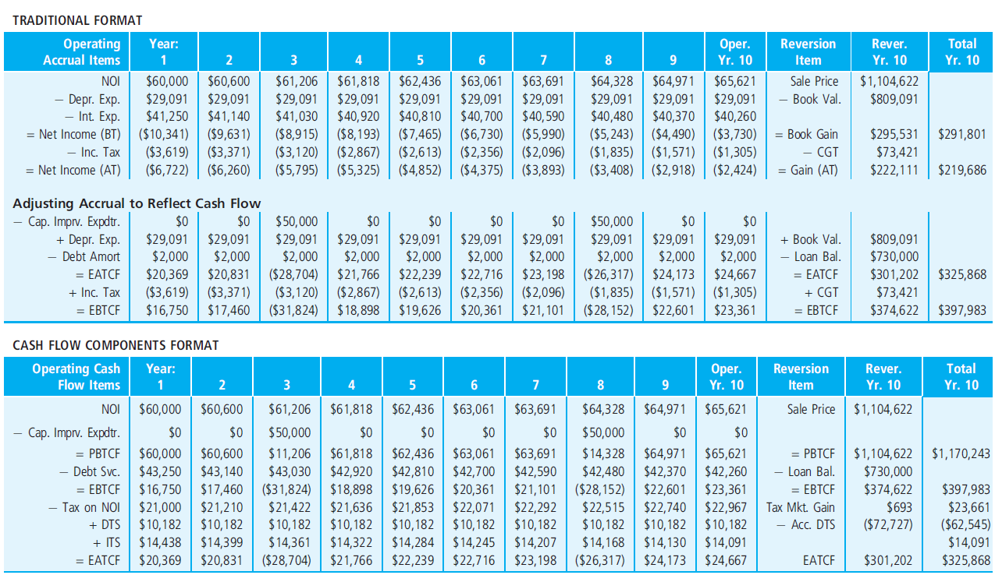
EXHIBIT 14-2 Example After-Tax Income and Cash Flow Proformas
© OnCourse Learning

Slide 10
14.2.2 Accrual-Based Income and Tax Shelter

Slide 11
14.2.3 After-Tax Operating Cash Flow

Slide 12
14.2.4 After-Tax Reversion Cash Flow

Slide 13
14.2.5 Cash Flow Components Analysis and Projected Total Return Calculations

Slide 14
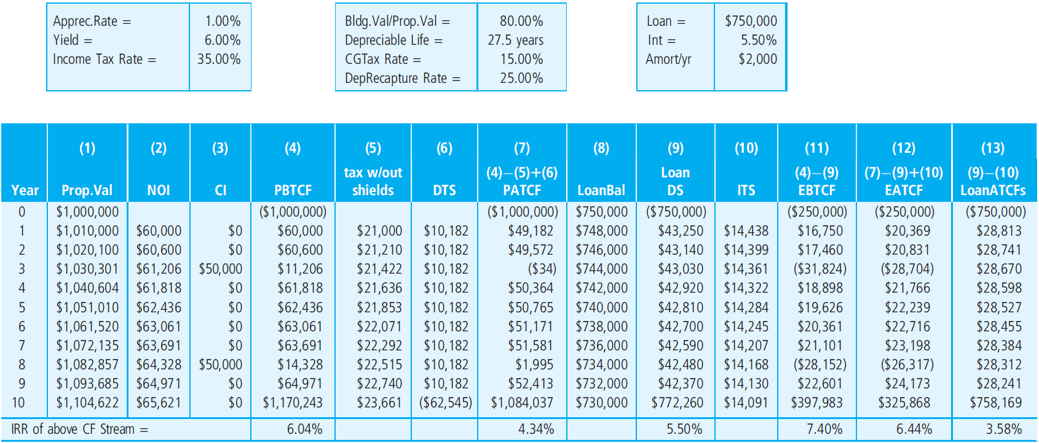
EXHIBIT 14-3 Cash Flow Components Investment Analysis of the Example Apartment Property
Need clean page from Joseph.
© OnCourse Learning

Slide 15
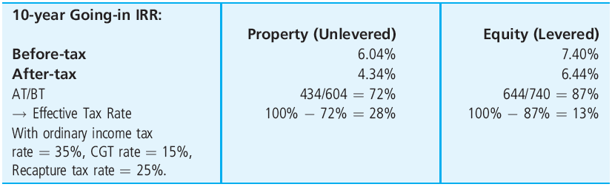
EXHIBIT 14-4 Apartment Example Going-in IRR Estimates
© OnCourse Learning

Slide 16
14.3 After-Tax Equity Valuation and Capital Budgeting

Slide 17
14.3.1 After-Tax DCF in General

Slide 18
14.3.2 Shortcut for Marginal Investors

Slide 19
*14.3.3 Evaluating Intramarginal Investment Value

Slide 20
*14.3.4 Value Additivity and the APV Decision Rule

Slide 21
*14.3.5 After-Tax Valuation of Debt Financing

Slide 22
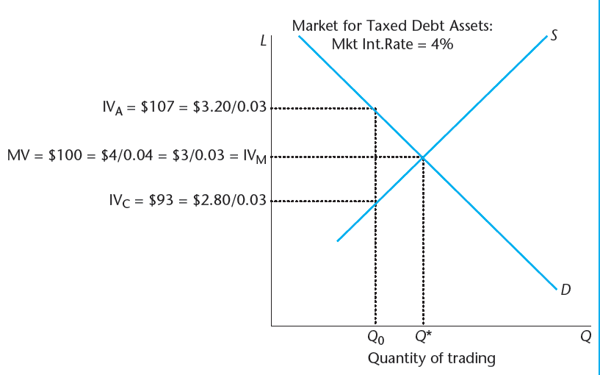
EXHIBIT 14-5 Market Value and Investment Value of Debt for Marginal and Intramarginal Investors Based on Tax Bracket
© OnCourse Learning

Slide 23
*14.3.6 Example Application of APV to Marginal Investor

Slide 24
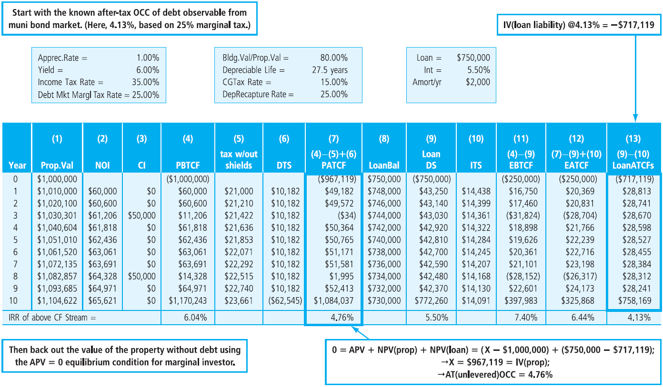
EXHIBIT 14-6 Apartment Property Example Valuation by Components for Marginal Investor
© OnCourse Learning

Slide 25
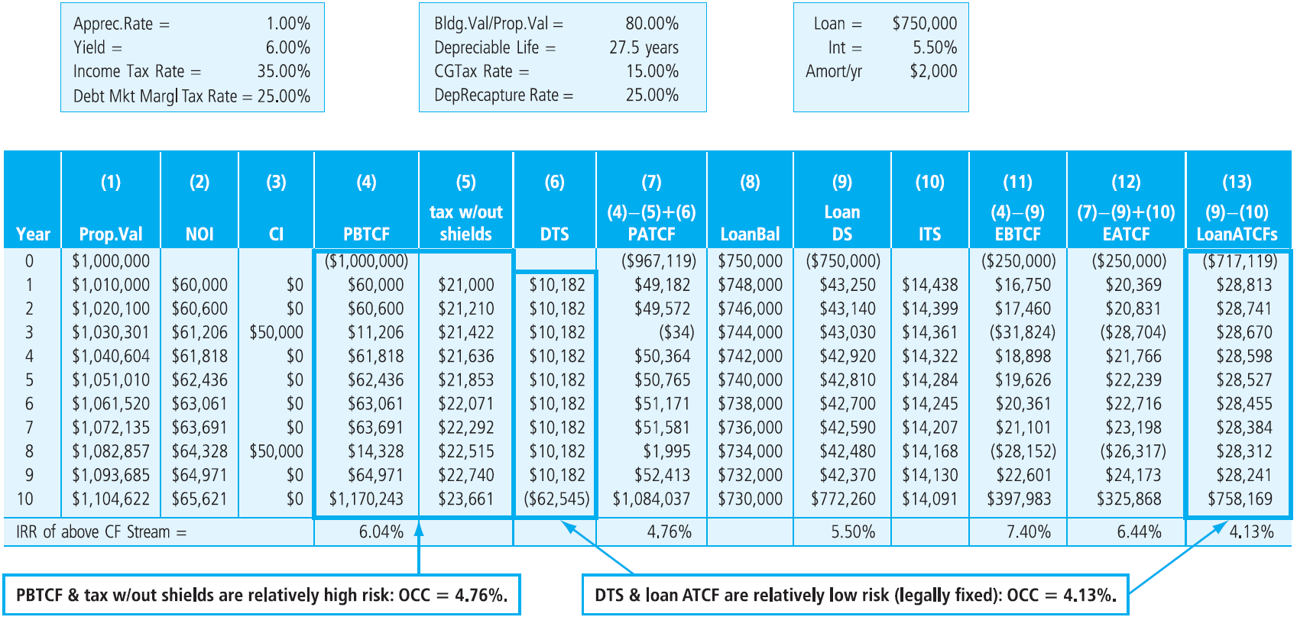
EXHIBIT 14-7 Apartment Property Example Cash Flow Components Grouped by Risk Category
© OnCourse Learning

Slide 26
14.4 Corporate Real Estate: The Own-versus-Rent Decision

Slide 27
14.5 Chapter Summary

Slide 28
KEY TERMS
property-level before-tax cash flows
owner-level after-tax cash flows
depreciation expense
book value
accumulated depreciation
capital expenditures
debt amortization
capital gains tax (CGT)
straight-line depreciation
debt service
interest expense
tax loss
tax shield or tax shelter
equity-after-tax cash flow (EATCF)
equity-before-tax cash flow (EBTCF)
depreciation tax shields (DTS)
interest tax shields (ITS)
depreciable life
ordinary income tax
property-before-tax (PBT) approach
value additivity principle
adjusted present value (APV)
buy-versus-lease (or own-versus-rent) decision

