Slide 1
Chapter 11
Nuts and Bolts for Real Estate Valuation: Cash Flow Proformas and Discount Rates

Slide 2
CHAPTER OUTLINE
11.1 Proformas and Cash Flow Projection
  11.1.1 PGI and Market Rent Projection
  11.1.2 Vacancy Allowance and EGI
  11.1.3 Operating Expenses
  11.1.4 Net Operating Income
  11.1.5 Capital Improvement Expenditures
  11.1.6 The Bottom Line: PBTCF
  11.1.7 Reversion Cash Flows
  11.1.8 Summary of Cash Flow Projection
11.2 Discount Rates: The Opportunity Cost of Capital
  11.2.1 General Observations about Real Estate Discount Rates
  11.2.2 Putting in Some Numbers: The Risk-Free Rate
  11.2.3 Putting in Some More Numbers: Historical Evidence on the OCC for Institutional Commercial Property
  11.2.4 Another Perspective: Survey Evidence
  11.2.5 Getting an Indication of Realistic Total Return Expectations by Observing Current Cap Rates in the Property Market
  11.2.6 Double Checking: Two Perspectives on the OCC Estimate
  11.2.7 Variation in Return Expectations for Different Types of Property
11.3 Chapter Summary

Slide 3
LEARNING OBJECTIVES
After reading this chapter, you should understand:
The components and terminology of the typical commercial property investment cash flow projection proforma.
Some major practical considerations in making realistic commercial property cash flow projections.
Some major practical considerations in estimating the appropriate opportunity cost of capital to use as the discount rate in DCF valuation of commercial property.

Slide 4
11.1 Proformas and Cash Flow Projection

Slide 5
11.1.1 PGI and Market Rent Projection

Slide 6
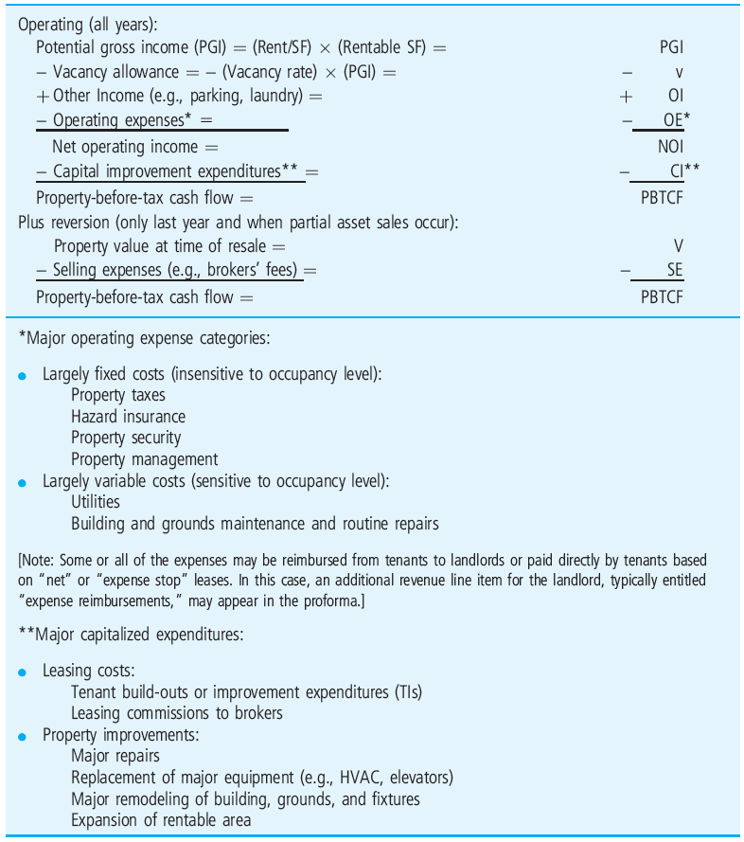
EXHIBIT 11-1 Typical Line Items in a Proforma for Income Property
© OnCourse Learning

Slide 7
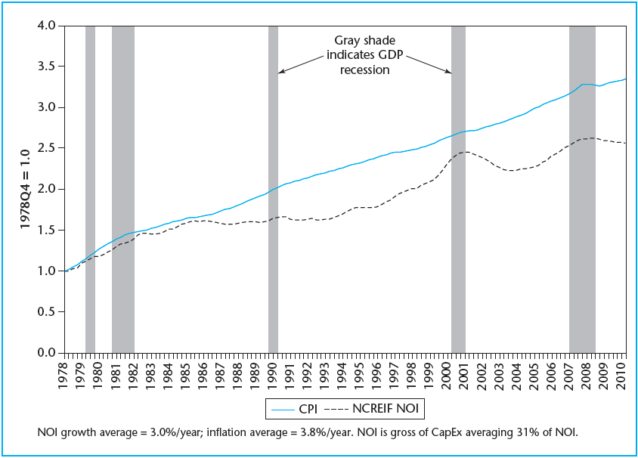
EXHIBIT 11-2 NCREIF Same-Property NOI Growth vs. Inflation, 1979–2011
© OnCourse Learning

Slide 8
11.1.2 Vacancy Allowance and EGI

Slide 9
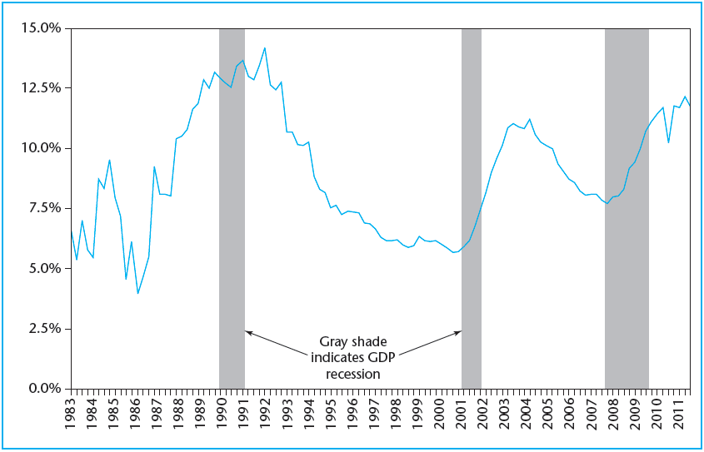
EXHIBIT 11-3 Average Reported Vacancy among NCREIF Properties, 1983–2011
© OnCourse Learning

Slide 10
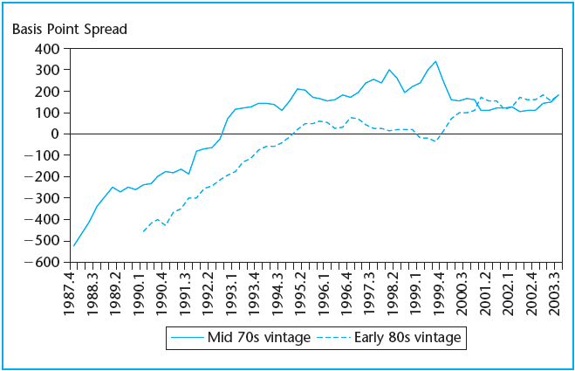
EXHIBIT 11-4 Difference Over Time between Building Vacancy Minus Average Submarket Vacancy (within which the buildings are located) for Two Vintages of Buildings Based on Year of Construction
Source: CBRE/Torto Wheaton Research, “Overview & Outlook,” winter 2004.

Slide 11
11.1.3 Operating Expenses

Slide 12
11.1.4 Net Operating Income

Slide 13
11.1.5 Capital Improvement Expenditures

Slide 14
11.1.6 The Bottom Line: PBTCF

Slide 15
11.1.7 Reversion Cash Flows

Slide 16
11.1.8 Summary of Cash Flow Projection

Slide 17
11.2 Discount Rates: The Opportunity Cost of Capital

Slide 18
11.2.1 General Observations about Real Estate Discount Rates

Slide 19
11.2.2 Putting in Some Numbers: The Risk-Free Rate

Slide 20
11.2.3 Putting in Some More Numbers: Historical Evidence on the OCC for Institutional Commercial Property

Slide 21
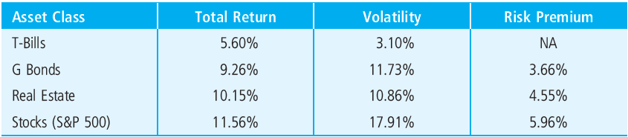
EXHIBIT 11-5 Historical Return, Risk, and Risk Premiums, 1970–2003
Source: Based on data from NCREIF, Ibbotson, TBI.

Slide 22
11.2.4 Another Perspective: Survey Evidence

Slide 23
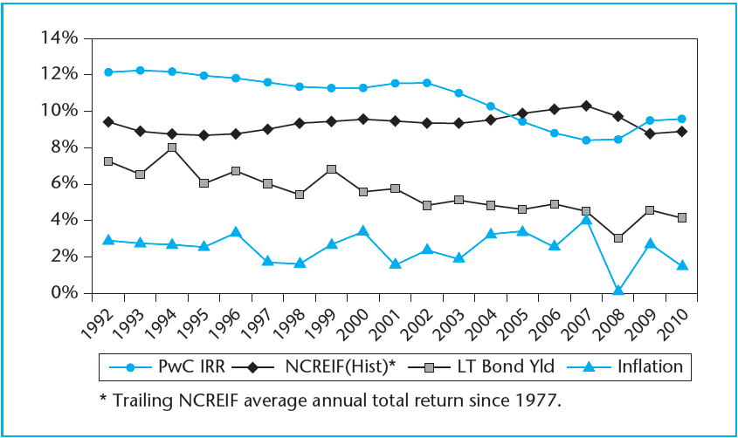
EXHIBIT 11-6 Backward-Looking vs. Forward-Looking Total Returns in the U.S. Institutional Property Market: NCREIF vs. PwC
© OnCourse Learning

Slide 24
11.2.5 Getting an Indication of Realistic Total Return Expectations by Observing Current Cap Rates in the Property Market

Slide 25
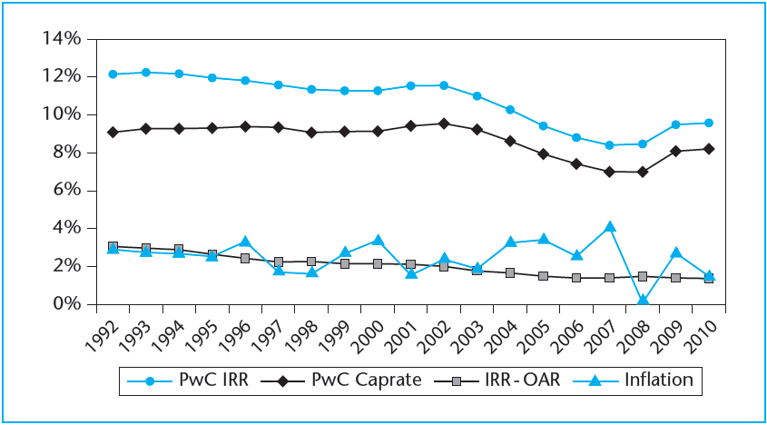
EXHIBIT 11-7 Stated Going-in IRRs, Cap Rates, and Inflation
© OnCourse Learning

Slide 26
11.2.6 Double Checking: Two Perspectives on the OCC Estimate

Slide 27
11.2.7 Variation in Return Expectations for Different Types of Property

Slide 28
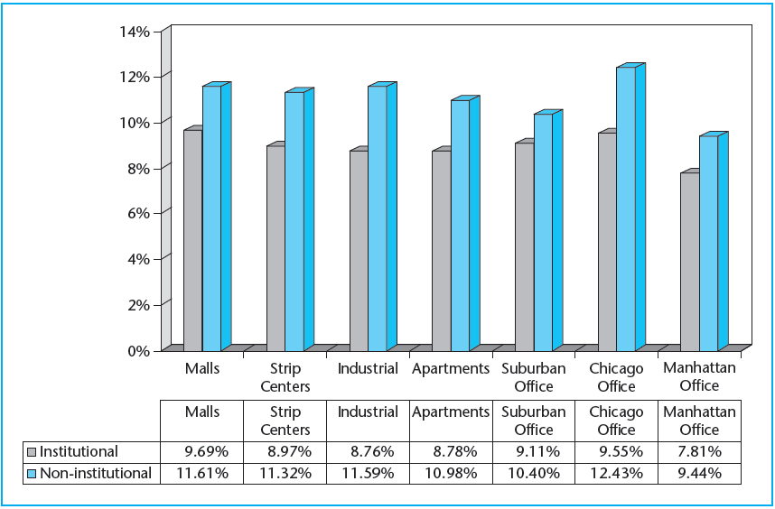
EXHIBIT 11-8A Investor Total Return Expectations (IRR) for Various Property Types
© OnCourse Learning
Source: PwC Real Estate Investor Survey, 2nd quarter 2011.

Slide 29
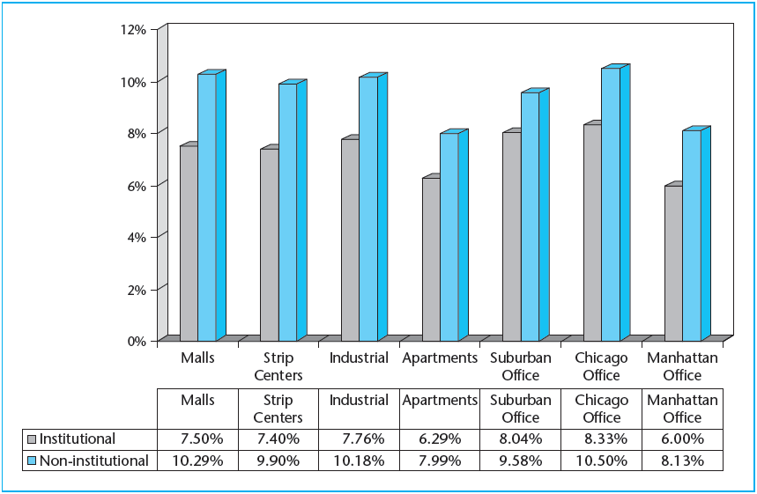
EXHIBIT 11-8B Investor Cap Rate Expectations for Various Property Types
© OnCourse Learning
Source: PwC Real Estate Investor Survey, 2nd quarter 2011

Slide 30
11.3 Chapter Summary

Slide 31
KEY TERMS
proforma
operating cash flows
reversion cash flows
potential gross income (PGI)
rent roll
rent comps analysis
vacancy allowance
effective gross income (EGI)
other income
operating expenses
property management opportunity cost
fixed costs
variable costs
net leases
expense stops
net operating income (NOI)
capital improvement expenditures
leasing costs
tenant improvement expenditures (TIs)
leasing commissions
Concessions
property-before-tax cash flow (PBTCF)

Slide 32
KEY TERMS (continued)
reversion cap rate
going-out cap rate
terminal cap rate
resale cap rate
going-in cap rate
discount rate
risk-free rate
sensitivity analysis
simulation analysis
opportunity cost of capital (OCC)
risk premiums
ex post risk premiums
ex ante expectations
NCREIF property index (NPI)
constant-growth perpetuity model
overall rate (OAR)
institutional quality commercial property
portfolio core properties
capital market segments and clienteles

