Slide 1
Chapter 10
The Basic Idea: DCF and NPV

Slide 2
CHAPTER OUTLINE
10.1 Relation Between Return Expectations and Property Values in the Asset Market
10.2 Discounted Cash Flow Valuation Procedure
  10.2.1 Match the Discount Rate to the Risk: Intralease and Interlease Discount Rates
  10.2.2 Blended IRR: A Single Discount Rate
  10.2.3 Unbundling Cash Flows: An Example
10.3 Ratio Valuation Procedures: Direct Capitalization and GIM as Shortcuts
  10.3.1 Relationship of the Cap Rate to the Total Return
  10.3.2 Empirical Cap Rates and Market Values
10.4 Typical Mistakes in DCF Application to Commercial Property
  10.4.1 If Your Case Lacks Merit, Dazzle Them with Numbers
  10.4.2 Excessive Laziness
  10.4.3 Watch Out for the Cycle
10.5 Underwriting Haircuts
10.6 Capital Budgeting and the NPV Investment Decision Rule
  10.6.1 NPV Rule Corollary: Zero-NPV Deals Are OK
  10.6.2 Choosing Among Alternative Zero-NPV Investments
  10.6.3 Hurdle Rate Version of the Decision Rule
10.7 Chapter Summary
Appendix 10A Micro-Level Investment Performance Attribution: Parsing the IRR

Slide 3
LEARNING OBJECTIVES
After reading this chapter, you should understand:
The relationship between investor return expectations and asset prices.
The DCF valuation procedure and how to use it.
The relationship between DCF and ratio shortcut procedures such as direct capitalization.
The NPV investment decision rule (including the hurdle rate).

Slide 4
10.1 Relation Between Return Expectations and Property Values in the Asset Market

Slide 5
10.2 Discounted Cash Flow Valuation Procedure

Slide 6
10.2.1 Match the Discount Rate to the Risk: Intralease and Interlease Discount Rates

Slide 7
EXHIBIT 10-1 Hypothetical Office Building Net Cash Flows

Slide 8
10.2.2 Blended IRR: A Single Discount Rate

Slide 9
10.2.3 Unbundling Cash Flows: An Example

Slide 10
10.3 Ratio Valuation Procedures: Direct Capitalization and GIM as Shortcuts

Slide 11
10.3.1 Relationship of the Cap Rate to the Total Return

Slide 12
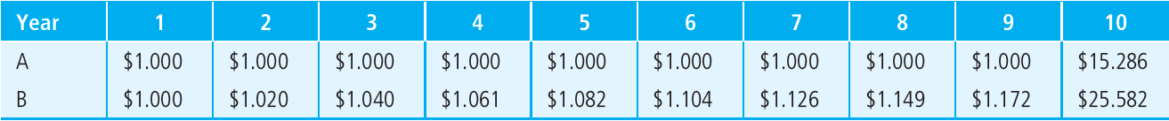
EXHIBIT 10-2 Annual Net Cash Flow Projections for Two Identical-Risk Buildings ($ millions)

Slide 13
10.3.2 Empirical Cap Rates and Market Values

Slide 14
10.4 Typical Mistakes in DCF Application to Commercial Property

Slide 15
10.4.1 If Your Case Lacks Merit, Dazzle Them with Numbers

Slide 16
10.4.2 Excessive Laziness

Slide 17
10.4.3 Watch Out for the Cycle

Slide 18
10.5 Underwriting Haircuts

Slide 19
10.6 Capital Budgeting and the NPV Investment Decision Rule

Slide 20
10.6.1 NPV Rule Corollary: Zero-NPV Deals Are OK

Slide 21
10.6.2 Choosing Among Alternative Zero-NPV Investments

Slide 22
10.6.3 Hurdle Rate Version of the Decision Rule

Slide 23
10.7 Chapter Summary

Slide 24
Appendix 10A Micro-Level Investment Performance Attribution: Parsing the IRR

Slide 25
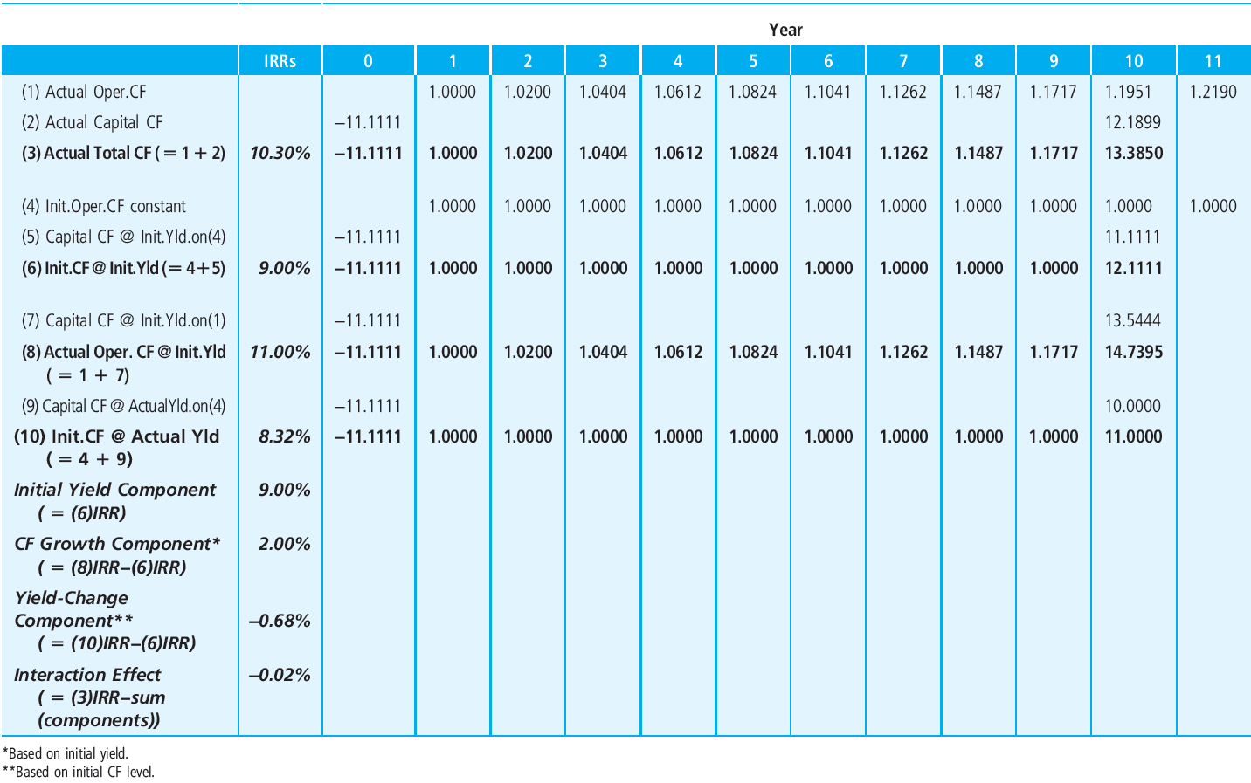
EXHIBIT 10A-1 Example Property Investment Cash Flow
© OnCourse Learning

Slide 26
KEY TERMS
returns and values
expected cash flows (numerators)
Greater Fool Theory
discounted cash flow (DCF)
opportunity cost of capital (OCC)
going-in IRR
intralease discount rate
interlease discount rate
reversion cash flow
expected returns (denominators)
blended IRR
unbundled cash flows
direct capitalization
gross income multiplier (GIM)
ratio valuation
empirical cap rates
GIGO
discount rate
net present value (NPV)
wealth maximization
market value
hurdle rate
performance attribution
initial yield component (IY)
cash flow change return component (CFC)
yield-change component (YC)

