Slide 1
Chapter 20
Commercial Mortgage Backed Securities

Slide 2
CHAPTER OUTLINE
20.1 What Are CMBS?
  20.1.1 A Brief History of the CMBS Industry
  20.1.2 Magnitude of the CMBS Industry and Its “Rise and Fall” (and Rebirth?)
20.2 CMBS Structure: Pooling, Tranching, and Subordination
  20.2.1 A Simplified Numerical Example of Tranching
  20.2.2 Allocating the Credit Losses
  20.2.3 Unbundling, Specialization, and Value Creation
20.3 CMBS Rating and Yields
  20.3.1 Bond Credit Rating
  20.3.2 Credit Rating, Market Yields, and CMBS Structure
20.4 Lessons from the Financial Crisis
20.5 Chapter Summary

Slide 3
LEARNING OBJECTIVES
After reading this chapter, you should understand:
The basic outlines of the U.S. CMBS industry, including the typical structure of CMBS products and the role played by rating agencies.
What is meant by tranching, and how this is used to concentrate and stratify the default risk in CMBS.
What determines the market yields of CMBS, and why these yields have varied over time.
Some important considerations in the industry, such as moral hazard and adverse selection.

Slide 4
20.1 What are CMBS?
CMBS are mortgage-backed securities based on commercial mortgages.
    Provide claims to components of the CF of the underlying mortgages.
Issued in relatively small, homogeneous units, so as to facilitate trading by a large potential population of investors,
    Including those who do not wish (or are unable) to invest large sums of money in any given security & passive investors w/out RE expertise (large pool of bond mkt capital).
Many CMBS are traded in relatively liquid public exchanges (part of the bond market).
    Market for a given individual security is likely to be rather thin, but the similarity within classes of securities is great enough to allow relatively efficient price discovery and resulting high levels of liquidity in the market.
Other CMBS are privately placed initially, only traded privately (if at all).

Slide 5
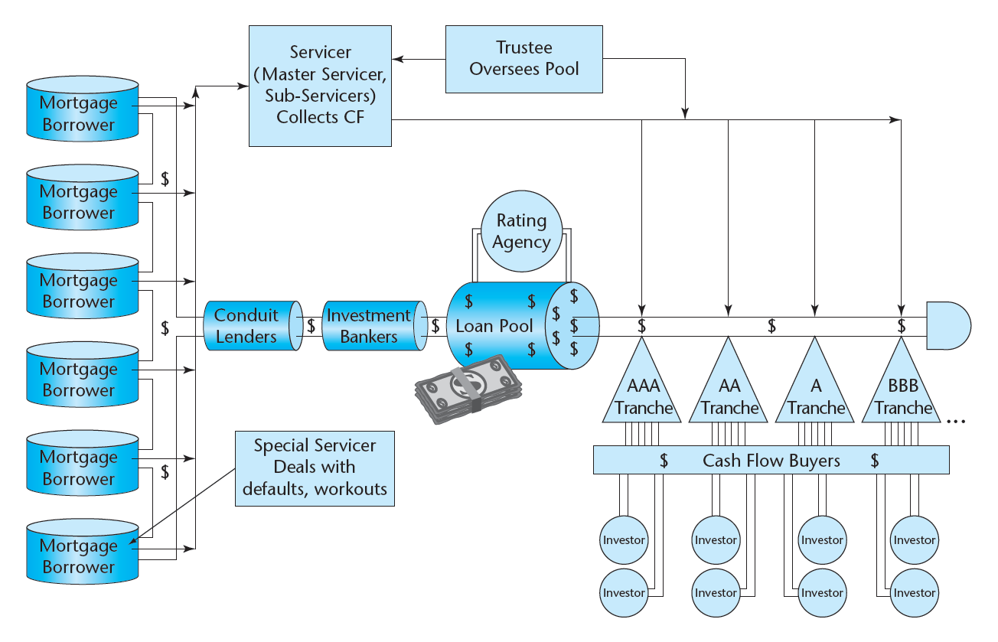
Exhibit 20-1: CMBS Securitization Process
© OnCourse Learning

Slide 6
CMBS - Servicers and Lingo …
Real Estate Mortgage Investment Conduit (REMIC)
Pooling and Servicing Agreement (PSA)
Servicers: Master, Sub, and Special
Trustee
B-Piece Buyers
Rating Agencies

Slide 7
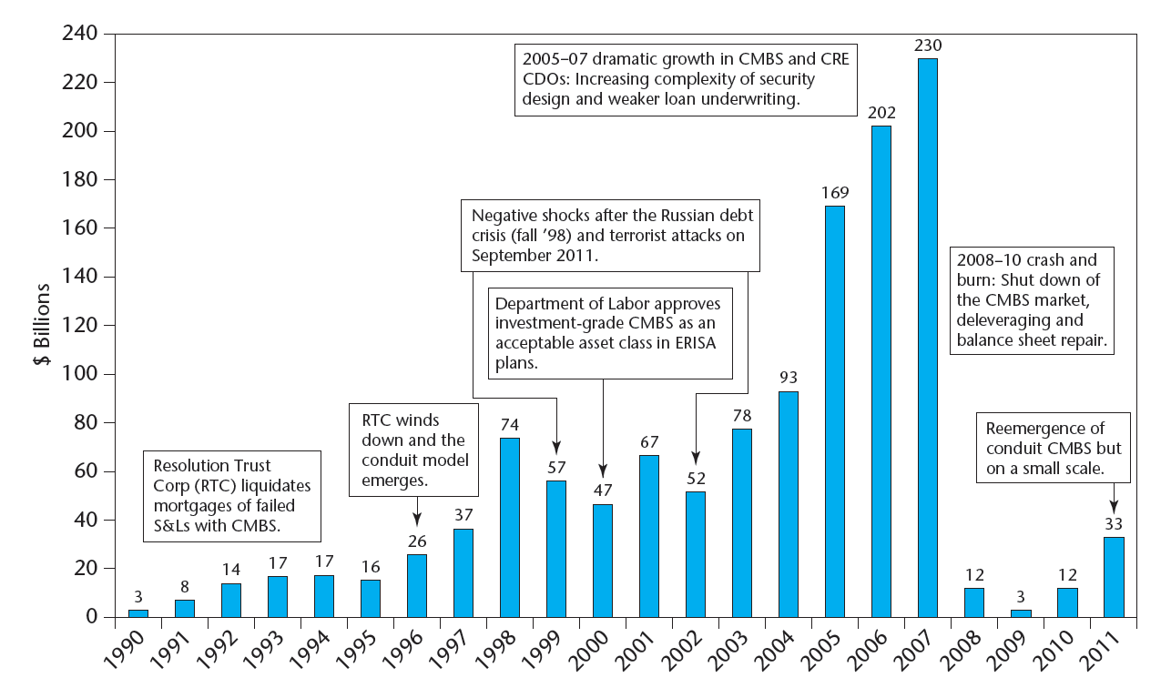
20.1.1 A Brief History of the CMBS Industry
Exhibit 20-2: CMBS Issuance, U.S., 1990-2011
Source: Based on data from Commercial Mortgage Alert and Clodfelter (2005).

Slide 8
Modern CMBS industry established in 1990s, grew to be major source of permanent CRE finance in 2000s boom…
Note: Banks & Thrifts provide shorter-term loans (< 5 yrs) and about half is typically construction loans. Major long-term permanent financing of CRE is LICs & CMBS (GSEs just apts).

Slide 9
Key to creation of CMBS industry in 1990s was devlpt by bond-rating agencies of the ability to rate the default-risk of CMBS tranches:
Bond mkt full of “passive investors” (lack time, resources, expertise to assess risk of individual bonds). Won’t invest w/out a reliable measure of default risk.
CMBS market could not develop until the investment industry figured out a way to apply traditional bond mkt credit risk ratings to CMBS.
This was done via sequential payment and sequential default assignment in the tranching of the securities issued from the CMBS pool (“waterfalls”).
When a CMBS tranche obtains a bond rating, investors who know little or nothing about CRE feel comfortable working under the assumption that default risk of that tranche is very similar to the default risk of any other bond with the same rating. (Post ‘08 ratings have had to - & by now can get away with? – being qualified as “(sf)”.)
This vastly expands the pool of potential investors and makes the public market for CMBS viable.
Bond mkt is currently (post 2008) “unsure” about the CMBS rating process, “worried” about the underlying CRE economics, but I think recovery is likely within 2-5 years.

Slide 10
20.2 CMBS Structure: Tranching & Subordination…
Basic Structure … A senior/subordinate structure in which the cash flow from the pool of underlying commercial mortgages is used to create distinct classes of securities (bonds); the pool is cut up into tranches.
Tranching cash flow claim priority involves two primary dimensions:
      Loan Contractual Retirement. ➔ Duration / Interest Rate Risk.
      Credit Losses. ➔ Default Risk.
In CMBS it is usually the default risk dimension that is most important (most commercial mortgages have “prepayment protection”).
The opposite used to be true in RMBS, where duration was traditionally the prime concern, due to the greater prepayment risk in residential loans (RMBS pools from FNMA FHLMC had “default protection”).
The way the CMBS industry has worked, an “IO” class is “stripped” off of the other securities (from the excess of pool loan coupon interest over the A-Tranche coupon interest), providing shorter-duration securities that have been major source of profit to CMBS issuers.

Slide 11
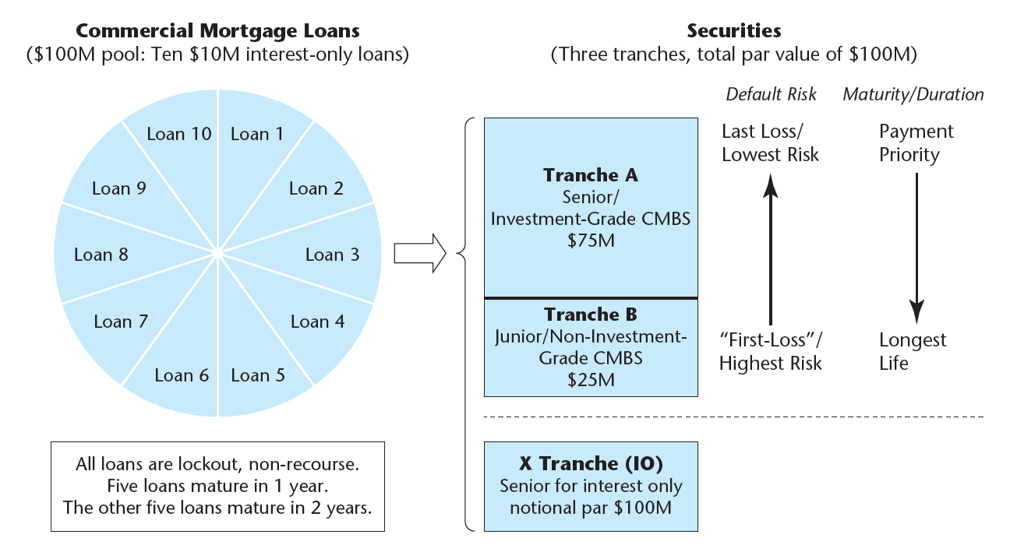
20.2.1 A Simplified Numerical Example of Tranching
EXHIBIT 20-3 CMBS Mortgage Securitization Basics: Numerical Example of Tranching and Senior/Subordinate Structure
© OnCourse Learning

Slide 12
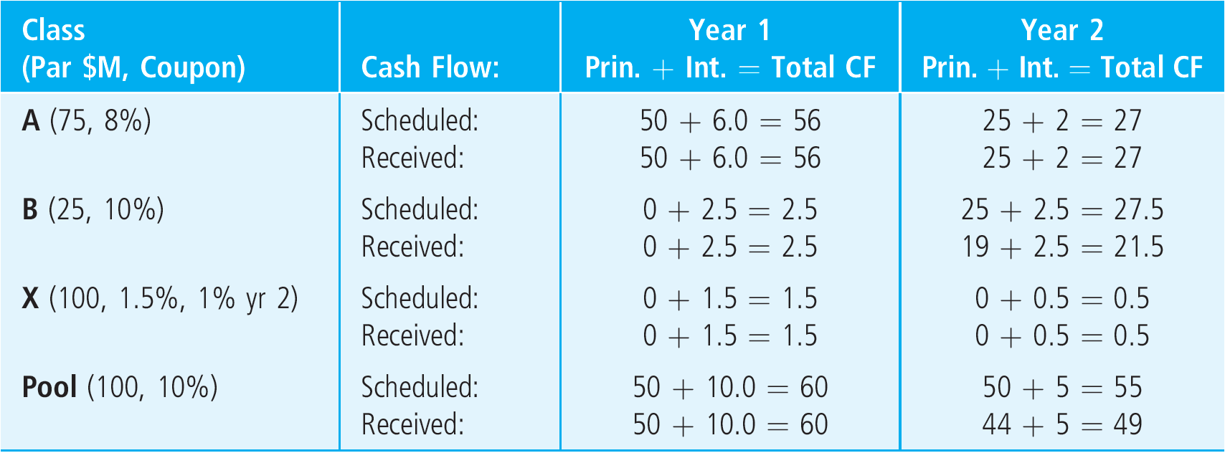
20.2.2 Allocating the Credit Losses
Exhibit 20-4: Contract vs Ex Post (realized) Cash Flows by Tranch and Year

Slide 13
20.2.3 Unbundling, Specialization, & Value Creation
Unbundle cash flow sources. Separate:
  Principal vs Interest
  Credit losses vs Contractual payments
  Stratify & concentrate default risk & maturity
Specialize match of securities to investors:
  AAA (& other “Investment Grade”) to passive conservative fixed-income investors
  Lower-rated & “B-pieces” to specialized investors with RE expertise, more active & aggressive
  Shorter maturities to investors with short-term liabilities (banks), longer maturities to investors with long-ter liabilities (LICs, PFs)
Market value of securities created in deal must exceed cost of acquiring the mortgage pool reflecting par values (OLBs) of the mortgages:
  Sufficient to cover cost of securitization and pool/trust administration (including necessary profit to investment bank).

Slide 14
How CMBS add value…
Unbundling & specialization:
  Match risk & return characteristics better to particular niches of investors in the bond market
Appeal to remote, passive investors without specialized real estate expertise, bring bond market to RE (inclu ratings, e.g., AAA CRE bonds).
Enhanced liquidity (top tranches) compared to whole loans
Standardization improves efficiency of origination & admin of loans.

Slide 15
Exhibit 20-5: Summary of CMBS Example Bond Characteristics, Values, and Ex Post Realized Returns
Example bond pricing, for Class B, the 12% market yield implies bond price (value) is $24.15, discounting contractual cash flows @ the yield:
Example realized yield for Class B (after credit losses) is the ex post IRR based on realized cash flows & original market price:

Slide 16
20.2.1 (2e revised) A simple numerical example of tranching...
CMBS Structure of Securities in the Deal…
Three classes (tranches) are created based on the underlying pool, and sold into the bond (CMBS) market:
A Tranche is “senior”, “investment grade” securities:
  Gets retired 1st (all five 1-yr loans liquidating pmts would go to A).
  25% credit support ⬅➔ 25% of pool par value will be assigned credit losses (par value lost in default) before Tranche A receives any credit losses (any reduction in par due to default). ➔ Effective LTV for A tranche = (1-0.25)70% = 52.5%. (Underlying properties would have to lose 47.5% of their value before Tranche A gets hit, since it is most senior tranche.)
  Shorter duration: WAM = (50/75)*1 + (25/75)*2 = 1.33 yrs.
Notes:
The expected CFs for the IO tranche are 75*.02 = $1.5M in year 1, and 25*.02 = $0.5M in year 2, so the WAM is (1.5/(1.5+0.5))*1 + (0.5/(1.5+0.5))*2 = 1.25 yrs; the mkt value is $1.5M/1.14 + $0.5M/1.14² = $1.70M.

Slide 17
B Tranche is “subordinated” (“non-investment grade” & “unrated”) securities:
Much riskier than whole loan of 70% LTV, because it is levered: loss of 47.5% of property value would wipe out B tranche, only cause 25% loss severity (1 - .525/.700) in loan. (“Levered Debt”)
Longer duration: (WAM = (25/25)*2 = 2.00 yrs.
“X Tranche” (IO security)
Notional par and high claim priority on interest:
Any recovery in default allocated 1st to interest, IO variable coupon 1.5%, 1% Yr1, 2, based on notional par = entire pool (as it remains).
Based on “extra interest” stripped from A tranche (security coupon = 8%, underlying pool WAC = 10%).
Notes:
Loss severity issue described here for B tranche is sometimes referred to as “levered debt”.

Slide 18
A Tranche contractual cash flows:
Yr.1: $50 principal cash inflow to pool from five maturing loans: All allocated to Tranche A because it is “top” active tranche and its remaining par value ($75) exceeds the principal cash inflow: = $50 (principal)
Yr.1: $6 of pool interest income (out of total $100*10% = $10) allocated to Tranche A because that is its coupon (8%* $75 = $6) and it has seniority and there is >= $6 interest available from the pool.
Yr.2: $25 principal cash flow allocated to Tranch A because that is its remaining par value, it has seniority, and there is >= $25 of principal cash flow available to pool (from five remaining maturing mortgages, totaling $50 contract payoff).
Yr.2: $2 of pool interest income (out of total $50*10% = $5) allocated to Tranche A because that is its coupon (8%* $25 = $2) and it has seniority and there is >= $2 interest available from the pool.
Total Yr1 = 50+6 = $56. Total Yr2 = 25+2 = $27.
Notes:
Loss severity issue described here for B tranche is sometimes referred to as “levered debt”.

Slide 19
X Tranche contractual cash flows (interest only):
Yr.1: $1.50 of pool interest income (out of total $100*10% = $10) allocated to Tranche X because that is its coupon (1.5%* $100 = $1.5) and there is >= $1.5 interest cash flow available in the pool and X has seniority (equal with A).
Yr.2: $0.50 of pool interest income (out of total $50*10% = $5) allocated to Tranche X because that is its coupon (1%*$50 = $0.5) and there is >= $0.5 interest cash flow available in the pool and X has seniority (equal with A).
Total Yr1 = $1.50. Total Yr2 = $0.50.
How did we determine the coupons in X?...
Consider difference between WAC in pool minus coupons in bonds:
Yr.1: A tranche has 8% coupon on $75M par (vs 10% WAC in pool), hence:
  (10% - 8%)*$75M = $1.5M extra interest, ➔ 1.5% of $100M Yr.1 total par.
Yr.2: A tranch has 8% coupon on $25M remaining par (vs 10% WAC in pool):
  (10% - 8%)*$25M = $0.5M on $50M remaining par in pool ➔ 1% coupon.
Notes:
Loss severity issue described here for B tranche is sometimes referred to as “levered debt”.

Slide 20
B Tranche contractual cash flows:
Yr.1: No principal paid to B because there is none left over in the pool after A got its share.
Yr.1: $2.50 of pool interest income (out of total $100*10% = $10) allocated to Tranche B because that is its coupon (10%* $25 = $2.5) and there is >= $2.5 interest cash flow available in the pool after Tranche A & Tranch X have been paid their coupons (with seniority): 10%*$100 = $10 ➔ $6 to A, $1.5 to X, rest to B.
Yr.2: $25 principal cash flow allocated to Tranch B because that is its remaining par value and there is >= $25 of principal cash flow available AFTER paying off Tranche A with seniority (from five remaining maturing mortgages, totaling $50 contract payoff: first $25 to A, last to B).
Yr.2: $2.50 of pool interest income (out of total $50*10% = $5) allocated to Tranche A because that is its coupon (10%* $25 = $2.5) and there is >= $2.5 interest cash flow available in the pool after Tranche A & Tranch X have been paid their coupons (with seniority): 10%*50 = 5 ➔ $2 for A, $0.5 for X, rest for B.
Total Yr1 = $2.50. Total Yr2 = 25+2.50 = $27.50.
Notes:
Loss severity issue described here for B tranche is sometimes referred to as “levered debt”.

Slide 21
Value at issuance as CMBS:
The present value (mkt value) of each tranche (class of bonds) is determined by discounting the contractual cash flows to maturity of the bonds back to PV using the market yield-to-maturity (“YTM”) as the discount rate:
The idea is that at issuance the sum of the values of all of the tranches exceeds the value (cost) of the pool of all the individual mortgages:
A + B + X = $75.00 + $24.15 + $1.82 = $100.97 > $100.
Notes:
Loss severity issue described here for B tranche is sometimes referred to as “levered debt”.

Slide 22
From bond mkt:
Supply & Demand ➔ price ➔ YTM
Value at issuance as CMBS:
Note: YTM is really just a way of quoting prices of bonds (similar to “cap rate” in real estate). The YTM doesn’t exactly causally determine the price (value) of the bond. (That’s more complicated.)
Example, in the case of Bond B, its price (mkt value) is less than its par value ($24.15 < $25). This reflects (implies) its YTM is greater than its coupon interest rate (12% > 10%).
Why do you suppose this is so for Bond B?...
Notes:
Loss severity issue described here for B tranche is sometimes referred to as “levered debt”.

Slide 23
Now suppose all loans pay as contracted except one of the 2-yr loans defaults in yr.2 paying no interest that year and recovering only $5 million in foreclosure sale proceeds (5/11 = 45% “recovery rate”,
55% loss “severity”). What will the ex post CMBS cash flows look like?...
Versus it was supposed to be:
$6M lifetime losses in overall pool = 6% loss rate (% orig par).
Yr.2 $6M loss vs $50M = 12% loss of remaining par balance (“UPB” = unpaid balance) B receives lifetime -0.34% yield (IRR) not 12%.
Notes:
Loss severity issue described here for B tranche is sometimes referred to as “levered debt”.

Slide 24
B Tranche is “subordinated” (“non-investment grade” & “unrated”) securities:
Much riskier than whole loan of 70% LTV, because it is levered: loss of 47.5% of property value would wipe out B tranche, only cause 25% loss severity (1 - .525/.700) in loan, based on security being “underwater”. (“Levered Debt”)
Longer duration: (WAM = (25/25)*2 = 2.00 yrs.
$5,000,000 recovery on defaulted Yr2 loan allocated 1st to owed interest on loan ($1,000,000), leaving only $4,000,000 for principal recovery ($6,000,000 loss assigned entirely to B tranche par value, but after it’s paid int owed on orig par).
Tranche B gets entire $2.50 coupon interest (on $25 contract par value) but only receives $19 of owed $25 principal: total = $21.50.
Ex post (realized) yield on B is -0.34% (instead of contract YTM @ orig of 12.00%)
A & X Tranches (senior securities):
$5,000,000 recovery on defaulted Yr2 loan allocated 1st to owed interest ($1,000,000), leaving pool interest whole, hence no loss of interest to A or X.
Tranche B absorbs entire $6 loss to pool principal, hence no loss of principal to A.
Notes:
Loss severity issue described here for B tranche is sometimes referred to as “levered debt”.

Slide 25
Recall value of the deal at time of issuance…
Value added by CMBS
Value at issuance as CMBS:
Note: YTM is really just a way of quoting prices of bonds (similar to “cap rate” in real estate). The YTM doesn’t exaclty causally determine the price (value) of the bond. (That’s more complicated.)
Example, in the case of Bond B, its price (mkt value) is less than its par value ($24.15 < $25). This reflects (implies) its YTM is greater than its coupon interest rate (12% > 10%).
Why do you suppose this is so for Bond B?...
Notes:
Loss severity issue described here for B tranche is sometimes referred to as “levered debt”.

Slide 26
Recall value of the deal at time of issuance…
Value added by CMBS
Added value is fundamentally important, enables:
  CMBS industry to earn sufficient profit (i.e., to exist);
  Real estate borrowers to obtain lower interest rates (than they otherwise could, i.e., &/or equivalently…)
  Real estate borrowers to obtain more capital than they otherwise could (holding interest rates constant):
      More loans on more properties, &/or
      Bigger loans (higher LTV – more leverage).
Notes:
Loss severity issue described here for B tranche is sometimes referred to as “levered debt”.

Slide 27
Recall value of the deal at time of issuance…
Value added by CMBS
Where does the added value come from (why, how)?...
Answer: Tailoring of product to bond market demand:
Two major ways:
  Securities target bond mkt demand niches in terms of:
      Default risk
      Maturity (& related interest rate risk or prepayment risk)
  Securities obtain bond mkt credit rating agencies’ default risk ratings (AAA, AA,…, BBB,…, B, C,… etc), thereby enabling:
      Remote, passive investors w/out special real estate expertise or info, to invest in real estate; more liquidity.
Notes:
Loss severity issue described here for B tranche is sometimes referred to as “levered debt”.

Slide 28
Recall example “credit event”: one of the 2-yr loans defaults in yr.2 paying no interest that year and recovering only $5 million in foreclosure sale proceeds (5/11 = 45% “recovery rate”). What will the ex post CMBS cash flows look like?...
Undifferentiated mortgage portfolio:
  Default risk vaguely homogeneous (average):
      Here 6.16% yield instead of contractual 10.00%.
  Maturity vaguely homogeneous (average): Here 1.5 years.
CMBS issue:
  Default risk stratified & concentrated, wider variation:
      Here Class B much riskier: -0.35% yield instead of 12.00%.
      Classes A & X much less risky: 8% ex post yld = 8% YTM.
  Maturity stratified & varied: Here ranges 1.25, 1.33, 2.00 years.
& Class A is bulk of pool. Allows creation of X.
Notes:
Loss severity issue described here for B tranche is sometimes referred to as “levered debt”.

Slide 29
How CMBS add value…
Unbundling & specialization:
  Match risk & return characteristics better to particular niches of investors in the bond market
Appeal to remote, passive investors without specialized real estate expertise, bring bond market to RE (inclu ratings, e.g., AAA CRE bonds).
Enhanced liquidity (top tranches) compared to whole loans
Standardization improves efficiency of origination & admin of loans.

Slide 30
20.3 CMBS Rating and Yields
Bond credit rating (e.g., “AAA”, “AA”, …) classifies amount of default risk in bonds. Is basic institution of bond market (goes back to early 20th century). Facilitates passive, non-specialized investors. Rating agencies are private for-profit companies.
Originally hired by bond investors. But rating info is “public good”. Agencies can’t make profit if paid only by investors. So, industry evolved, now rating agencies hired by bond issuers.
Rating agencies compete w ea other for business: ➔ Potential for conflict of interest (“rating shopping”). But…
Rating agencies depend on their reputations, credibility.
Long history & pretty good track record rating corp bonds and muni bonds (& even sovereign debt). Structured finance (inclu CMBS) is newer, presents particular info & data challenges.

Slide 31
Exhibit 20-6: Bond Ratings

Slide 32
Rating CMBS tranches...
Credit-rating agencies employ:
  Statistical and analytical techniques,
  Qualitative investigation (inclu legal & mgt assessments, due diligence),
  Common sense.
The issuer’s track record is considered as well as the pool of loans & the underlying property collateral.
Traditional underwriting measures such as LTV ratio and DCR are examined for the pool as a whole.
Larger mortgages in the pool are examined individually.
Pool aggregate measures (weighted average) are considered.
Pool heterogeneity is also considered:
  Dispersion in LTV & DCR,
  Diversification of collateral (by property type, geographic location).
Diversity & heterogeneity of the mortgages within a pool can matter as much as the average characteristics of the pool, esp. for lower-rated tranches:
  e.g., Diversification ➔ Reduced default risk for senior trances; Increased default risk for lower tranches (esp. first-loss). Why?...
Notes:
A typical conduit pool will have several hundred individual mortgages, averaging maybe $5,000,000 value per mortgage. It is not possible for the credit rating agency to individually examine each mortgage in the pool, nor do such agencies have the local underwriting expertise to do such analysis effectively. But the agency can investigate a few of the loans, usually the largest ones and sometimes a random sample of the smaller ones. And it can examine the record and capability of both the conduit entity packaging the deal and the primary market banks issuing the individual loans.
Diversification reduces the likelihood that all (or almost all) the mortgages will default (all real estate markets are unlikely to tank at once), thereby reducing the chance of the kind of “meltdown” that could seriously hurt the top-rated tranches. But diversification increases the probability that there will at least be a few defaults (unlikely that ALL real estate market segments will escape trouble over a long period of time). Even a few defaults can spell big trouble for the first-loss tranche and possibly some of the other lower-rated tranches. Consider the following relevant metaphor. When flying across the Atlantic, would you rather fly in a 4-engine jet or a 2-engine jet. The 4-engine jet is MORE likely to experience engine failure en route, but the 2-engine jet is more likely to crash as a result of such engine failure.

Slide 33
Rating CMBS tranches (cont.)…
Rating agencies (and consultants working for them) develop & employ:
  Econometric models of commercial mortgage default probability (e.g., regression, proportional hazard models).
  Empirical estimates of conditional loss severity.
  Monte Carlo simulation of interest rates, property market, property dispersion, and credit losses, to “stress test” the pool and the various tranches that may be defined based on it. (Need to consider idiosyncratic risk in individual properties.)
But ultimately, in a mass-production industry (CMBS by 2000s), standardization occurs. Each rating agency produced their “model”, which they shared with issuers, to facilitate the security production process. Also necessary to make rating process fair and objective across all deals & issuers.
Because of the importance of the credit-rating function in determining the value and hence financial feasibility of a CMBS issue, the rating agencies played a quasi-regulatory role in the CMBS market.
The result is greater standardization, less flexibility, in commercial mortgages, especially smaller loans of the type that are most likely to be issued by conduits.

Slide 34
Rating CMBS tranches (cont.)…
Variables that can be important in analyzing the credit quality of a mortgage pool and the various tranches that can be carved out of it, in either quantitative or qualitative analysis, include:
    Overall average LTV ratio & DCR
    Dispersion (heterogeneity) in LTV and DCR
    Quality of LTV and DCR information
    Property types in the pool
    Property ages and lease expirations
    Geographical location of properties
    Loan sizes & total number of loans
    Loan maturities
    Loan terms (e.g., amortization, floating rates, prepayment, recourse)
    Seasoning (age) of the loans
    Amount of pool overcollatalization or credit enhancement
    Legal structure & servicer relationships
    Number of borrowers & cross-collateralization

Slide 35
Since the financial crisis, rating agencies now no longer try to claim that a given credit rating for a Structured Finance product (like CMBS) is equivalent to the corresponding rating for Corporate (or muni) bonds. They designate the ratings with a “(sf)” suffix.
In the early days of the CMBS industry (1990s), they probably could not have gotten away with this. The bond mkt needed to “believe” that the ratings meant the same thing as what they were familiar with. But by now, the MBS industry may (may) have enough history that it will work?...

Slide 36
20.3.2 Credit Rating, Market Yields, & CMBS Structure
Rating agencies (Moody’s, Fitch, S&P, Morningstar, etc…) develop “models” that they use (& make available to issuers) to determine amount of subordination required for each rating in each issue (considering mortg pool characteristics).
More lenient the model (lower subord requirements) ➔ More profit for securities issuer. Hence, pressure on rating agency. However…
Model too lenient ➔ Investors lose confidence in rating, discount price willing to pay for securities, drive up mkt yield on the issue, reduces profitability and undercuts viability of entire industry. Result:
➔ Trade-off. Balancing act.

Slide 37
Back to our simple numerical example. Recall how the CMBS bonds are valued in the market…
Value at issuance as CMBS:
The present value (mkt value) of each tranche (class of bonds) is determined by discounting the contractual cash flows to maturity of the bonds back to PV using the market yield-to-maturity (“YTM” or just “yield” for short) as the discount rate:
Example, in the case of Bond B, its price (mkt value) is less than its par value ($24.15 < $25). This reflects (implies) its YTM is greater than its coupon interest rate (12% > 10%).
Notes:
Loss severity issue described here for B tranche is sometimes referred to as “levered debt”.

Slide 38
Suppose we could have had just 20% credit support (subord.) and STILL GET SAME YIELDS…
Value at issuance as CMBS:
$101.32 vs 100.97: “A” Tranche $80>$75, “X” Tranche $2>$1.82, more than makes up for: “B” Tranche $19.32<$24.15.
Less subordination makes more $$$ for issuers in two ways: More bonds sold @ par instead of @ discount to par, & more IO bonds available to sell, provided the bond mkt yields (YTM here) don’t deteriorate (maintain spreads to swaps or Treasuries): i.e., provided the mkt “believes” the credit ratings.
➔Pressure on rating agencies to be more lenient, allowing less subordination for same rating.
Notes:
Loss severity issue described here for B tranche is sometimes referred to as “levered debt”.

Slide 39
20.4 Lessons from the Financial Crisis
The bond market isn’t always right! (not perfectly efficient & rational, can herd and bubble, beware the credit cycle).
Rating agencies are only human (& they are an element within the bond mkt industry).
Systemic risk can take down sectors that in themselves may not be so egregious.
Complexity is dangerous.
Moral hazard (lack of “skin in the game”) can cause dangerous behavior. (Can be exacerbated by adverse selection.)

Slide 40
The Credit Cycle: Capital Flow Helped Push Up Asset Prices in 1980s & 2000s…

Slide 41
During the 2000s a major part of the credit cycle was CMBS…
CMBS accounted for up to half of all CRE credit (more than half of permanent debt) during peak bubble period.

Slide 42
Exhibit 20-7: History of CMBS Subordination Levels,
1995-2008 (pre-crisis)
What should these have been?...

Slide 43
Roughly consistent with this, the credit rating agencies suggested that in CMBS deals:
    BBB- tranche should be protected against the “average” commercial mortgage lifetime losses, which, based on available ACLI history was approximately:
        15% default probability X 33% loss severity
        = 5% expected loss
    AA tranche should be protected against the “worst case” (1986 ACLI loan cohort performance):
        28% default rate X 43% loss severity
        = 12% loss rate.
    However, some “buffer” above the expected loss was necessary to consider idiosyncratic dispersion in individual loan performance (deviation from average).
    (Possibly mitigated by an unknown amount by expectation that distress would not occur until some of the underlying mortgage pool principal had been contractually paid down (amortized, matured) thereby enhancing effective subordination in remaining tranches.)
    Also, question of how CMBS conduit loans would perform in crisis (no history) relative to LIC loans: Conduits no “skin in the game” (vs portf lenders keep loans they originate).
    Bottom line (perhaps):
        BBB- should have >= 5%-6% subordination.
        AA should have >= 12%-13% subordination.

Slide 44
The pre-crash history of Rating Agency CMBS subordination levels…
What should it have said (to the rating agencies) when starting in 2004 the bond mkt began to demand (and “price”, i.e., pay for) “super-senior” tranches above the AAA subordination cut-off?...

Slide 45
The pre-crash history of Rating Agency CMBS subordination levels…
If 12% was the worst case ACLI credit loss experience, and AA should be protected against that, then shouldn’t the AA protection have been a bit greater than 12% subordination?... ➔ Problem 2004-2007.

Slide 46
The pre-crash history of Rating Agency CMBS subordination levels…
Furthermore…
How much sense does it make to think of a constant level of “correct” subordination if real estate prices are highly cyclical?...

Slide 47
Cyclicality in U.S. Commercial Property Asset Market…
2004-07
If loan origination underwriting is not counter-cyclical, i.e., not more conservative near cycle peak (which it clearly is not), then mortgages are more risky near cycle peak.

Slide 48
Cyclicality in U.S. Commercial Property Asset Market…
If loan origination underwriting is not counter-cyclical, i.e., not more conservative near cycle peak (which it clearly is not), then mortgages are more risky near cycle peak.

Slide 49
Conduit loan origination underwriting did not generally get more conservative as we approached the cycle peak. Same LTV on peak property prices much more risky loan than same LTV on trough property prices. (And these figures ignore possible loss of realism in the stated LTV & DCR numbers near the peak.)
Stated (pro-forma) underwriting criteria of loan originators NOT more strict during bubble years.
Source: Stanton & Wallace (2010)

Slide 50
Even though credit rating agencies had their own “hair-cut” models of credit risk in the mortgages, which showed deterioration in loan origination underwriting during 2005-07, the agencies did not increase subordination levels (credit protection) for the bond ratings…
Exhibit 20-8: CMBS Conduit Loans LTVs at Issuance, as Underwritten by Issuers and as Haircutted by Moody’s, 2003-2011.
Source: Moody’s Investors Service, Trepp LLC, September 2011. © Moody’s Investors Service, Inc. &/or its Affiliates. All rights reserved. Reprinted by permission.
Here note how the Moody’s haircut LTV rose alarmingly to very high levels in 2005-07.

Slide 51
Even though credit rating agencies had their own “hair-cut” models of credit risk in the mortgages, which showed deterioration in loan origination underwriting during 2005-07, the agencies did not increase subordination levels (credit protection) for the bond ratings…
Here note how the Moody’s haircut DSCR fell alarmingly to historically low levels in 2005-07.

Slide 52
The pre-crash history of Rating Agency CMBS subordination levels…
Maybe subordination levels could have (correctly) been lower (less conservative) in the late-1990s (perhaps even at 2007 levels then); but should have been higher by 2005 and later as we entered the asset mkt bubble (maybe actual late-90s levels then). Could this have been known at the time (without advantage of hindsight?). What pressures prevented a more rational behavior?...

Slide 53
How the (bond) market prices the same amount of (rated) default risk (AAA) varies over time.
Downward pressure on spreads ➔ Upward pressure on rating agency subord. Requirments…
Exh.20-9:
Big event:
1998 fin crisis (Russia, Asia, LTCM): Liquidity shock, quick recovery
Prior to 2008 crisis, bond mkt yields (prices) were not signaling fear, were putting downward pressure on subordination (except “Super-Srs” demand was a hint).
Early history: Mkt learning, spreads falling
Mature industry: RE boom after 2001 recession & stock mkt tech bust: spreads falling (along with subord.)

Slide 54
Exh.20-10:
All of the prior history & experience was as nothing compared to 2008-09
1998 crisis

Slide 55
“Moral Hazard”
Party controlling a risky decision does not bare the negative consequences of the risk
E.g., loan originator quickly sells loan into conduit pool, no longer exposed to risk in the loan.
E.g., CMBS issuer quickly sells the securities into bond market, no longer exposed to risk in the securities.
Entities controlling the risk have no “skin in the game.”

Slide 56
“Adverse Selection”
Statistical characteristics of the pool you can choose from are worse than the average in the underlying population
E.g., Cars for sale on the used car market have a greater likelihood of being a “lemon” than the average car on the road (same year & model).
Borrowers requesting higher-interest (less favorable) loans tend to be more risky than borrowers not requesting such loans.

Slide 57
Moral Hazard & Adverse Selection
Fundamentally caused by asymmetric information:
Borrower knows more about how risky he is than loan originator knows.
Loan originator knows more about how risky loan is than CMBS issuer knows.
CMBS issuer knows more about risk of securities than investors (& credit rating agency) know.
This type of information asymmetry is inherent in lending business. Not just CMBS. Can afflict any branch of debt market. But CMBS adds extra layer, encourages lack of “skin in the game.”

Slide 58
Moral Hazard & Adverse Selection
MH & AS can synergize with each other…
If investors suspect adverse selection, they will demand higher interest rates, stricter loan terms,
This will discourage better borrowers, exacerbate adverse selection.
If originators, issuers don’t keep “skin in the game” then they have less incentive to guard loan quality.
Investors are aware of MH problem, which exacerbates their fear of adverse selection, making the situation worse.

Slide 59
It’s all about information…
Long-run health of CMBS industry depends on quality and credibility of information about the default risk in the bonds.
Rating agencies have made improvements (e.g., independent review of rating models)
Regulatory structure is still evolving (Dodd-Frank implementation, Basel III)
How much (and how) “skin in the game”?
CMBS industry seems to be gradually recovering ($45B in 2012, maybe $65B in 2013?)
Financial crisis actually provides silver lining in that it will ultimately provide a wealth of data on actual CMBS performance through worst financial crisis and recession since 1930s. Data = info ➔ antidote to fear…
Fundamentally CMBS has great potential to provide “win/win” allocation of capital & risk via very effic mkt…

